Slide 1
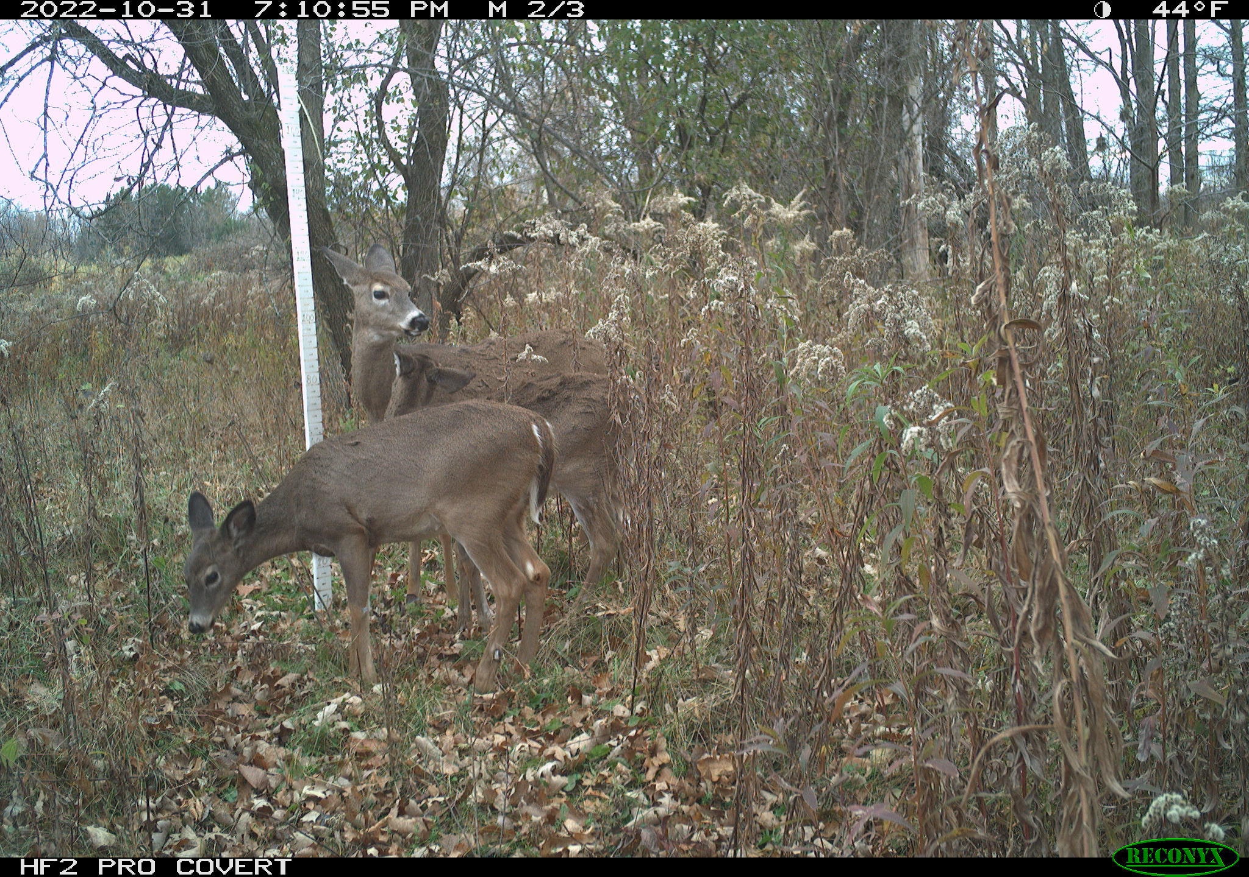
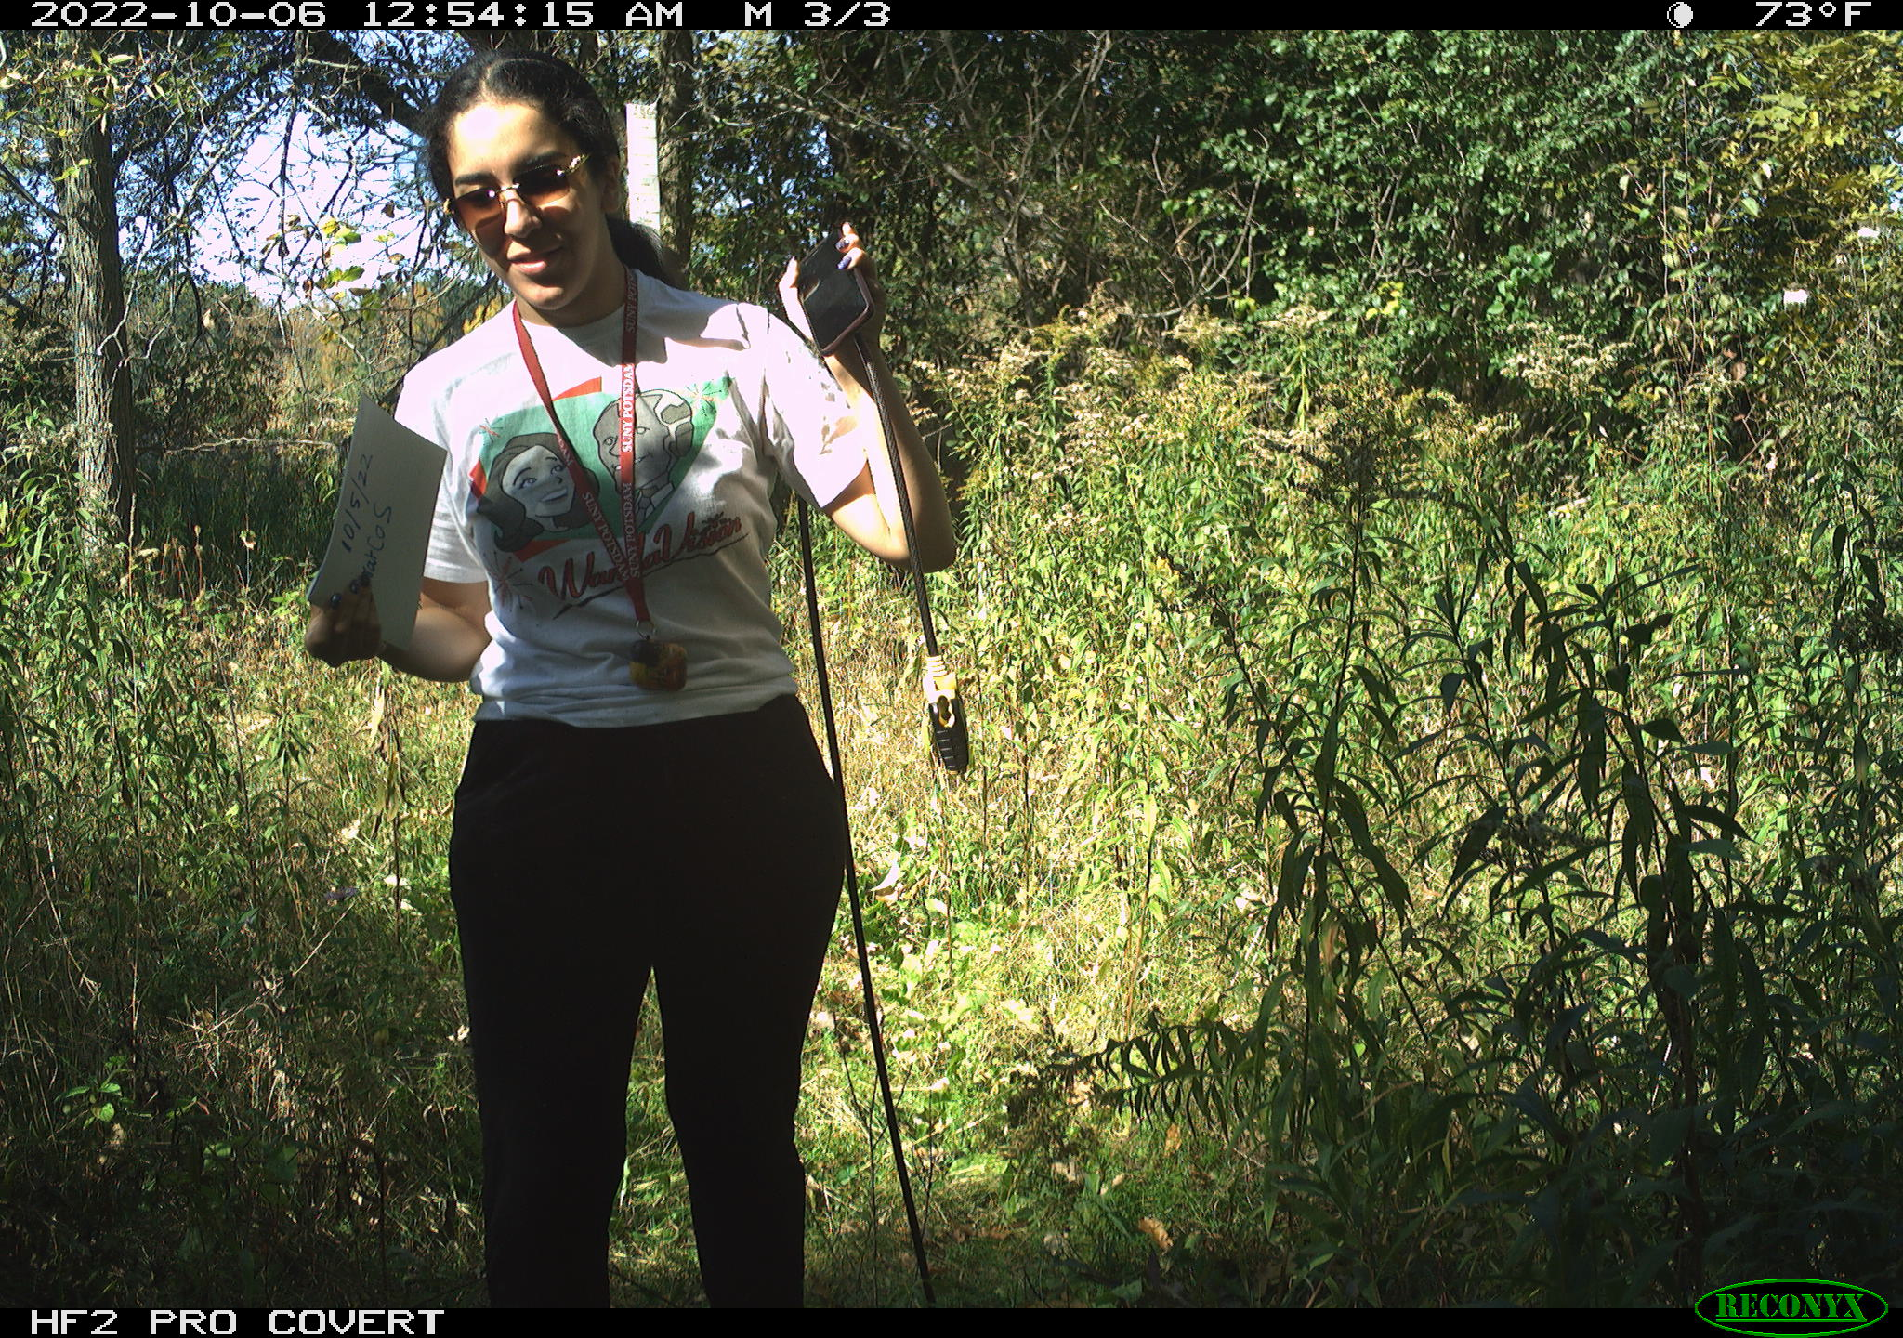
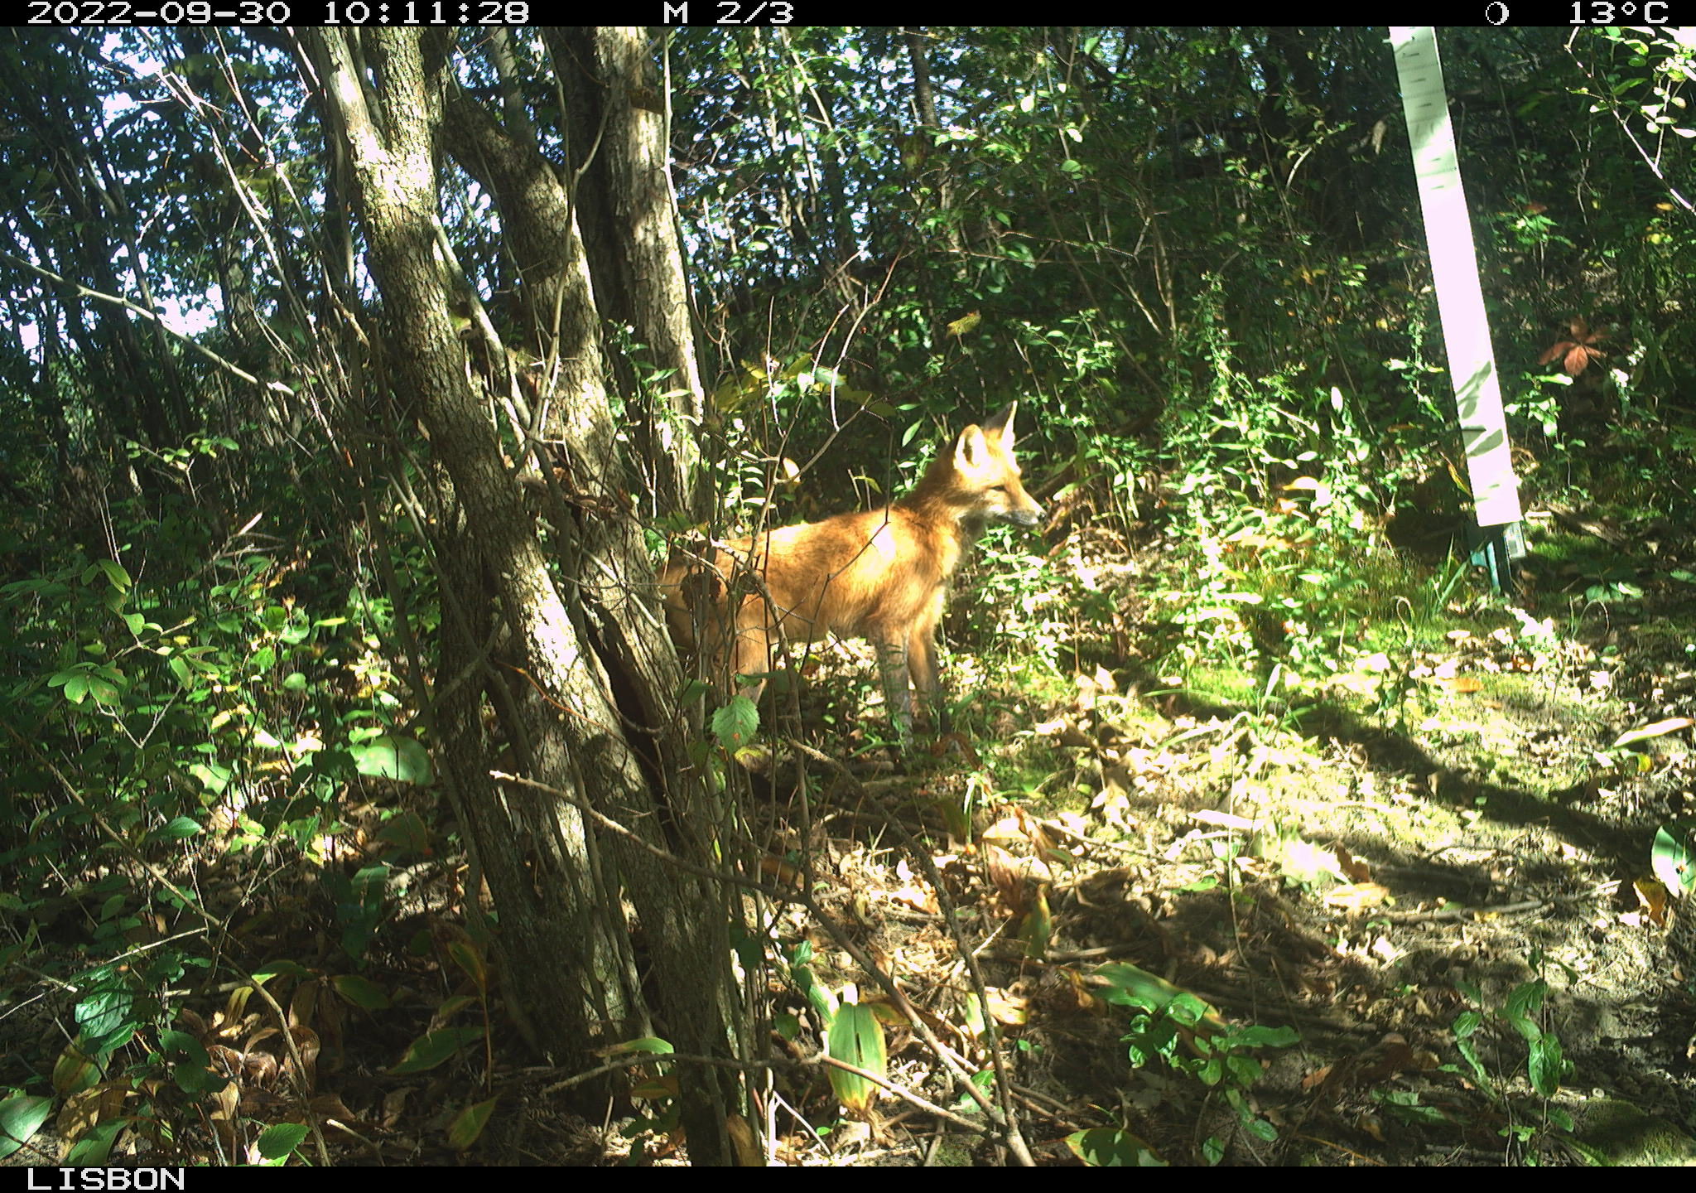
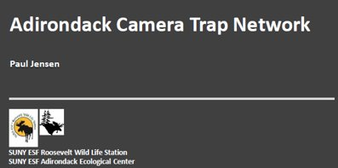
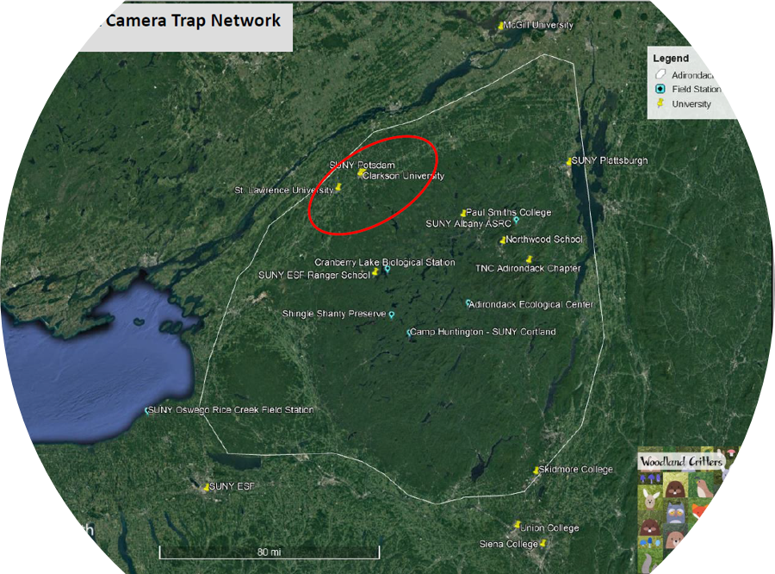
Adirondack Inventory and Monitoring Camera Trapping at SUNY Potsdam.
Yaricuyay E. Moran
State University of New York at Potsdam – Environmental Studies Department
Introduction
Results
Discussion
The purpose of this project is to use camera traps to track and monitor wildlife populations at SUNY Potsdam. This project is part of a larger regional effort, the Adirondack Inventory and Monitoring (AIM) network started by Paul Jensen at SUNY ESF. It is a grand hope that these findings will expose patterns of wildlife movement that can't be detected with any other approach. The camera trap approach unlike other methods does not harm animals or result in their death from capture. The data collected can then be used to help determine more regional issues, such as how climate change may be impacting species richness and their distributions in the Adirondacks and Northeast.
In this project, we were trained in using the same procedures for setup and maintenance of the three camera traps placed along the SUNY Potsdam campus. We monitored each of the cameras on a regular tri-weekly schedule basis. Initial analyses are showing a range of biodiversity and wildlife interactions at each of the camera locations. We anticipate that continued monitoring throughout the years will uncover any changes in these early patterns that we are seeing.
The three game cameras were out for a total of 82 days with varying species seen in each sampling hexagonal.
In every game camera I spotted white tailed deer. Gray Squirrels were seen the most consistently with about 55 days in Lehman. NatcoNorth only had white tailed deer. NatcoSouth camera had some gray squirrels seen throughout 10 days.
The total species richness for the campus was 15 species (graph below). The location with the highest species richness was Lehman (Table 1). The location with the lowest species richness was NatCO North (Table 1).
There were 15 total species found throughout the 3 AIM Camera Trap Sites in the Suny Potsdam Grids. There were dogs and cats spotted on the Reconyx cameras, and these domestic animals can pose a threat to the native wildlife.
There were high levels of species richness in the Lehman site with a wide range of biodiversity occurring. This may be due to the fact that there are lots of Riparian areas with nearby lakes in a forested area with dense canopoy cover.
In the future, I feel that this AIM Camera trapping study should be continued to be monitored in current sites and expand to watch more hexagonal cells in other riparian areas in the Adirondacks to seek an even wider range of wildlife. This study was quite fun to be a part of since I got to witness Adirondack creatures in their natural habitat without disturbing them.
Figure 2. Red fox at the Lehman Park site
Table 1. TOTAL SPECIES RICHNESS BY SITE*
NatCo North | 1
NatCo South | 6
Lehman | 14
* excludes humans
References
TJensen,P. Adriondack Camera Trap Network
Kays, R., Lasky, M., Allen, M. L., Dowler, R. C., Hawkins, M. T., Hope, A. G., Kohli, B. A., Mathis, V. L., McLean, B., Olson, L. E., Thompson, C. W., Thornton, D., Widness, J., & Cove, M. V. (2022). Which mammals can be identified from camera traps and crowdsourced photographs? Journal of Mammalogy, 103(4), 767–775. https://doi.org/10.1093/jmammal/gyac021
Figure 1. Adirondack Camera Trap network range
Figure 3. Bobcat at the Lehman Park site
Methodology
I Followed the Aim Camera Trap Protocol.
There were Three Reconyx Game Camera set on SUNY Potsdam Campus from September 2022-Dec 2022 in different sampling areas. Three snow stakes with lure and a feather were set. The lure is made up off castor and muskrat musk with other chemicals that effectively tracked animals in Lehman, Natco North, and Natco South. Camera Traps were checked monthly. When checking the cameras we noted the date, time, and any tracks. All the Data was uploaded to the AIM Network through the Survey 123 app.
Acknowledgements
We would like to thank the Frederick B. Kilmer Fund in the Lougheed Center for Applied Learning for financial support of this project.
Thank you to my advisor Dr. Kate Cleary, Environmental Studies

