Slide 1
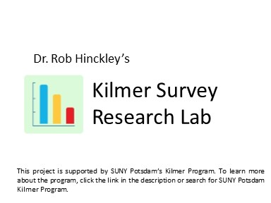
How the COVID-19 Pandemic Polarizes American Public Opinion
Justin Brandon Berrios, Ayisha Khalid, Robert Patterson IV, Jessica Perez, Jack Rice, & Samuel Wright

Slide 2
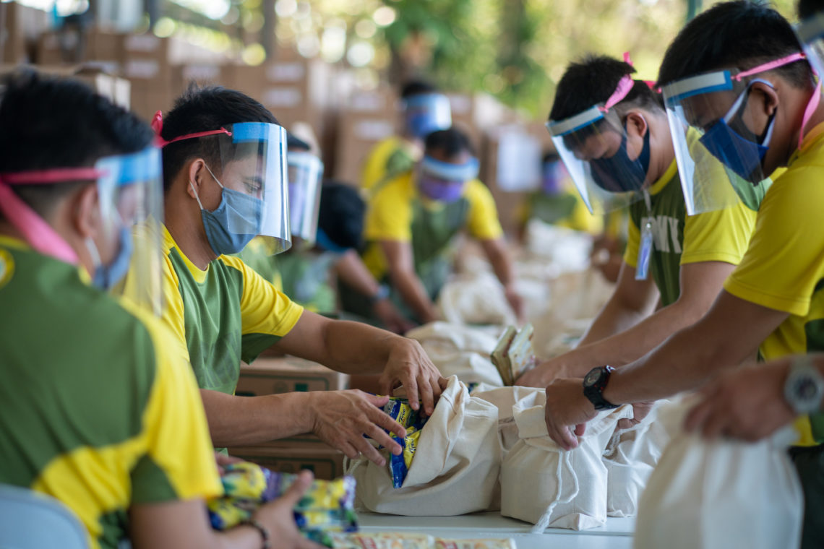
Introduction
Public opinion on the COVID-19 Pandemic
Political/Social Polarization
Pandemic's Influence?
Terror Management Theory/Mortality Salience
How does confronting one's own mortality affect their worldview?

Slide 3
Hypotheses
Pandemic Reminder Hypothesis
Exposure to a reminder of the COVID-19 pandemic will result in more positive views of immigrants among those low in the social dominance orientation (SDO) and more negative views among those high in SDO compared to a control group.
Mortality Salience (MS) Hypothesis
Exposure to reminder of one’s own mortality will result in more positive views of immigrants among those low in the social dominance orientation (SDO) and more negative views among those high in SDO compared to a control group.

Slide 4
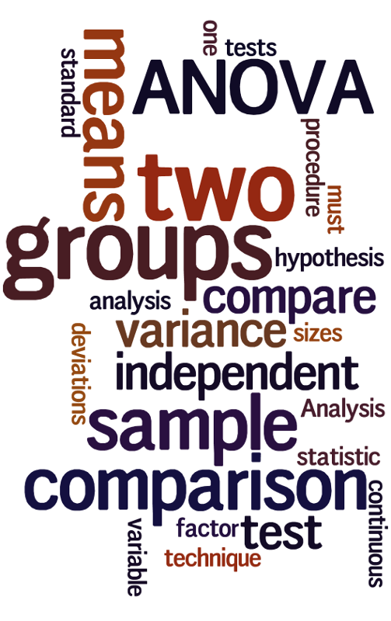
Methods
1518 American adults participated in the Kilmer Lab survey, 758 were then randomly assigned to the experiment in one of three groups:
Control Group- Asked to consider the thought of dental pain
Mortal Salience Treatment Group- Asked to consider their own mortality
Covid Reminder Treatment Group- Asked to consider what would happen if they got coronavirus
Respondents' SDO was measured with a three-question additive index

Slide 5
Results
The two study hypotheses were tested by examining the interaction between each treatment (compared to the control group) and SDO. Mixed support was found for both hypotheses.
In both experimental groups, those low in SDO expressed more positive attitudes about immigrants than in the control group. In both experimental groups, those low in SDO expressed more positive attitudes about immigrants than in the control group

Slide 6
Conclusion
We concluded that the COVID-19 pandemics, like other existential threats, can increase worldview polarization even in an already politically polarized society. Major attitude change was encountered only in the group characterized by low social dominance orientation, with their views towards immigrants becoming more positive.
Those individuals characterized by high social dominance saw less change in their attitudes toward immigration, possibly because they already held very negative views of immigrants before participating in this study.
Additional tests for attitude polarization based on authoritarianism and partisanship showed no significant differences. In sum, polarization can result from one side moving further apart politically from the other.

Slide 7
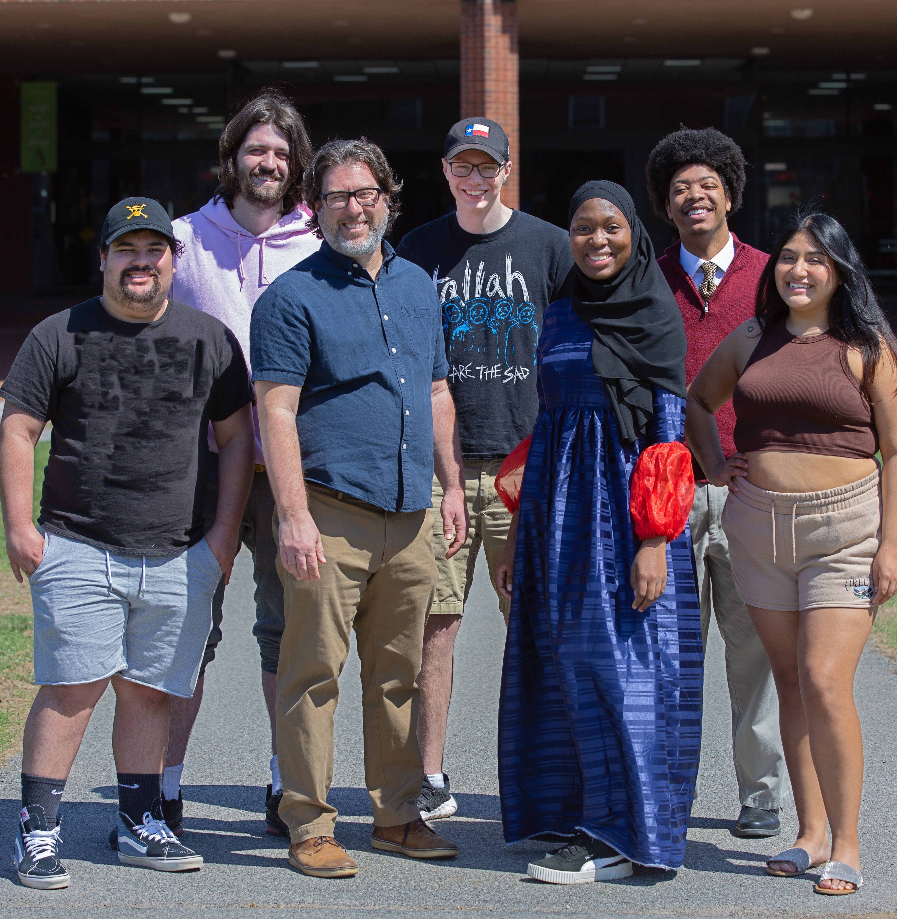
THANK YOU!

