Slide 1
Minority Stress, Microaggressions and Distress in the LGBT+ Community
Ja’liza Michaux, Senior, Dep. of Psychology
Under the supervision of Dr. Claire Starrs, Assistant Professors of Clinical Psychology

Slide 2
INTRODUCTION
Heternormative society creates minority stress for members of the LGBT+ community, including homophobia & transphobia.
Additional layer of racism when BIPOC
Current study: 3 layers of stress in BIPOC-LGBTQ+ participants vs. 2 in White-LGBTQ+ participants: 1) LGBTQ+ minority stress, 2) POC-minority stress & 3) LGBTQ+ microaggressions.
Main hypothesis: LGBTQ-BIPOC participants experience more minority stress, more microaggressions & more distress than white LGBTQ+.

Slide 3
PARTICIPANTS
BIPOC N=7, also identified as part of the LGBTQ+ spectrum. The age range of the participants is 21 to 40 years old, mean Age = 28.14 (SD = 8.214)
Procedure: This study was embedded in a larger online study, that is currently ongoing
MEASURES
Minority Stress Scale (MSS, Outland, 2016)
POC-Minority Stress (POCS-MSS, Balsam et al., 2011)
Sexual Orientation Microaggressions Inventory (SOMI, Swan et al., 2016)
Dep, Anx & Suicidality (PHQ, Spitzer, et al., 1999)

Slide 4
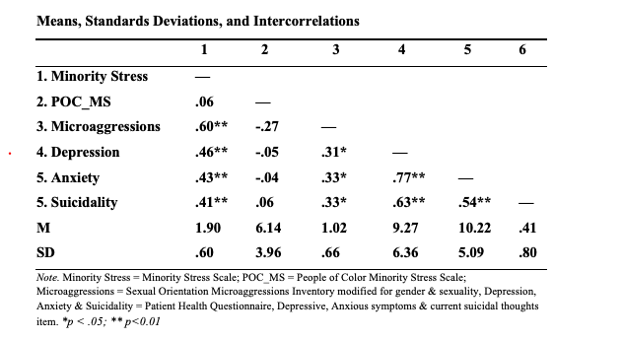
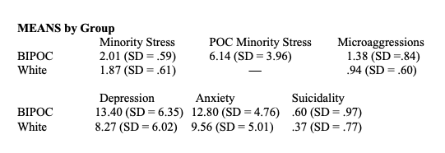
CORRELATIONS
80%
80%
MEANS by Group
All non-significant, except for Depression t(?) = .??, p = .???

Slide 5
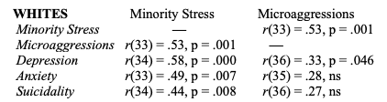
RESULTS

Slide 6
Conclusions
Overall conclusion: although low power due to small sample, the mean differences suggest that with a larger sample my hypothesis is likely to be supported
Limitations: small overall sample, small BIPOC group, Covid on distress, self-report only
Strengths: multiple measures of minority stress
Future Research: Intersectionality of sexuality, gender & ethnicity

Slide 7
THANK-YOU!
To the Learning & Research Fair committee and the judges for their time and attention today. Additionally, thank you to Dr. Starrs and all the participants for their time.

