Slide 1
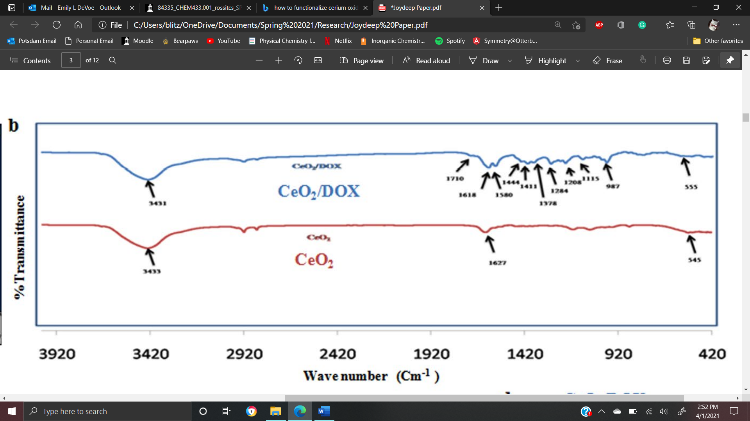
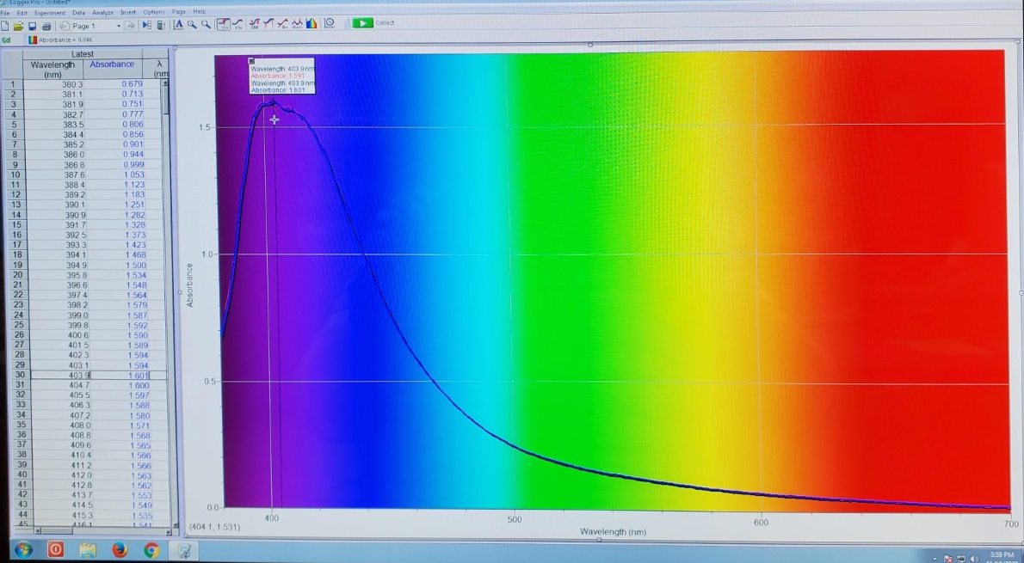
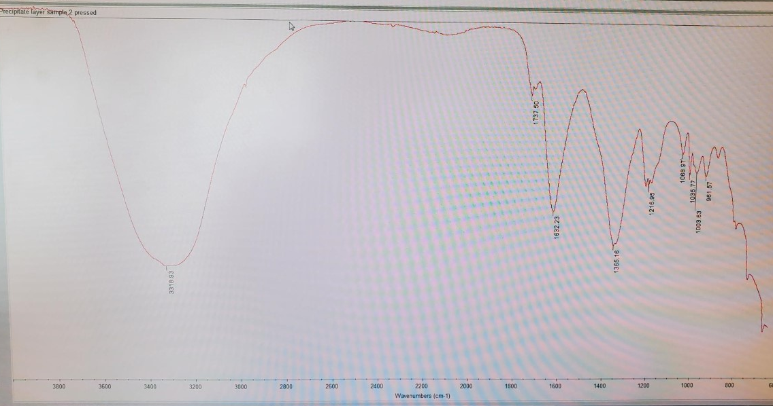
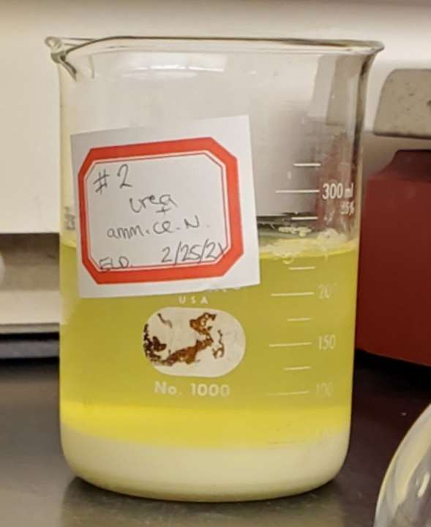
Synthesis and functionalization of cerium oxide nanoparticles
Emily DeVoe and Maria Hepel
Department of Chemistry, State University of New York at Potsdam, NY 13676
.
Summary
Cerium oxide nanoparticles are used in many medical applications for their excellent antioxidant, anti-inflammatory and bacteriostatic properties. Nanoparticles are used in tandem with other cancer treatments such as photothermal therapy, allowing for a much more focused treatment of the tumor site without excess damage to the surrounding tissue, unlike most cancer treatments. Anti-cancer drugs such as doxorubicin are commonly placed onto nanoceria via electrostatic interactions and deliver the drug to the cancer site once the electrostatic interaction is disrupted by the highly acidic tumor cell environment. In my poster, two different methods of CeO2 nanoparticles' synthesis and their functionalization with anticancer drugs will be presented.
Antibacterial Activity:
Materials and Methods
Bare NPs (Precipitation Method):
-Ammonium cerium nitrate was dissolved in deionized water and an arbitrary amount of urea added. The solution was refluxed at 100 ºC for 1 hour, in which precipitate forms. The solution was then refluxed an additional 4 hours before being cooled and washed with deionized water. Sample was diluted to 1 wt. % of solid.
DOX-doped:
-Doxorubicin added to nanoparticles via electrostatic interaction with a weight-feed ratio for cerium oxide nanoparticles and doxorubicin of 5:1.45. This electrostatic interaction is broken at the low pH environment of cancer cell, depositing the DOX to the cancer site directly.
Dextran-doped:
Results
Literature Data:
Bare NPs: Dextran-doped NPs:
DOX-Doped:
Experimental Data:
Dextran-Doped:
Bare NPs:
Introduction
Cerium oxide nanoparticles have the following health benefits:
Antibacterial
Antioxidant- eliminates free radicals
Anticancer
Targeted drug/gene delivery
Anti-diabetic
Tissue engineering
Reduction of Free Radicals:
Targeted Drug Delivery:
Conclusion
Synthesis and functionalization of cerium oxide nanoparticles is only the beginning when it comes to applications of nanoparticles in the medical field. This novel technique has much more to offer as research in the subject progresses.
-0.1 M Dextran T-10 was mixed with 1 M cerium nitrate. 30% ammonium hydroxide was then added dropwise and stirred for 24 hours at room temperature before centrifuging at 4000 rpm for 30 min and being stored at 4 ºC.
References
Thakur, Neelam et al. Journal of nanobiotechnology vol. 17,1 84. 10 Jul. 2019
Ming-Shyong Tsai, Materials Science and Engineering: B, Volume 110, Issue 2, 2004, Pages 132-134, ISSN 0921-5107
ACS Biomater. Sci. Eng. 2015, 1, 11, 1096–1103 Publication Date:October 5, 2015
Emily DeVoe
devoeel202@potsdam.edu
State University of New York at Potsdam

