Slide 1
Health Insurance in the United States
Georgdina Estrada Harvey, Noah Manning, Akilah Millington

Slide 2
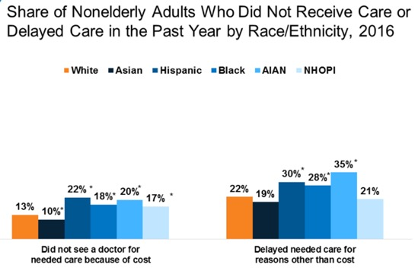
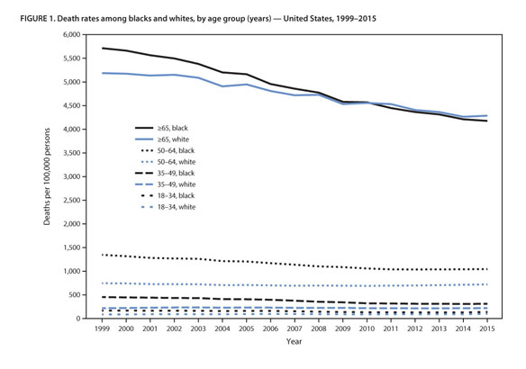
Trends & Patterns of U.S. Healthcare
Public health insurance and privatized health insurance has become a commodity in the United States. Families and others are impacted by health insurance costs directly by avoiding getting help because they can’t afford out-of-pocket costs.
~41 million or about one-in-seven Americans went without health insurance for an entire year in the early 2000’s. In 2018, it was reported that 8.5% of people (~27.5 million) were uninsured at any point during the year. The COVID-19 pandemic may increase these numbers substantially. ₁
One health aspect that represents these trends are diabetes. The most common form of insulin costs 10 times more in the U.S. than in other developed countries. Roughly 30 million Americans have diabetes, and 25% of those with diabetes need insulin. ₂
₃
This graph represents mortality rates among blacks and whites in the United States. These rates have steadily been decreasing due to health services, the environment, and chronic conditions. ₄

Slide 3
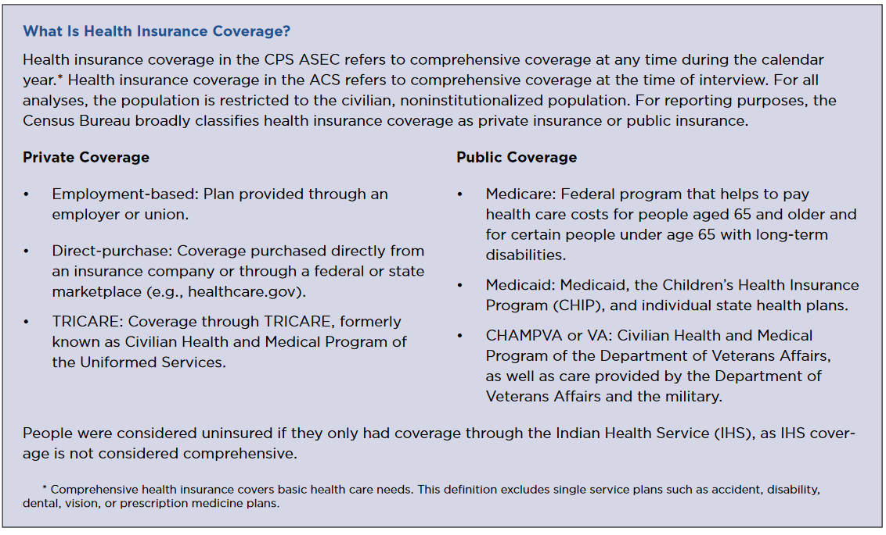
How is Health Insurance Implemented?
Medicare:
- Is a federally-funded program that provides nationwide coverage for people of ages 65+. Individuals under Medicare pay deductibles and some coverage costs. ₅
Medicaid:
- Is federally and state funded. This program provides for pregnant women, individuals with disabilities, and families/people with low or no income. These individuals pay little to no coverage costs as Medicaid is funded by various taxes and revenues. ₅
Affordable Care Act:
- The act was enacted into law by Barack Obama in 2010. This program is federally, and state funded. The main goal is to expand eligibility (e.g., under Medicare/Medicaid) to uninsured individuals, control health care costs, and improve the health care system. ₆
8

Slide 4
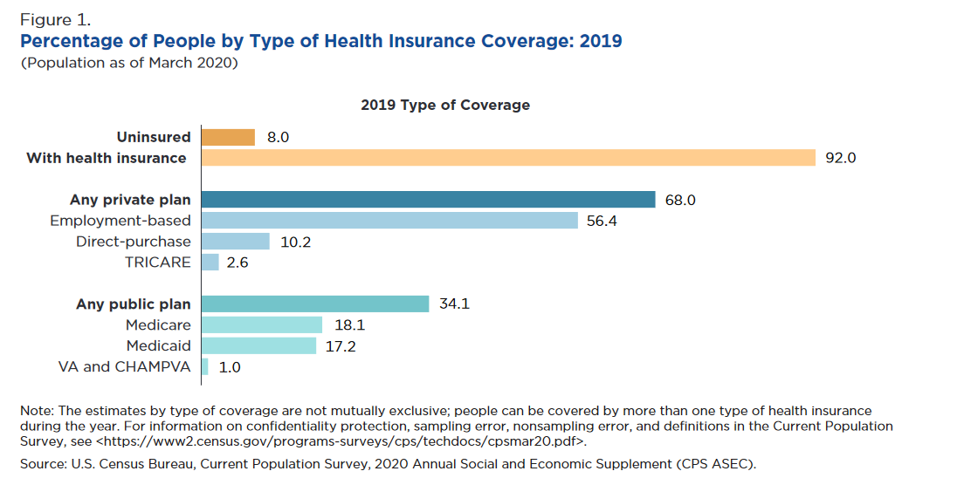
Status of Health Insurance Coverage
As of 2019, 92% or 298.4 million Americans had some sort of health insurance in 2019 ₇
68% or 1.1 million Americans had private coverage.
34.1% or 110.6 million Americans had public coverage.
8% or 26.1 million of Americans were uninsured.
All public healthcare was provided by federal programs, Medicare, Medicaid, Veteran’s Affairs and Civilian Health and Medical Program. ₇
-People with higher income are more likely to have health insurance coverage. The most uninsured people were those living in poverty in 2019. ₇
₈
Notes:
https://www.census.gov/content/dam/Census/library/visualizations/2020/demo/p60-271/figure1.pdf

Slide 5
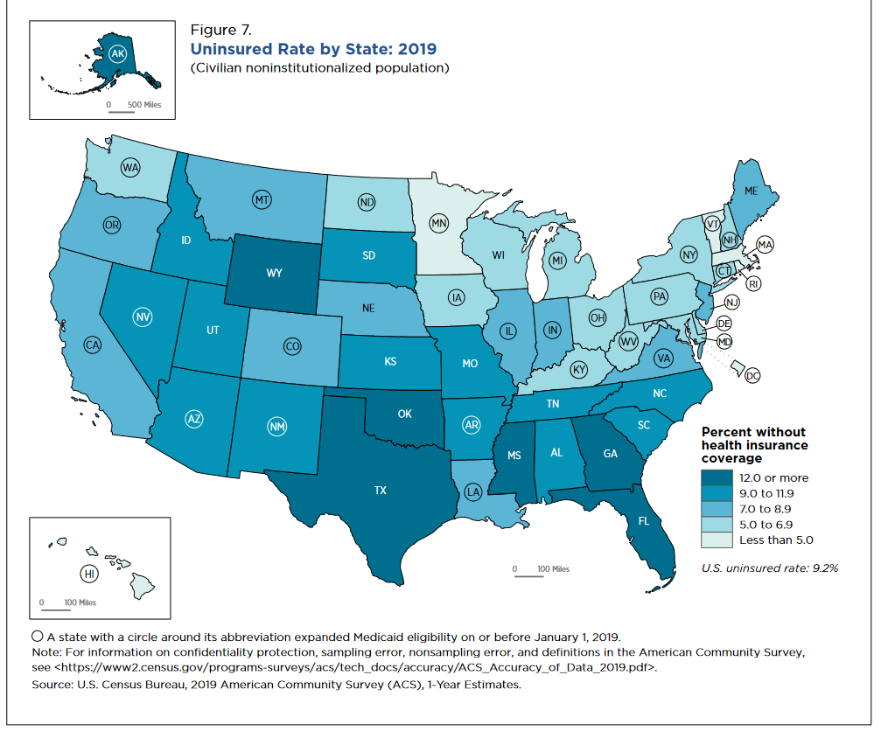
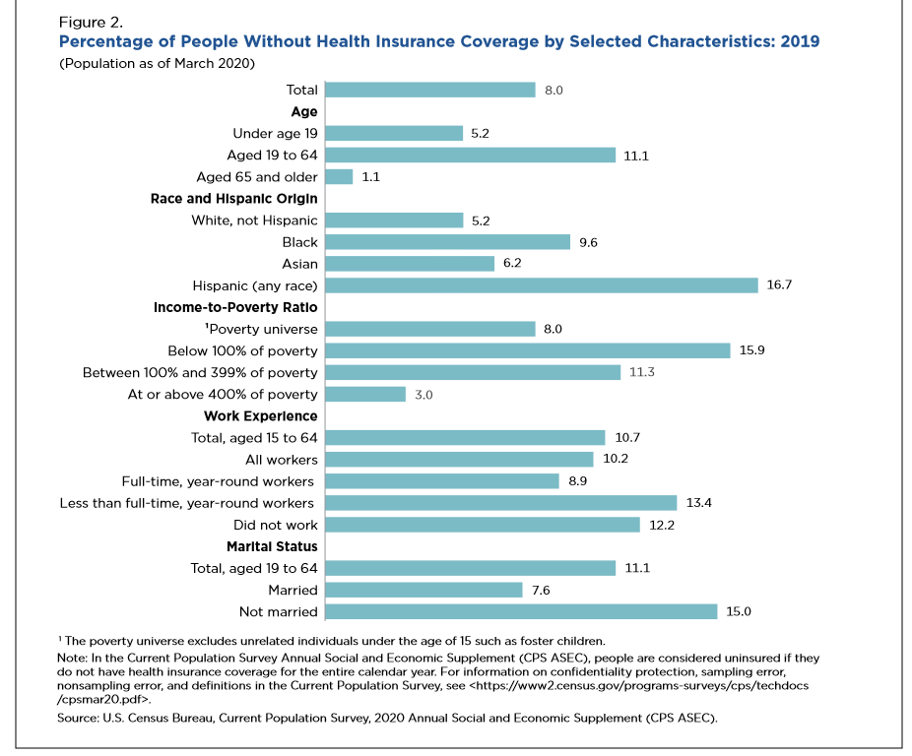
Barriers to access of Healthcare
Health Disparities: "a particular type of health difference that is linked with social, economic, and/or environmental disadvantage." ₉
Lack of Insurance: The average cost of healthcare out-of-pocket is $662 as of 2017. ₁₀
Lack of Trust in Healthcare system
Lack of Education
Geographic location, community relationships, religion, organizations you're also influence access or lack thereof to healthcare. ₁₁
- The following graphs identify uninsured rates by state and specific characteristics. The states that have more rural than urban cities and areas have higher rates of uninsured individuals.
₈
₈
Notes:
https://www.census.gov/content/dam/Census/library/publications/2020/demo/p60-271.pdf

Slide 6
Determinants in access to health insurance and causes to health inequality.
Social Determinants Of Health¹²
Lack of Community resources (parks, trails, gyms)
Lack of quality housing
Food availability/choices ( fresh vs. Fast food)
Exposure to toxic environments – living near chemical waste
Availability of Opportunity structures (schools, job training)
Determinants of Equity¹²
System of Powers – control over policies and programs.
Economic structures – allocation of funds and distribution of goods.
Health Insurance equity allows for routine care, preventive care, and managing diseases.
Access to transportation, safe quality housing, healthy food choices, and social support system influence health and they type of health insurance coverage.¹³
The Health Insurance structure is a complex system and varies by state, awareness of intersectionality can help distinguish gaps in health inequality¹³
Notes:
Butler, M., S. (2020) Achieving an equitable national health system for America. Brookings. Retrieved from https://www.brookings.edu/research/achieving-an-equitable-national-health-system-for-america/.
Jones P. C., Jones CY, Perry, S. G., P., Barclay G, Jones C. A. Addressing the social determinants of children's health: a cliff analogy. J Health Care Poor Underserved. 2009;20(4 Suppl):1-12. doi: 10.1353/hpu.0.0228. PMID: 20168027. Retrieved from http://www.hawaiipublichealth.org/resources/Documents/2-Jones-cliff-2009.pdf.

Slide 7
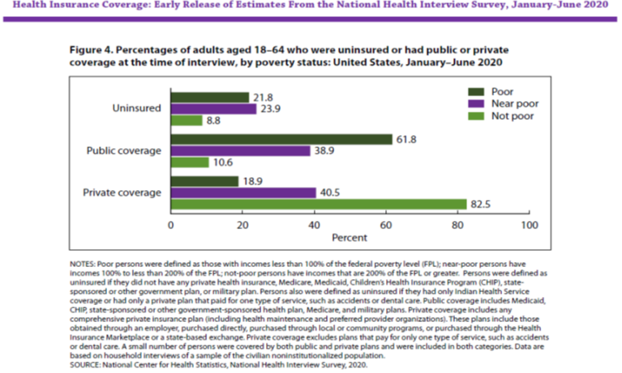
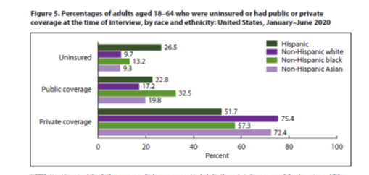
Health Coverage by the numbers and Racial makeup.
14
The Health Insurance structure is a complex system and varies by state, awareness of intersectionality can help distinguish gap in health inequality. The higher the income the better health insurance coverage, poor people are uninsured or have public health care at a higher rate.¹⁴
Notes:
Cohen, A. R., Terlizzi, P. E., Cha, E. A., Martinez, E. M. (2020). Health Insurance Coverage: early release of estimates from the National Health Interview Survey, January–June 2020. CDC National Center for Health Statistics. Retrieved from https://www.cdc.gov/nchs/data/nhis/earlyrelease/insur202102-508.pdf.

Slide 8
References
1. “US health-care system faces cost and insurance crises. (2003). Lancet, 362(9381), 375. https://doi-org.potsdam.idm.oclc.org/10.1016/S0140-6736(03)14057-3 (Noah)
2. High Cost of Insulin Has Life-or-Death Implications for Diabetic Patients.” Mayo Clinic, Mayo Foundation for Medical Education and Research, 2 Jan. 2020, newsnetwork.mayoclinic.org/discussion/high-cost-of-insulin-has-life-or-death-implications-for-diabetic-patients/.
3. Health Catalyst. “2020 Healthcare Trends and How to Prepare.” Health Catalyst, 25 Feb. 2021, www.healthcatalyst.com/insights/2020-healthcare-trends-and-how-to-prepare.
4. Cunningham, T. J., Croft, J. B., Liu, Y., Lu, H., Eke, P. I., & Giles, W. H. (2017, May 5). Vital signs: racial disparities in age-specific mortality among blacks or African Americans--United States, 1999-2015. Morbidity and Mortality Weekly Report, 66(17), 444+. https://link.gale.com/apps/doc/A494442849/AONE?u=potsdam_main&sid=AONE&xid=8b33c4d4
5. Dover, Susan. “Medicare vs Medicaid: Key Differences You Need To Know.” Social Security Resource Center, Social Security Resource Center, 24 Apr. 2019, socialsecurityofficenear.me/medicare-vs-medicaid/.
6. Published: Apr 25, 2013. “Summary of the Affordable Care Act.” KFF, 17 Dec. 2018, www.kff.org/health-reform/fact-sheet/summary-of-the-affordable-care-act/.
7. Keisler-Starke, Katherine, and Lisa N. Bunch. "Health Insurance Coverage in the United States: 2019." United States Census Bureau. Web. https://www.census.gov/library/publications/2020/demo/p60-271.html.
8. "Who Went Without Health Insurance in 2019, and Why?" Congressional Budget Office. 30 Sept. 2020. Web.. https://www.cbo.gov/publication/56504.
9. Disparities. (n.d.). Retrieved April, 2021, from https://www.healthypeople.gov/2020/about/foundation-health-measures/Disparities
10. STATISTICAL brief #495: Out-of-pocket health care expenses in the U.S. CIVILIAN noninstitutionalized population by age and insurance coverage, 2014. (n.d.). Retrieved April, 2021, from https://meps.ahrq.gov/data_files/publications/st495/stat495.shtml
11. “Access to Health Services.” Healthypeople.gov, Office of Disease Prevention and Health Promotion, www.healthypeople.gov/2020/topics-objectives/topic/Access-to-Health-Services#:~:text=Access%20to%20health%20care%20impacts%20one%27s%20overall%20physical%2C,no%20insurance%20coverage.%20Lack%20of%20availability%20of%20services.
12. Jones P. C., Jones CY, Perry, S. G., P., Barclay G, Jones C. A. Addressing the social determinants of children's health: a cliff analogy. J Health Care Poor Underserved. 2009;20(4 Suppl):1-12. doi: 10.1353/hpu.0.0228. PMID: 20168027. Retrieved from http://www.hawaiipublichealth.org/resources/Documents/2-Jones-cliff-2009.pdf.
13. Butler, M., S. (2020) Achieving an equitable national health system for America. Brookings. Retrieved from https://www.brookings.edu/research/achieving-an-equitable-national-health-system-for-america/.
14. Cohen, A. R., Terlizzi, P. E., Cha, E. A., Martinez, E. M. (2020). Health Insurance Coverage: early release of estimates from the National Health Interview Survey, January–June 2020. CDC National Center for Health Statistics. Retrieved from https://www.cdc.gov/nchs/data/nhis/earlyrelease/insur202102-508.pdf.

