Slide 1
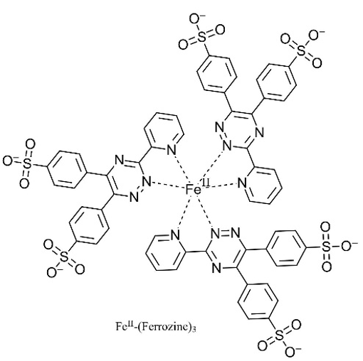
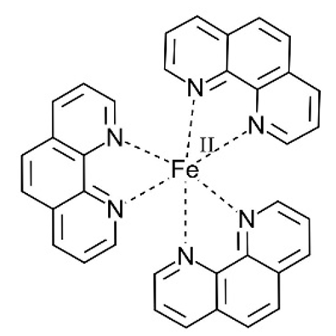
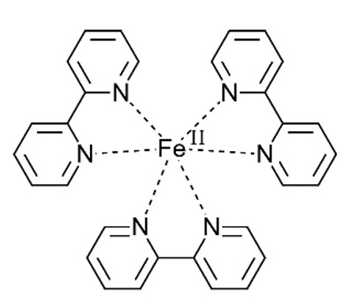
Complexation of Ferrous Ions by Ferrozine, 2,2’-Bipyridine and 1,10-Phenanthroline: Implication for the
Quantification of Iron in Biological Systems
Cassidy H. Welsh¹, Ruth E. Reichard¹,Gideon L. Smith¹, Aliaksandra A. Reutovich¹, Ayush K. Srivastava¹, Artem Melman^{2*}, Fadi Bou-Abdallah^{1*}
¹ Department of Chemistry, State University of New York at Potsdam, Potsdam, NY 13676 , 2 Department of Chemistry & Biomolecular Science, Clarkson University, Potsdam, NY 13699
Abstract
Results
Because of Iron's redox properties and involvement in a wide range of biological processes, several chemical tools were developed to detect reduced (Fe²⁺) and oxidized (Fe³⁺) forms of iron in biomolecules. We quantify the concentration of ferrous ions in aqueous solutions, owing to the unique absorption spectra, molar absorptivity, and characteristic colors of these Fe²⁺-chelator complexes. Our results show that kinetics of the formation of the {Fe²⁺-(ferrozine)₃} and {Fe²⁺-(bipyridine)₃} complexes, but not the{Fe(II)-(phenanthroline)₃} complex depend on the concentration of the iron chelator. The molar absorptivity values of these complexes under excess chelator concentrations were 31,500 ± 1,500 M⁻¹cm⁻¹ for ferrozine at 562 nm, 9.950 ± 100 M⁻¹cm⁻¹ for 2,2’-bipyridine at 522 nm, and 12.450 ± 370 M⁻¹cm⁻¹ for 1,10-phenanthroline at 510 nm.
Structures of
Iron (II) Ligands
Introduction
Many chemical tools and assays have been developed to qualitatively and quantitatively measure the redox status of iron and its distribution and accumulation in biological systems. Spectroscopic methods to quantify the concentration of metal ions in aqueous solutions involve the measurement of absorbance changes using chromogenic reagents, and color changes are directly proportional to the concentration of metal ions in solution. Reagents that contain a specific and cyclic atomic configuration N=C-C=N that binds metal ions, including Fe(II), to form colored complexes. The most used ferrous iron chelators is ferrozine (FZ), which has high water solubility, high sensitivity, and stability over a wide range of pH. The ferrous-ferrozine complex exists in a 3:1 ratio of ferrozine to iron. The accurate quantification of Fe²⁺ions is affected by several factors including pH, temperature, concentration of reagents, incubation time, anions such as oxalate, cyanide and nitrite, and the presence of Fe³⁺ cations. Many studies have used stoichiometric amounts of ferrozine, or a slight excess of chelator, to make sure that Fe²⁺ ions are fully bound, however, we obtained conflicting results. We also investigated the complexation kinetics of two other frequently used ferrous ions chelators (2,2’-bipyridine and 1,10-phenanthroline) to explore whether the peculiar behavior observed with ferrozine is also prominent with these other strong Fe(II) chelators.
Fe(II)-(Ferrozine)₃
Methods and Materials
Fe(II)-(Phenanthroline)₃
Chemicals: 1,10 phenanthroline, 2,2’-bipyridine, MOPS [3-(N-morpholino) propanesulfonic acid] buffer, tris-(hydroxymethyl) aminomethanehydrochloride (Tris-HCl), sodium chloride and acetic acid, ferrous sulfate heptahydrate and sodium acetate, ferrozine (5,6-Diphenyl-3-(2-pyridyl)-1,2,4-triazine-4,4'-disulfonic acid disodium salt hydrate, > 97 % purity). Fe(II) stock solutions were freshly prepared immediately before each experiment with pH 2.0 deionized water. All other solutions were freshly prepared in DI water/buffer.
Absorption Spectroscopy and Ultraviolet−Visible (UV−vis) Kinetics: UV−vis absorption spectroscopy was performed on a Varian Cary 50 Bio (or Cary 60) spectrophotometer. Unless otherwise noted, all experiments were conducted at 25.00 °C in 50 mM MOPS and 100 mM NaCl (pH 7.4). For the absorbance measurements, multiple samples were prepared as indicated in the figure captions and were left on a rocker, wrapped in aluminum foil, for 30-50 min. The kinetics of Fe(II) complexation with ferrozine were followed at 562 nm. All experiments were repeated 3 to 7 times, using freshly prepared solutions each time, and the instrument is zeroed using the ferrozine-buffered solution as the blank with spin bar rapidly stirring.
Fe(II)-(Bipyridine)₃
Acknowledgements
This work is supported by an NSF grant
(Award #1934666) and by a Henry Dreyfus Teacher-Scholar Award #TH-16-007.
Analysis and Conclusions
Here, we have shown that the kinetics of Fe(II) complexation by ferrozine, but not by 2,2’-bipyridine or 1,10-phenanthroline depend on the concentration of the ligand, or the ligand:Fe(II) ratio. For ferrozine, it is recommended that a molar ratio of 100:1 ferrozine: Fe(II) be employed with a corresponding molar absorptivity of 31,500 M⁻¹cm⁻¹. For bipyridine, a molar ratio of 10:1 bipyridine: Fe(II) must be used with a corresponding molar absorptivity of 9,950 M⁻¹cm⁻¹. This value is much higher than the published value. As to 1,10-phenanthroline , a stoichiometric molar ratio of 10:1 phenanthroline: Fe(II) is also recommended. A molar absorptivity value of 12,450 M⁻¹cm⁻¹ was determined for the {Fe(II)-(phenanthroline)₃} complex at 510 nm, a value higher than that reported . Our results have important implications in the quantification of iron in biological systems since many studies often employ less than optimal concentrations of these iron chelators, leading to inaccurate determination of iron concentrations.
References
Experiment vs Published Molar Absorptivity Values
Fe (II) - Chelator | Epsilon _{Experimental} | Epsilon _{Literature} | Percent Error
Fe (II) - (Ferrozine)₃ | 31,500 | 27,900 | ~10%
Fe (II) - (Bipyridine)₃ | 9,950 | 8,650 | ~13%
Fe (II) - (Phenanthroline)₃ | 12,450 | 11,100 | ~11%
1. F. Bou-Abdallah, The iron redox and hydrolysis chemistry of the ferritins. Biochimica et Biophysica Acta 2010, 1800, 719–731. doi:
2. T.M. Jeitner. Optimized ferrozine-based assay for dissolved iron. Anal. Biochem. 2014, 454, 36–37.
3. D.J. Hennessy, G.R. Reid, F.E. Smith, S.L. Thompson. Ferene - a new spectrophotometric reagent for iron, Can. J. Chem. 1984, 62, 721-724.

Slide 2
Complexation of Ferrous Ions by Ferrozine, 2,2’-Bipyridine and 1,10-Phenanthroline: Implication for the
Quantification of Iron in Biological Systems
Cassidy H. Welsh¹, Ruth E. Reichard¹,Gideon L. Smith¹, Aliaksandra A. Reutovich¹, Ayush K. Srivastava¹, Artem Melman^{2*}, Fadi Bou-Abdallah^{1*}
¹ Department of Chemistry, State University of New York at Potsdam, Potsdam, NY 13676 , 2 Department of Chemistry & Biomolecular Science, Clarkson University, Potsdam, NY 13699
Results
Structures of
Iron (II) Ligands
Experiment vs Published Molar Absorptivity Values
Fe (II) - Chelator | Epsilon _{Experimental} | Epsilon _{Literature} | Percent Error
Fe (II) - (Ferrozine)₃ | 31,500 | 27,900 | ~10%
Fe (II) - (Bipyridine)₃ | 9,950 | 8,650 | ~13%
Fe (II) - (Phenanthroline)₃ | 12,450 | 11,100 | ~11%
Fe(II)-(Ferrozine)₃
Fe(II)-(Phenanthroline)₃
Fe(II)-(Bipyridine)₃

Slide 3
Acknowledgments
This work is supported by an NSF grant (Award #1934666) and by a Henry Dreyfus Teacher-Scholar Award #TH-16-007.
THANK YOU

