Slide 1
Daily Hassles, COVID Stressors & Affect in College Students
Taylor Samperisi, senior, Dep. Of Psychology
Presidential Scholar’s Project
Supervisor: Claire J. Starrs

Slide 2
Introduction
Stress HIGH in college students (D’Zurilla & Sheedy, 1991)
COVID’s exceptionally challenging for college students (Aucejo et al., 2020)
Some more than other? COVID or after COVID?
Seniors more vs. other class years
1st-generation students vs. non-1st-gen

Slide 3
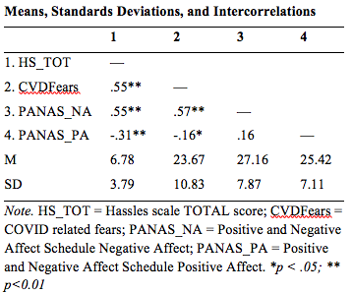
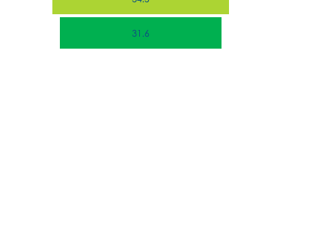
Participants & Correlations
Measures
Hassles (mHS, Holmes & Rahe, 1967)
COVID Fears (adapted from SARS Fear Scale, Ho, et al., 2005
PANAS (Watson, Clark & Tellegen, 1988)
N = 171, Mean age: 20.46(SD=2.84)
Correlations
HS-CVDF pos moderate
HS-NA pos moderate
HS-PA neg small
CVDF-NA pos moderate
CVDF-PA neg small

Slide 4
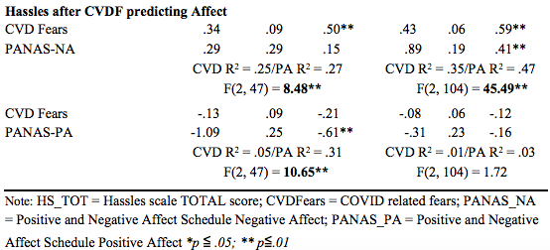
Q1. Seniors vs. Others
CORRELATIONS SENIORS
Hassles to PA r(49) = -.51, p = .000, moderate negative
Hassles to NA r(49) = .38, p= .006, moderate positive
CVD Fears to PA r(49) = -.22, p = .129, non-significant
CVD Fears to NA PA r(49) = .49, p = .000, moderate positive
CORRELATIONS NONSENIORS
Hassles to PA r(107) = -.18, p = .061, non-significant
Hassles to NA r(107) = .62; p = .000, moderate positive
CVD Fears to PA r(109) = -.12, p = .199, non-significant
CVD Fears to NA PA r(109) = .61, p = .000, moderate positive
CONCLUSIONS
Senior stress related to LOWER positive affect
Both stress related to HIGHER negative affect
REGRESSIONS: Stress predicting after controlling for COVID-related fears
Hassles predicted negative affect, after COVID Fears, in both seniors (2% more, small effect) & Non-seniors (12% more, still small)
Hassles predicted less positive affect after COVID Fears in seniors only (26% more, almost moderate effect)

Slide 5
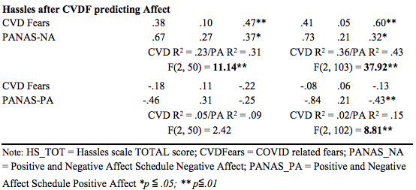
Q2: 1st-generation vs. non-1st-generation
REGRESSIONS: Stress predicting after controlling for COVID-related fears
CORRELATIONS 1st-generation
Hassles to PA r(51) = -.30, p = .030, moderate negative
Hassles to NA r(51) = .54, p = .000, moderate positive
CVD Fears to PA r(53) = -.19, p = .171, non-significant
CVD Fears to NA PA r(53) = .52, p = .000, moderate positive
CORRELATIONS non-1st-generation
Hassles to PA r(105) = -.35, p = .000, moderate negative
Hassles to NA r(105) = .56; p = .000 , moderate positive
CVD Fears to PA r(105) = -.15, p = .131, non-significant
CVD Fears to NA PA r(105) = .60, p = .000, moderate positive
CONCLUSIONS
BOTH stress related to LOWER PA & HIGHER NA
Hassles predicted negative affect, after COVID Fears, in both 1st-gen (8% more, small effect) & non-1st-gen (7% more, still small)
Hassles predicted less positive affect after COVID Fears in non-1st-gen only (13% more, almost moderate effect)

Slide 6
Conclusions
Why?
COVID Fears had an affect on all students
Seniors under more changes
First-generation had more to feel good about
Limitations?
Small Sample size
Only Potsdam Students
Future Direction?
Comparing class years more
Looking at hassles closer (Varying stressors)

Slide 7
Thank You!
Thank you to the Presidential Scholars Program for letting me do this independent research project!
Thank you to Dr. Starrs for being my mentor and helping me throughout this research project!
Thank you for your interest in my project!

