Slide 1
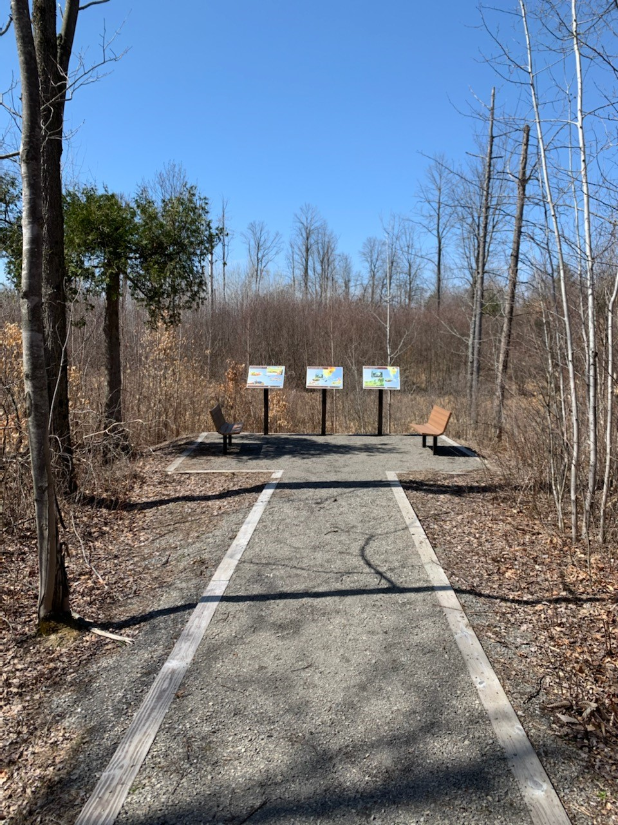
Arrival dates for birds in the St. Lawrence County
By, Preston Santimaw, Ryan Spaman, Charles Martin, Sean Kouznetsov
Background
Our goal of this project was to get an understanding on the arrival dates of the targeted species and how this is affected by weather. The hypothesis that we determined was ”Warmer temperatures caused migratory birds to arrive earlier”. The targeted species we produced collectively was the Osprey, Turkey Vulture, Eastern Phoebe, and the Killdeer. The research question that we have decided on was, Do warmer temperatures cause earlier arrival dates for local migratory bird species?
Results
After the four weeks that we went to gather data, we recorded the earliest arrival date for each species. We used eBird.org citizen science data to determine the first arrival dates from 1990-2020 and used our own data for this year. After we collected our data, we graphed out each specie's Julian dates for every year that they arrived. From taking the p-values from each of these tests we found that each graph’s p-values were less than 0.10 meaning that they are statistically significant. By rejecting the null, we accepted our hypothesis that warmer temperatures will in fact have an effect on the first arrival dates.
Abstract
Global climate change has resulted in consistently warmer winters in the Northeastern US consequently previous analysis of observational records in the region have concluded increasingly early first arrival dates of many avian springtime migratory species. We undertook this study to determine if the same pattern is occurring in St. Lawrence County, New York as this topic had yet to be studied in this area. We obtained records of first arrival dates of four springtime migratory birds using records of citizen science data from the months of January to May from 1990-2020 obtained from birdwatchers from the website eBird and from our own personal observations for the current year and used year as a proxy for temperature. We hypothesized that we would observe a similar pattern of increasingly early first arrival dates because we used the year as a proxy for temperature. For all four species, we found a consistent pattern of increasingly early arrival dates we found a statically significant relationship between year and first arrival date.
Methods
The research gathered was found through observations at certain sites within St. Lawrence county. This study received IRB approval and our research was gathered for 4 weeks.
Our group figured out the more common species within the county and the sites that they were most frequent in.
We went to our chosen sites, and we made stationary observations for approximately 45 minutes.
Collected data on how many times we spotted the given species for each day of observation.
We also considered the weather and date of the given days of our observation.
We used citizen science data from eBird to collect arrival dates tracking back to 1990-2021
Upper and lower lakes
Lehman park
Discussion
The results of our study show a trend of increasingly early arrival over the 31-year period which is similar for all four species additionally based on regression analysis there is a highly significant relationship between the year proxy and first arrival time. However, it is important to consider that in many years especially prior to 2005 there was no record of their observation at all for that year or the first arrival date had been observed to occur after May for those years we entered a value of 0 for the Julian date when we did the regression analysis. Nonetheless, it is unlikely that this impacted the results significantly because a very similar pattern of increasingly early arrival dates has been observed among all four species. Although we suspect this trend is due to increasing spring temperatures the increase in earlier first arrival dates may also result from increased observations from birdwatchers and/or more likely increased reporting of sightings to eBird.
This Photo by Unknown Author is licensed under CC BY-SA

