Slide 1
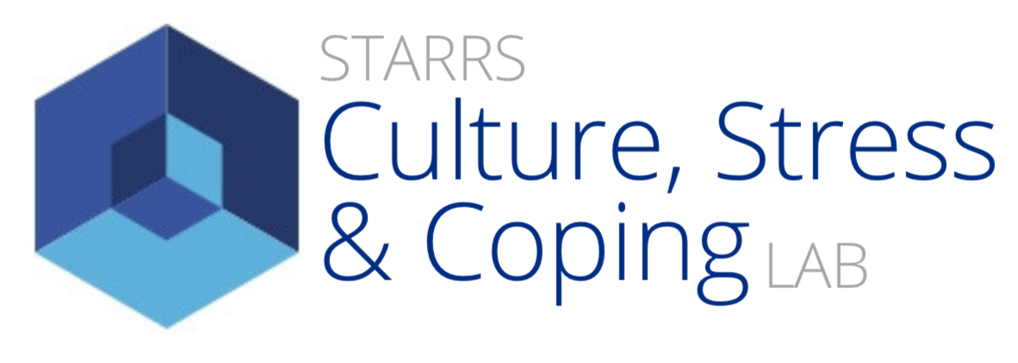
ICINA: Indigenous Cultural Identity Scale Development using a Mixed-Methods Approach
Awehiawaks Karson Herne,
Senior, Department of Psychology
Mentor: Dr Claire J. Starrs, Assistant Professor of Clinical Psychology
Learning & Research Fair, May 2021

Slide 2
INTRODUCTION
Lack of measures that meld Indigenous ways of knowing & healing and Western therapeutic methodologies
Design: Indigenous Cultural Identity Narrative Assessment (ICINA, Herne & Starrs, 2020)
Study, 2-phases, 2 questions:
Does ICINA work? My presentation covers this phase
Is ICINA a valid measure

Slide 3
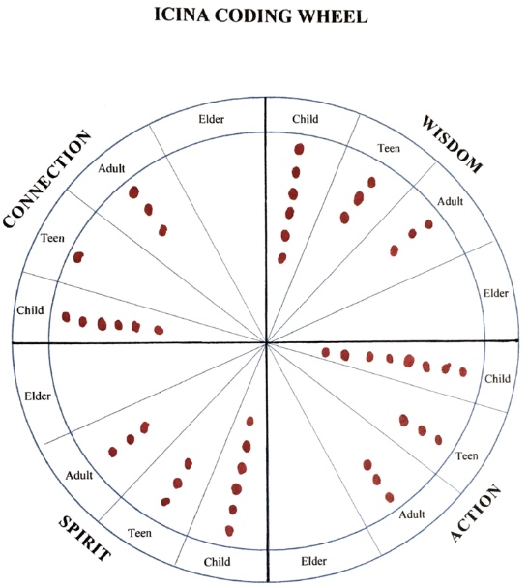
ICINA
Narratives/stories
Medicine Wheel framework
Wisdom: acquiring knowledge/learning
Action: application of knowledge
Spirit: individual and collective identity
Connection: interpersonal relationships
Four stages of life

Slide 4
DEMOGRAPHICS
Mean age = 41.57
SD = 12.843
43%
14%
29%
14%

Slide 5
RESULTS: TOTAL SAMPLE
QUADRANTS
N Min Max Mean SD
WISDOM 7 4 12 7.29 3.15
ACTION 7 6 14 8.57 2.70
SPIRIT 7 2 12 6.14 3.44
CONNECTION 7 6 15 9.43 3.26
CORRELATIONS 1 2 3 4
1. WISDOM —
2. ACTION .76* —
3. SPIRIT .83 .82* —
4. CONNECTION .59 .48 .29 —
Note: *p <.05; **p< .001
STAGE OF LIFE
N Min Max Mean SD
child total 7 3 26 10.86 7.30
teen total 7 3 14 8.14 3.89
adult total 7 3 22 10.57 6.32
elder total 7 0 5 1.86 2.34
WISDOM, ACTION & SPIRIT are significantly positively correlated, CONNECTION is nonsignificant

Slide 6
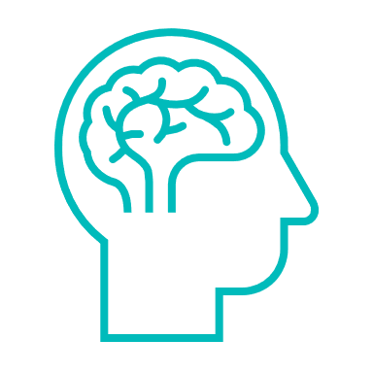
RESULTS: Female vs. Males
WISDOM
Female - M = 8.7 (SD = 3.055)
Male - M= 6.3 (SD = 3.202)
CHILD
Female - M = 15.0 (SD = 9.849)
Male – M = 7.8 (SD = 3.403)
ACTION
Female - M = 8.7 (SD = 3.055)
Male - M= 6.3 (SD = 3.202)
TEEN
Female – M = 9.7 (SD = 1.528)
Male – M = 7.0 (SD = 4.967)
SPIRIT
Female - M = 8.0 (SD = 4.00)
Male - M = 4.8 (SD = 2.630)
ADULT
Female - M = 8.3 (SD = 4.041)
Male - M= 12.3 (SD = 7.762)
Female - M= 8.3 (SD = 2.082)
Male – M = 10.3 (SD = 4.031
Female - M = 1.3 (SD = 2.309)
Male - M= 2.3 (SD = 2.630)
CONNECTION
ELDER

Slide 7
CONCLUSIONS
It works!
Participants: positive feedback
Suggests: valuable clinical tool for working with Indigenous clients
Adaptable to other Indigenous Peoples – future projects!
“…when you’re at the longhouse, and you’re dancing, and an elder acknowledges you dancing, that makes you feel like you belong, that’s a good feeling ”
(Wisdom, Action, Spirit, Connection)

Slide 8
THANK YOU!
Thank you to all the judges for your time, attention and consideration towards this project.
A special thank you to Dr. Starrs for your mentorship and guidance throughout this journey.
Awehiawaks Karson Herne Email: hernek201@potsdam.edu

