Slide 1
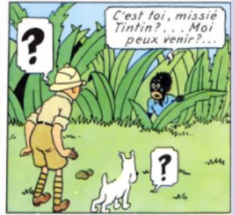
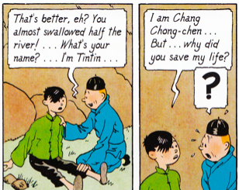
A Look at, ‘The Blue Lotus’ Through Language, Imagery, and Historical Setting
Introduction:
The beloved comic series The Adventures of Tintin has been translated into many languages and repeatedly adapted for film and television. Children across the world have grown up accompanying the young Belgian reporter and his dog as they escape dangers and run into exciting adventures. Yet the series is rife with racist imagery and language.
Thesis:
This paper finds that even “The Adventures of Tintin: The Blue Lotus,” a story set during the Japanese occupation of China that is often cited as the moment when its author, Hergé, changed his outlook toward non-Europeans, remains embedded in racist discourse.
A Pattern is Set:
Tintin in the Congo: (1931)
The Congolese are drawn with exaggerated features
of puffy lips against dark skin.
Hergé writes the Congolese to speak in “pidgin French”
The French articles “le,” “la,” and “les,” are replaced
with “li.” ¹
Tintin in America: (1931)
The Blackfoot Native Americans are drawn with Red skin
The Blackfoot chief is named “Big Chief Keen-Eyed Mole.”
The white American is named ““Paleface-with-eyes-of-the-Moon.”²
Source: Tintin in the Congo
The Blue Lotus:
Set during the “Mukden Incident” on September 18th, 1931. Wherein, Japanese officials bombed the Manchurian railway, blamed the Chinese, and then occupied the country.
The Chinese characters are dressed in light colors, the same which Tintin wears. The Japanese are in dark colors. Light versus Dark.
Hergé wrote the story so that the Chinese were seen to be suffering in need of a savior. In doing this, Tintin (representing Hergé) took on that role.
The character of Chang is stripped of his Chinese features and replaced with Eurocentric ones:
oval eyes, round face, and hair. This was done so that white readers sympathize with the Chinese.
Comic illustrations portray Japanese characters, especially Mitsuhirato (the villain)
as animalistic, buffoons, and manipulators.
Mitsuhirato’s face is elongated, ears ballooned out, and teeth large. Parallel to how
anti-Japanese propaganda of the same time described Japanese.⁴
The Japanese soldiers are militaristic .The dark greens and greys as well as their stature alludes to
their corruption.
Mitsuhirato’s assistant, named “Yamato,” (which means Japan) is drawn to have nuclear yellow skin and
grinning teeth.
Deceit can also be found in a Japanese character portraying a Chinese man attempting to kill Tintin.
How Film Changes the Story:
In later television adaptations (1991), voice characterizations and music also convey racial motifs. Mitsuhirato receives a distorted voice and both Chinese and Japanese accents create exotism.
Linguistically, there are certain phrases that get changed. Many sentences stereotyping Japan or the Chinese get erased.
The omission of certain elements found in the book; such as racially driven scenes, evil associated with “yellow skin,” as well as much of the context of the Second Sino-Japanese War affirms the inaccuracies that this research uncovered.
References:
1. Hergé, Tintin in the Congo, 1931
2.Hergé, Tintin in America, 1931
3. Yvan Daniel, “Quelques aperçues comparatistes s sur les représentations du corps souffrant en France et En Chine.” 2015
4.“'How to spot a Jap’ Daily Mail
Gemma L. Small

