Slide 1
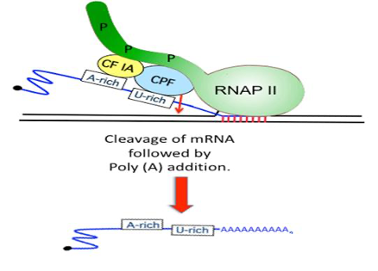
Does a protein degradation factor (Elc1) bind to mRNA processing factors? Aisha Laguda and Fathima Nazeer
Abstract
Introduction
Results
In eukaryotes when DNA is transcribed, pre-mRNA is made by RNA polymerase. It is then cleaved, and a tail structure added before the mRNA is transported to the cytoplasm to be translated into protein. Specific protein complexes called cleavage and polyadenylation factors are required for the cleavage and tail addition process. This process of tail addition is impaired following certain types of DNA damage. ElcI is a protein degradation factor. Our hypothesis is that Elc1 binds to cleavage and polyadenylation factors to degrade these proteins following DNA damage. We use a process called immunoprecipitation to test this hypothesis. We use extracts of a specific strain of yeast with a tag on ElcI that will bind to an antibody conjugated bead. We then test the proteins bound to Elc1 by analyzing this bead- antibody -Elc1 complex in order to check if cleavage and polyadenylation factors bind to Elc1 following DNA damage.
W303-NQO
elc1 Δ -NQO
W303-UT
elc1 Δ -UT
Pre
In eukaryotes, mRNA is produced in the nucleus and translated in the ribosome to create proteins. Prior to the translation process, mRNA goes through a series of changes. Initially, RNA polymerase transcribes DNA to produce pre-mRNA. pre-mRNA has to be cleaved and polyadenylated (the addition of a series of adenine nucleotides that form a tail structure) to produce mature mRNA. This is carried out by cleavage and polyadenylation factors. Once mature mRNA is made, it is ready for translation.
Elc1 is a protein involved in protein degradation.
We have some evidence that this protein is involved in regulating the cleavage step of mRNA maturation, after certain types of DNA damage.
Our hypothesis is that Elc1 binds to mRNA processing factors to facilitate their degradation.
Inhibition of mRNA cleavage following DNA damage is dependent on a protein degradation factor, Elc1.
We used in-vitro cleavage assays using in-vitro transcribed radiolabelled RNA to assess cleavage activity. When in-vitro cleavage assays were performed on cell extracts lacking Elc1 following 4-NQO treatment we observed no inhibition of cleavage after 4-NQO treatment.
Methods and Material
Future Directions
I grew yeast cells and extracted proteins for a yeast strain with a tag on ElcI. I streaked plates, waited for them to grow, then placed some colonies in a flask and allowed it to grow overnight. I used a spectrometer to evaluate cell growth. Then pelleted and resuspended cells in lysis buffer with potassium acetate and protease inhibitors. The cell extacts were vortexed with glass beads to break open the cells and proteins were separated from cell debri by centrifugation.
We will be assessing if the tagged Elc1 in our extracts interact with mRNA processing factors using an immunoprecipitation assay. Elc1 has a Myc tag. I will use beads that have an antibody against this tag to isolate Elc1 and other proteins associated with Elc1. By analyzing the complex of proteins attached to the beads we can check if polyadenylation factors bind to Elc1. We will identify these factors using a method called Western Blotting.
References
Nazeer, F. I., Devany, E., Mohammed, S., Fonseca, D., Akukwe, B., Taveras, C., & Kleiman, F. E. (2011). P53 inhibits mRNA 3′ processing through its interaction with the CstF/BARD1 complex. Oncogene, 30(27). https://doi.org/10.1038/onc.2011.29
Acknowledgements
Fredrick B. Kilmer Student Research Fellowships—SUNY Potsdam
Collegiate Science & Technology Entry Program (CSTEP)

