Slide 1
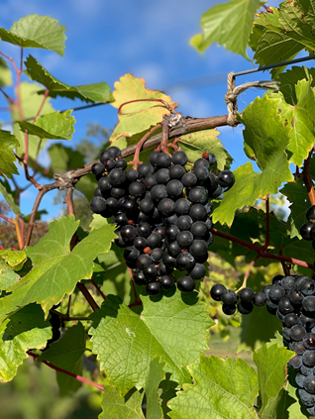
Global Climate Change Influences Wine Production and Tourism in Northern New York
Dawn Robinson, Jefferson Community College, Watertown, NY, USA
Cara Aguirre, Jefferson Community College, Watertown, NY, USA
Pamela Griffin, SUNY Potsdam, Potsdam, NY, USA
2nd International Conference on Tourism Research ICTR 2019
14-15 March 2019
University Portucalense (UPT) Porto, Portugal
https://www2.potsdam.edu/griffipr/GlobalClimateChangeInfluencesWineProductionandTourisminNorthernNewYork.pdf

Slide 2
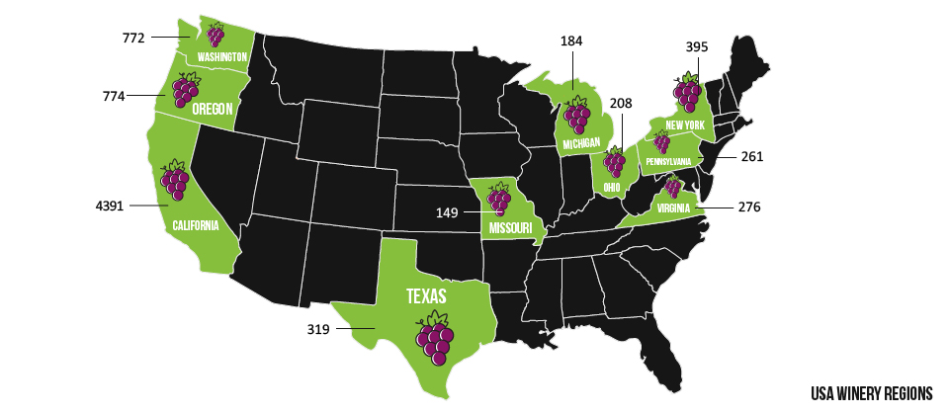
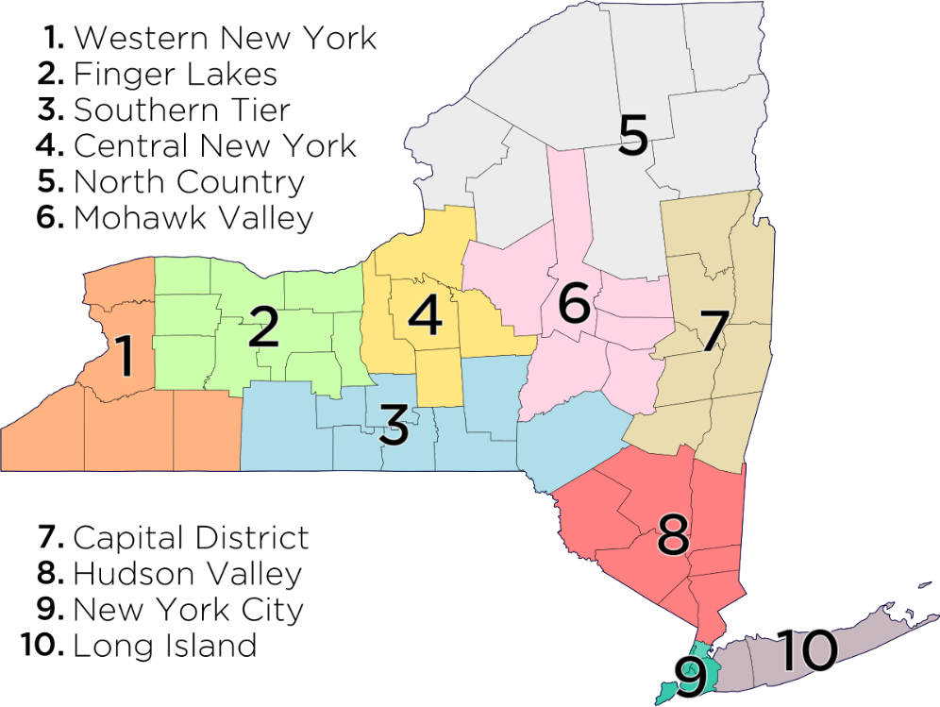
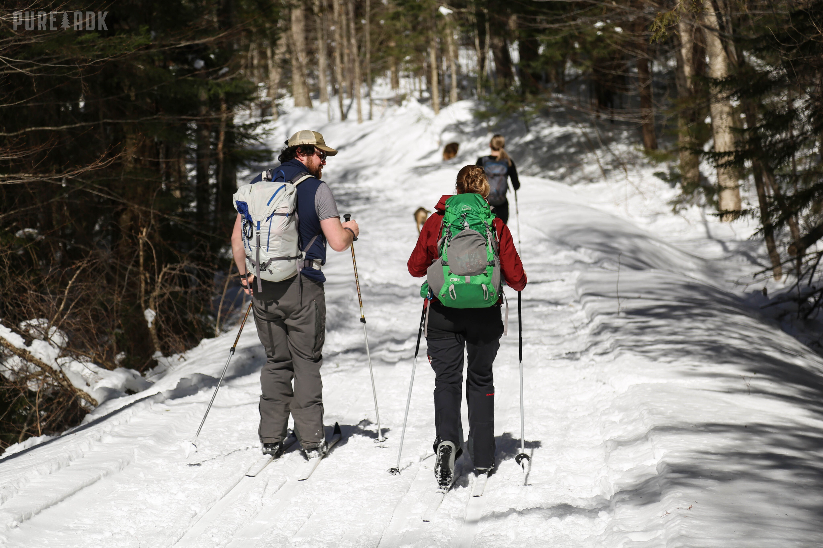
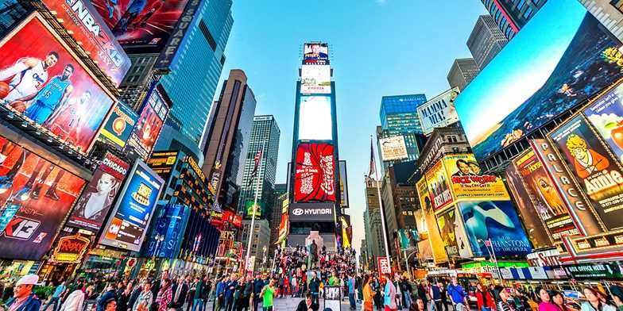
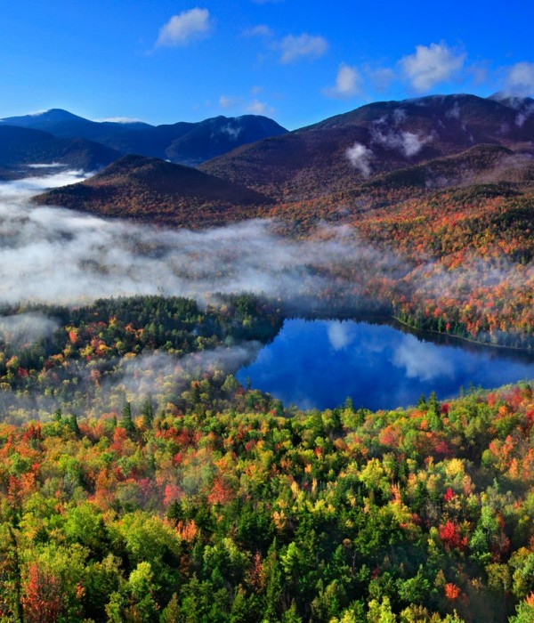
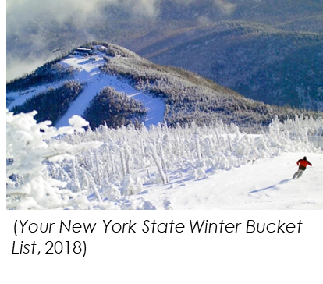
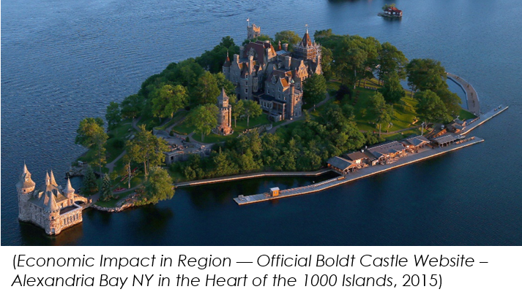
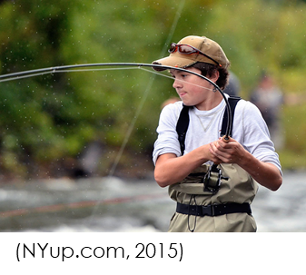
Where and What is the North Country in New York?
(Family Friendly Hikes in the Adirondacks, 2018)
‌
(An Introduction to the Top 10 Wine Regions of the USA, 2019)‌
(Shapiro, 2019)‌
(Explore the Adirondacks | Official Adirondack Region Website, 2002)‌

Slide 3
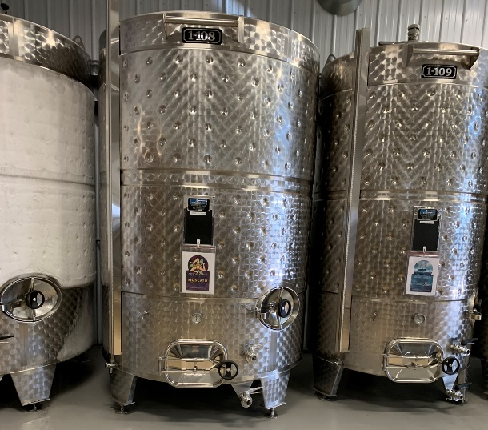
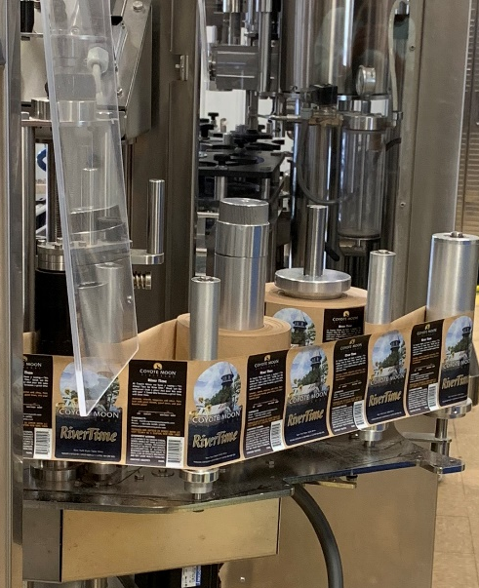
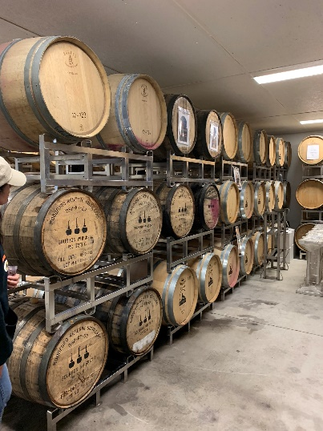
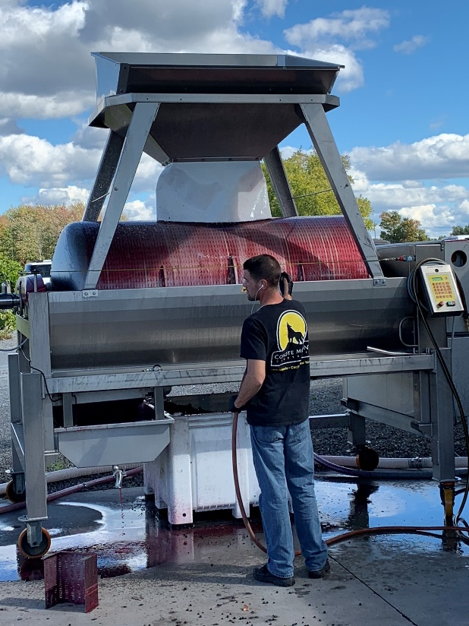
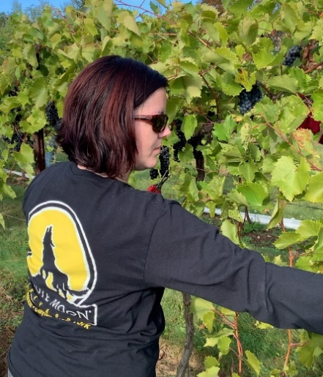
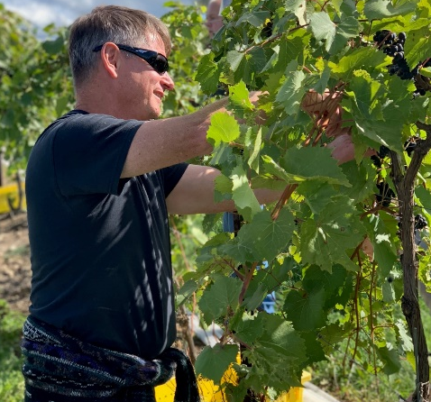
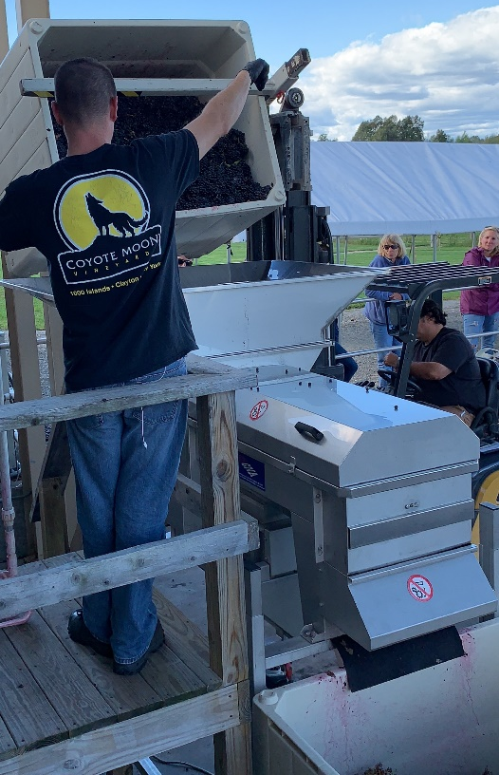
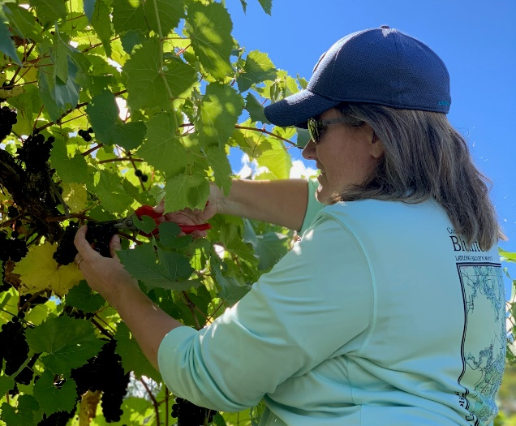
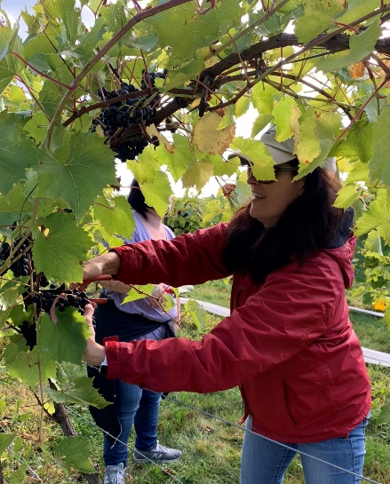
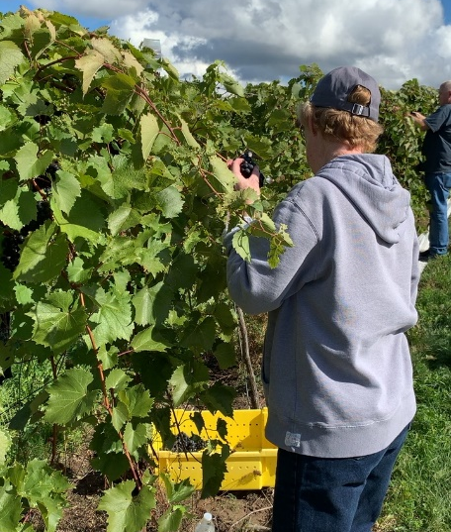
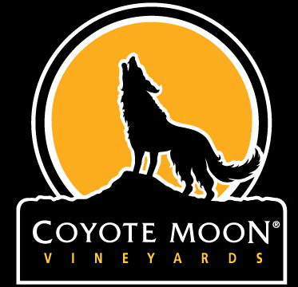
Purpose
Wine Production
Wine Tourism
Brand Equity

Slide 4
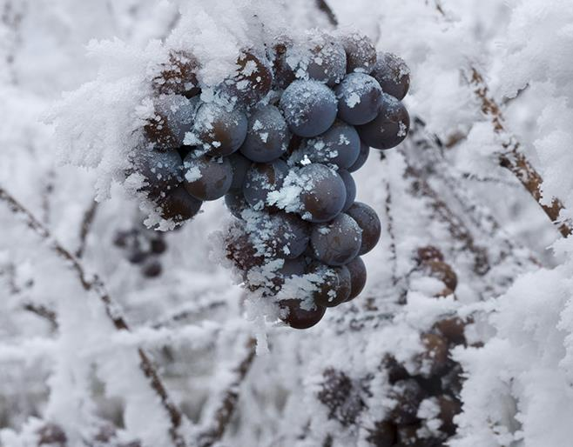
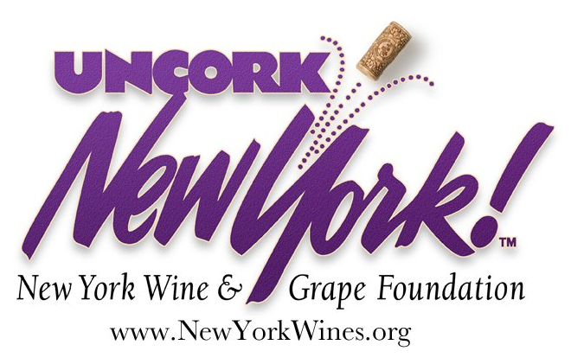
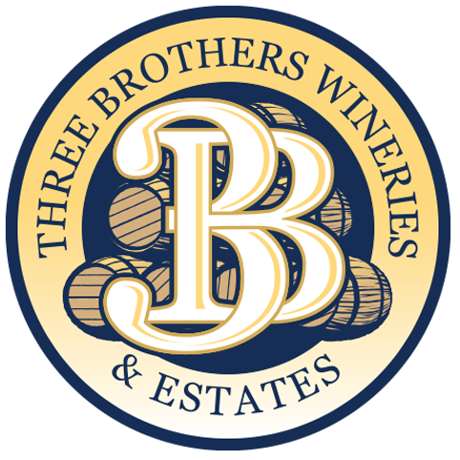
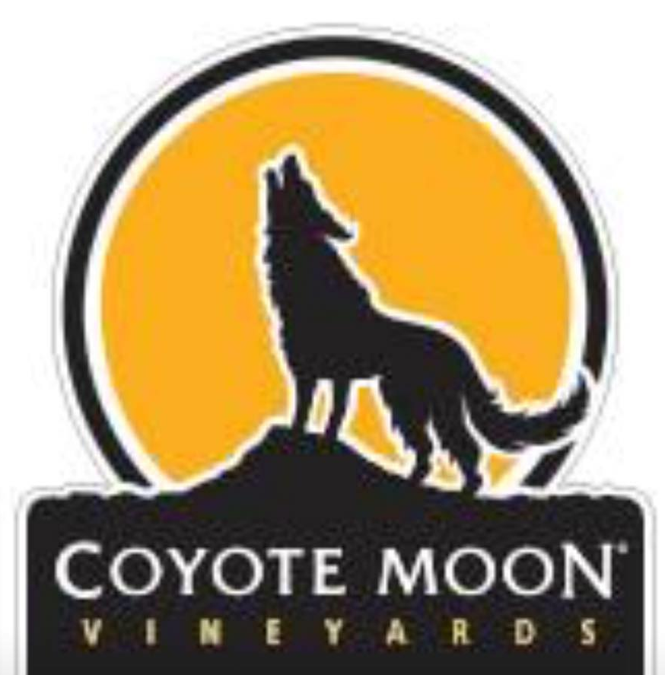
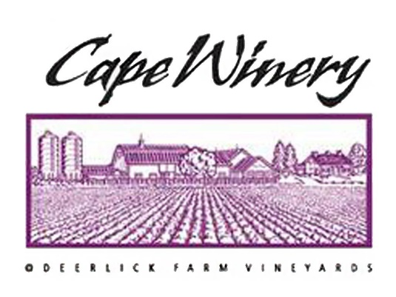
Overview of Problem
First Winery Opened in
2002
Due to being so young the challenges for wine production in Northern New York:
Building brand equity
Climate
Genetically engineered grapes
(Siren, 2018)‌
(Our Logos | New York Wine & Grape, 2018)‌
(Logo - Picture of Thousand Islands Winery, Alexandria Bay - TripAdvisor, 2008)‌
(Logo,” 2011)
(Three Brothers Wineries & Estates, 2008)‌
(Otter Creek Winery, 2017)‌
(Coyote Moon Vineyards, 2018)‌
(Kazzit, 2016)‌

Slide 5
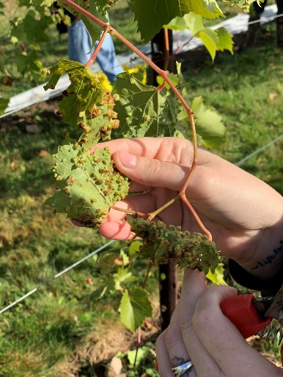
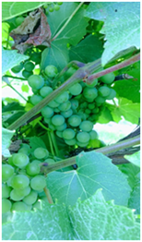
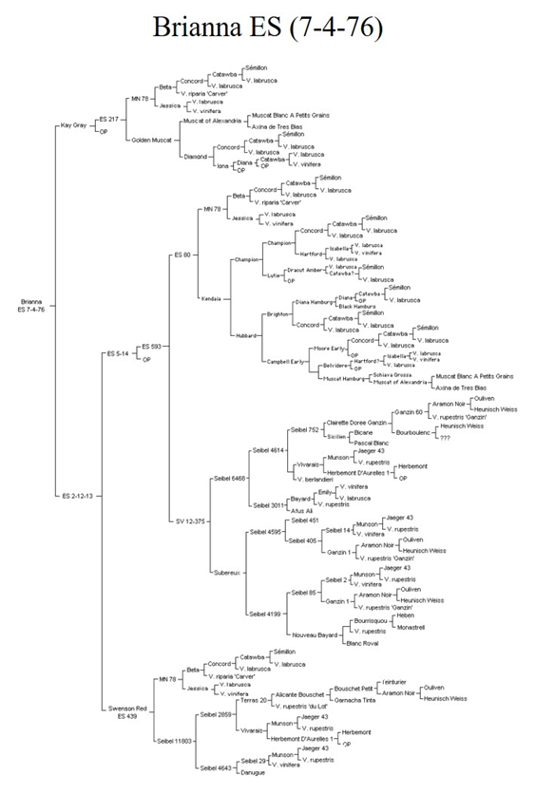
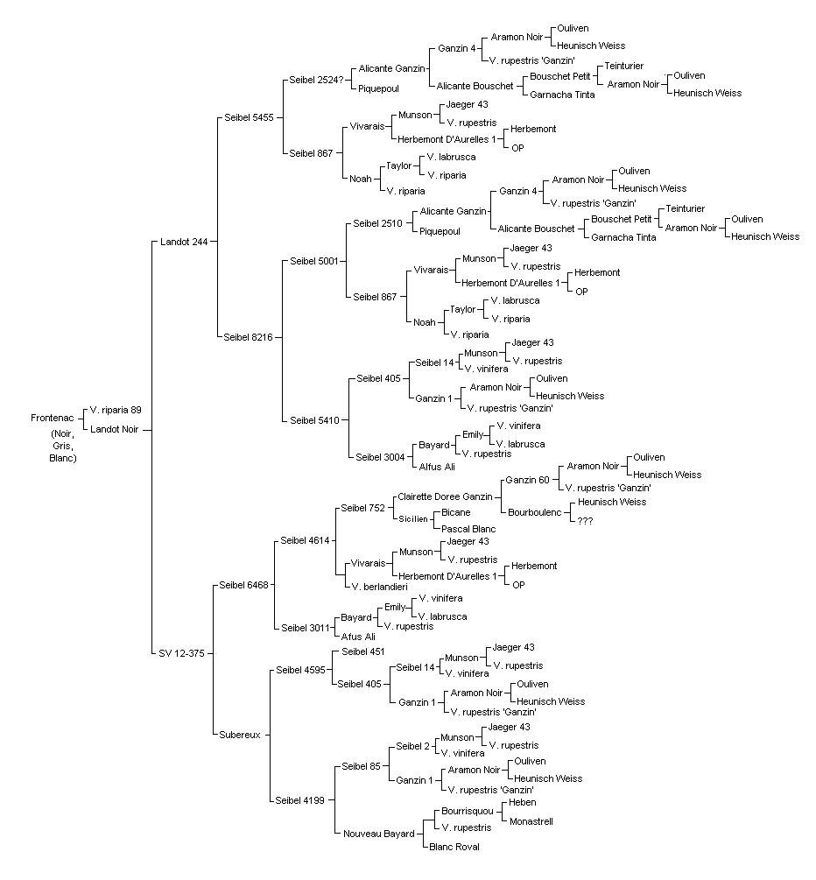
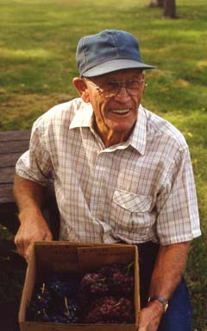
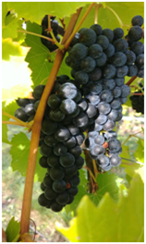
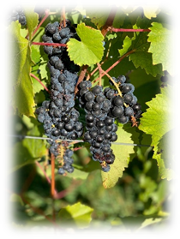
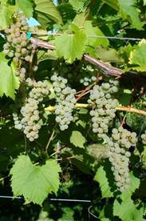
Grape Pedigree
Frontenac (Noir, Gris, Blanc)
(Image: CCC Home - Minnesota Grape Growers Association, 2019)‌

Slide 6
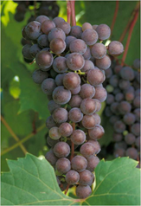
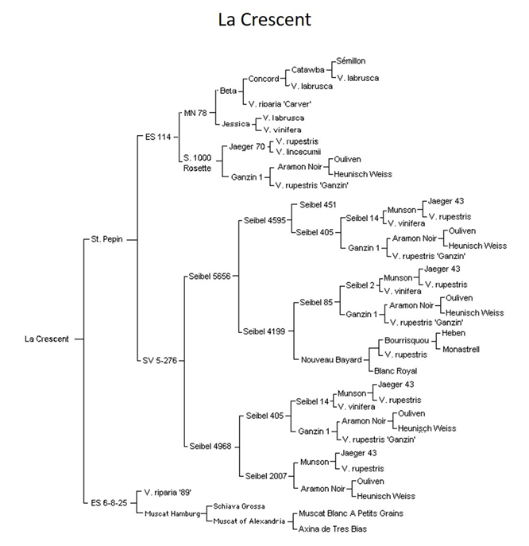
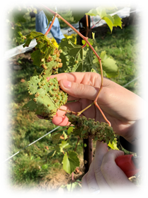
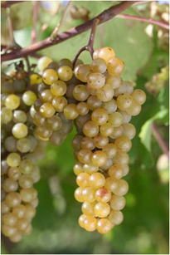
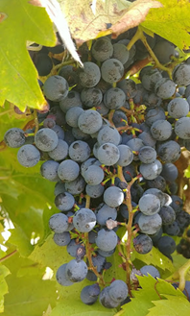
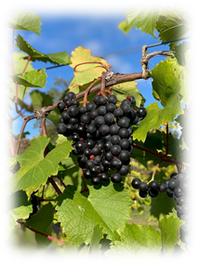
Grape Pedigree
(File:University of Minnesota wordmark.png - Wikimedia Commons, 2009)‌

Slide 7
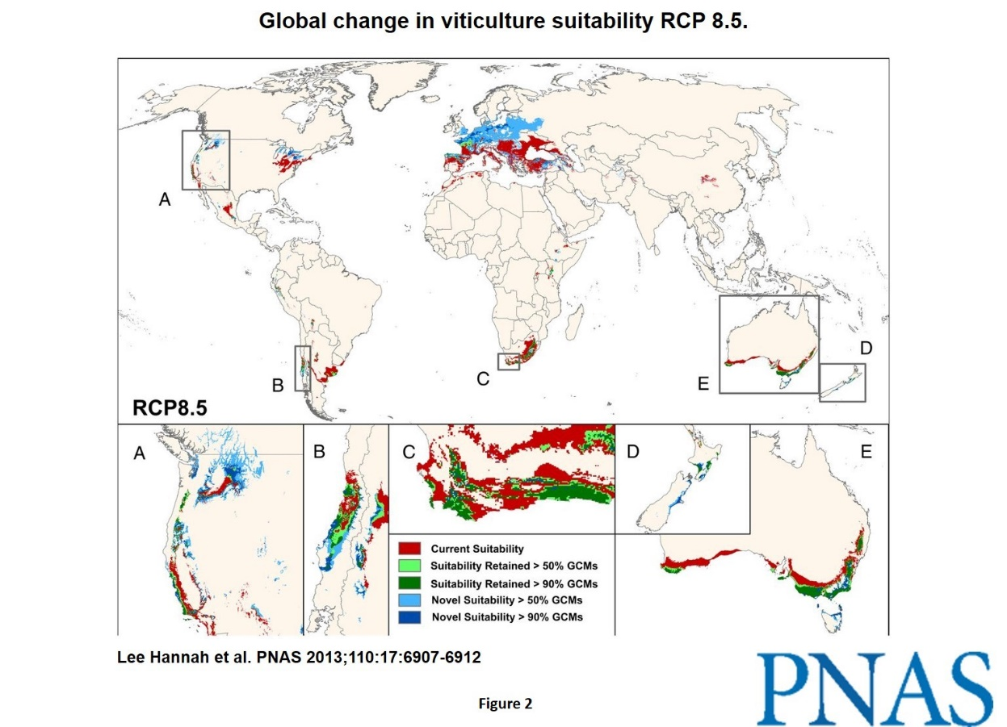
Review of Prior Research
Brand Equity of Premium Wines – France vs California, U.S.A.
Climate Change and Viticulture – Globally and in Quebec, Canada
https://www2.potsdam.edu/griffipr/GlobalClimateChangeInfluencesWineProductionandTourisminNorthernNewYork.pdf

Slide 8
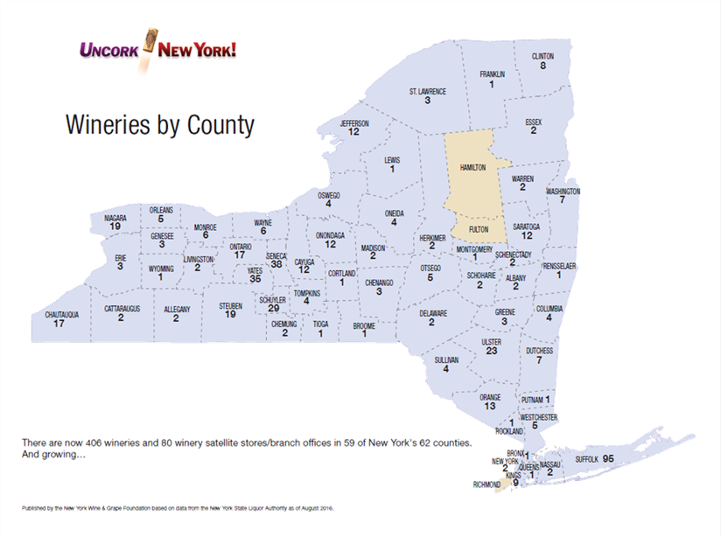
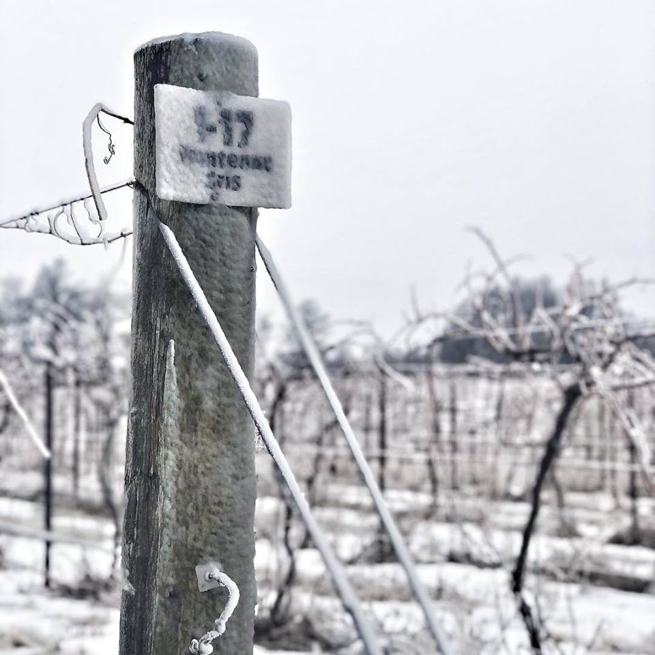
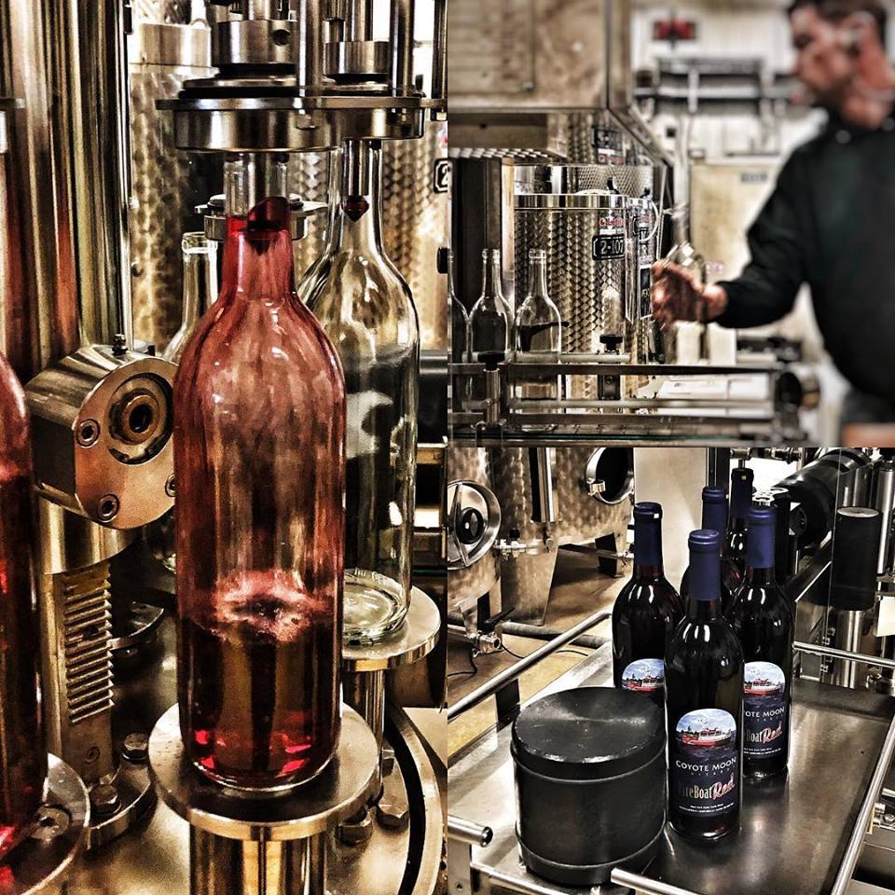
Methodology
Qualitative Analysis:
Existing Literature
Climate Data
Pedigrees of Grapes
Regional Economic Data
Qualitative Interviews
https://www2.potsdam.edu/griffipr/GlobalClimateChangeInfluencesWineProductionandTourisminNorthernNewYork.pdf

Slide 9
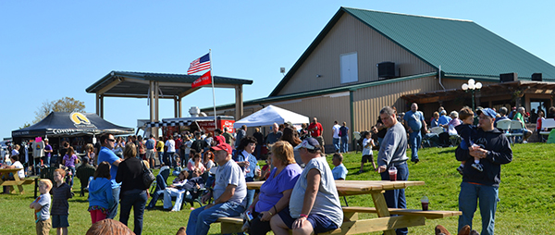
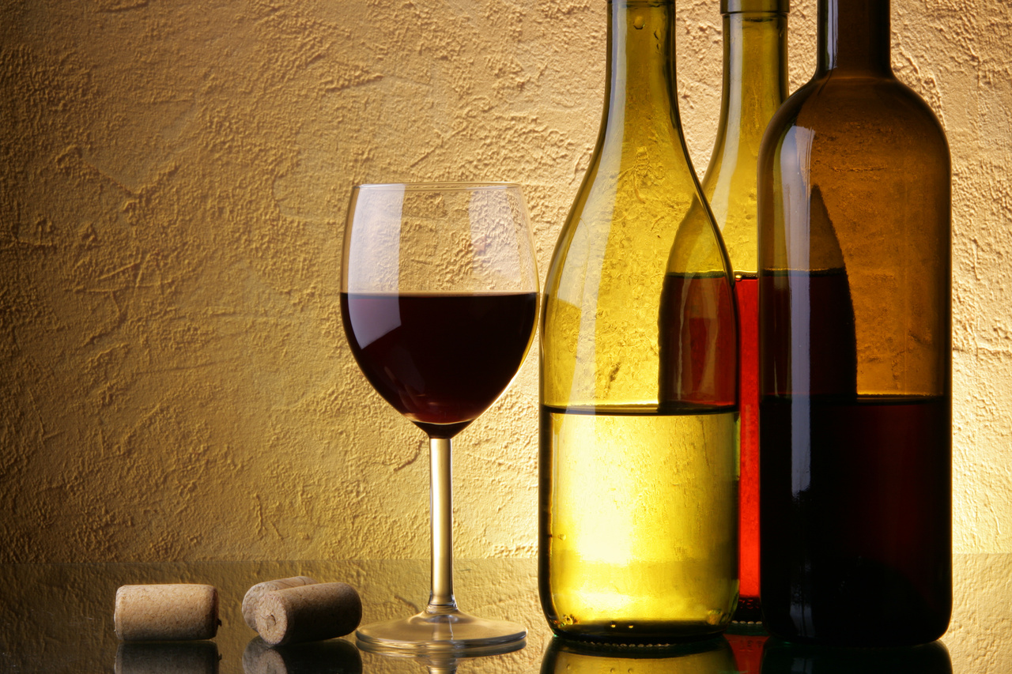
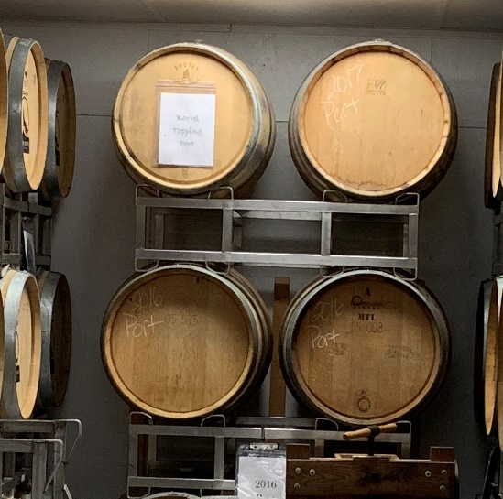
Results
Local Concerns Regarding Climate Change
Measures Taken by Winery Operators
Climate Change and Tourism
Climate Change and Wine Production
Current Promotional Activities
Wine Tourism in Northern New York is Growing
Wine Tourism Outlook for Region
(Wines for Thanksgiving, 2019)
‌
(Coyote Moon Vineyard - Harvest Festival | Visit the 1000 Islands, 2018)
‌

Slide 10
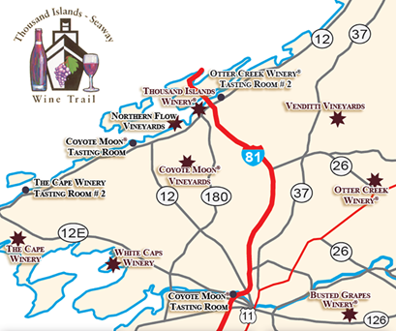
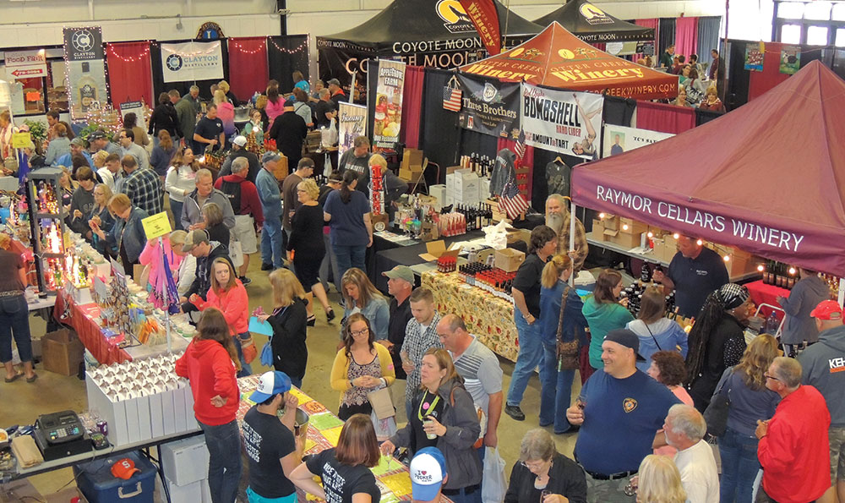
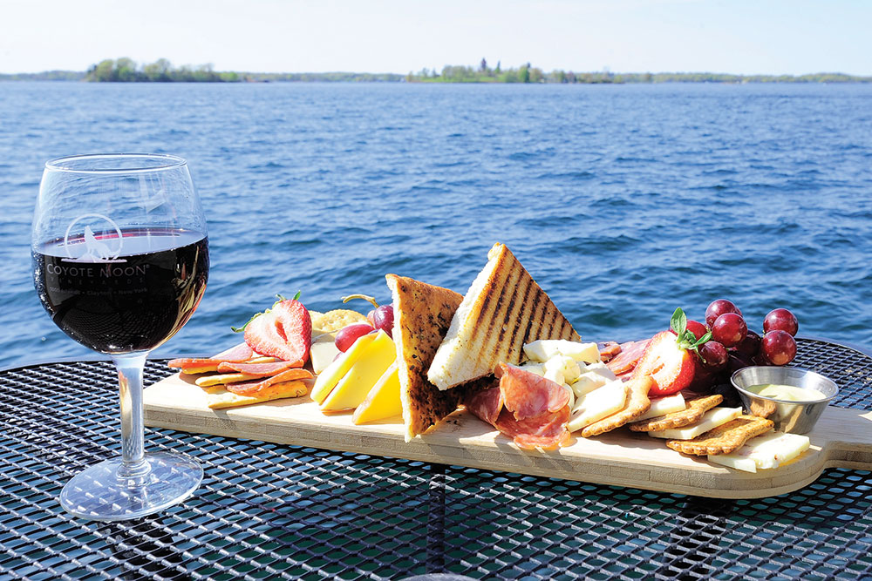
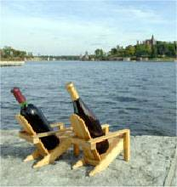
Recommendations
The wineries should strategically position themselves:
Unique winery experience destination
Educate and promote the cold-hardy grape varieties
Create an industry marketing standard for growers
(Craft Beverages – Thousand Islands – Visit Clayton NY in the 1000 Islands Region of NY, 2017)‌
(Thousand Island Wine Region | New York Wine & Grape Foundation | New York Wine & Grape, 2017)‌
(Wine Tasting Thousand Islands New York - Drink 1000 Islands, 2018)‌
(Craft Beverages – Thousand Islands – Visit Clayton NY in the 1000 Islands Region of NY, 2017)‌

Slide 11
Exploring the Thousand Islands Region
https://youtu.be/cXWQd76yiG0

