Slide 1
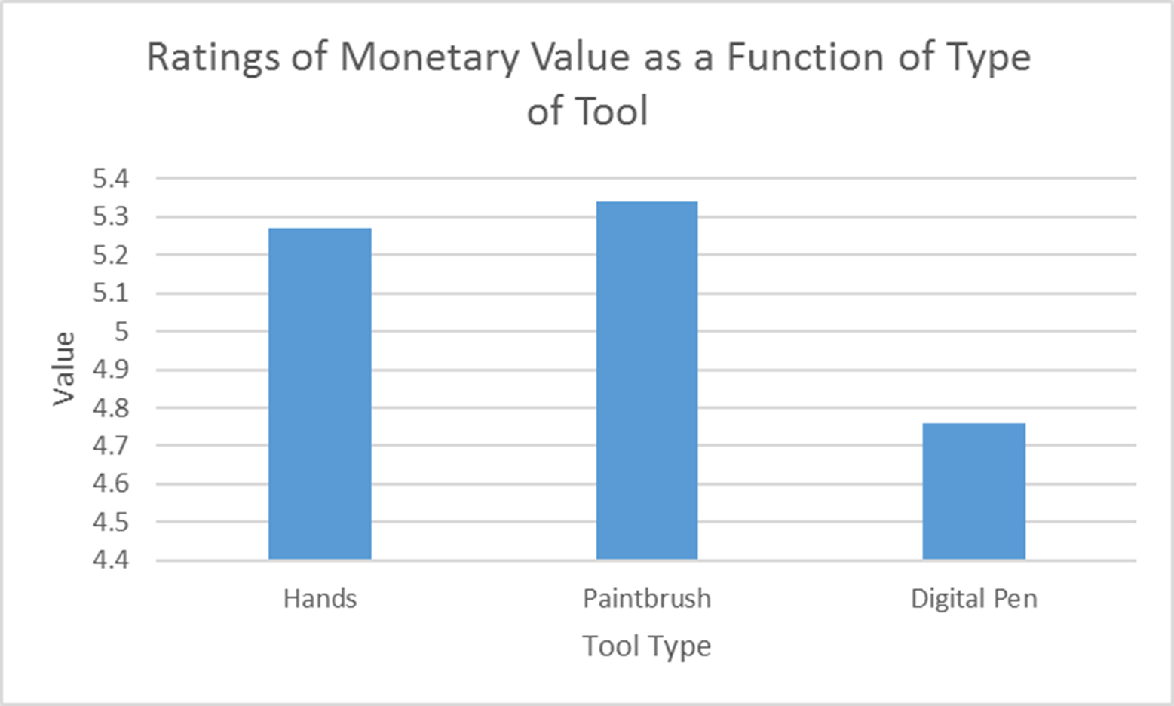
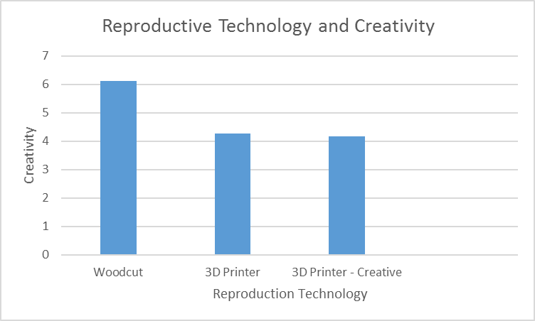
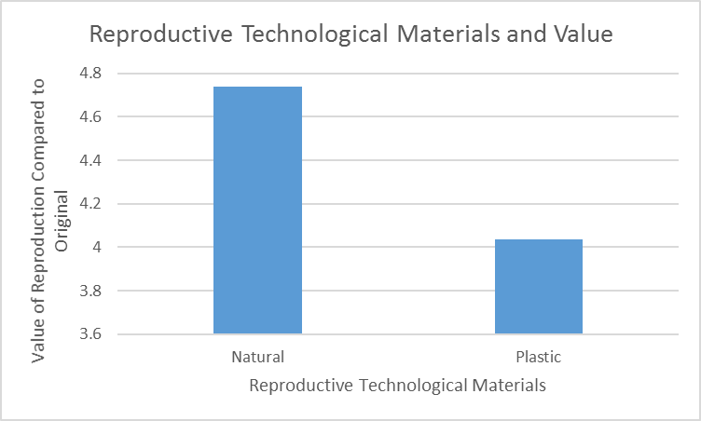
The Valuation of Computer Generated or Enhanced Art
Jeremy Walts
State University of New York - Potsdam
Introduction
When we assign value to an art object, what is it that we are actually valuing? Two dominant factors are the creative performance and (magical) contagion – the perceived passing of an artist’s creative essence into the piece (Newman & Bloom, 2012).
Prior research has suggested that we devalue computer-assisted or generated art (Chamberlain et al., 2018).
The current studies examine performance and contagion in the context of computer art.
Method
Participants
State University of New York – Potsdam (n = 104).
Study One
Narrative: There is a special exhibit opening at a museum titled “Celebrating Technique.” It will feature the work of a single skilled artist who was commissioned a substantial amount of money to create landscape pieces using three different techniques. The museum professionals agree that although the techniques are different the skill and effort needed to create each piece is equivalent and the curators have valued them at $1500 each. These pieces will be auctioned upon exhibit closing.
One of the landscapes…
SCENARIO 1: HANDS
… was made using a technique called smudging... Using their hands – fingertips and thumbs, they can purposefully smudge those lines with a significant amount of rubbing...
SCENARIO 2: PAINTBRUSH
…was created using oil on canvas and was painted with the use of different shaped paint brushes…The artist uses a technique called Gradient Blending which allows them to purposefully smudge the lines with a significant amount of rubbing using a Filbert Brush...
SCENARIO 3: DIGITAL
…was created using a tablet and a pen. Here, an artist can use a stylus on touch-sensitive screen... The artist.. selection of a smudge tool. They can then select multiple settings for the desired gradient of shading and can smudge the lines by guiding the smudge tool/the stylus over the colors...
Dependent Variable:
How much do you think this item will go for at auction?
Please rate the value on a scale of 1 to 9 (1 = a lot less than $1,500, 5 = about $1500, and 9 = a lot more than $1500)
Results and Discussion
Tool Type (Hands, Paintbrush, Digital Pen) as the independent variable and Valuation as the dependent variable. One way ANOVA, F (2, 91) = .93, p > .05 (n.s.)
Hands: M = 5.27, SD = 1; Bush: M = 5.34, SD = 1.75; Digital Pen: M = 4.76, SD = 2
The non-significant results could indicate that these tools are all perceived as extensions of the creator and therefore the level of contagion in all three categories is similar.
Study 2
In an attempt to disambiguate contagion from the creative performance, we conducted a study where in all three conditions what is being valued is a reproduction of an original, but that reproduction was created using tools of differing materials; naturals vs. plastics, a woodcut or a 3D printer. For the 3D printer conditions we made the creative performance explicit or implicit.
Method
Narrative: In order to preserve our culture a museum was awarded a small grant to replicate some of its artwork. One of the pieces to be replicated is an illustration by an artist renowned in the area the museum is located. The original is valued by the museum at $7000. A proposal was submitted to replicate the painting via...The creation of the… and the piece will take approximately 9 months of work to complete.
SCENARIO 1: Natural Materials/Woodcut
Woodcutting is an artistic technique where an artist dutifully and meticulously etches into a piece of wood, such that only certain parts of the wood, when covered with ink, will touch a medium (in this case, canvas). Then, the woodcut is pressed into the canvas, or vice versa, while covered with ink, in order to leave the print.
SCENARIO 2: Plastics/Digital w/out explicit creativity
A 3-D printer is a machine that uses a mechanical arm to draw or paint a print on some medium (in this case, canvas)…
SCENARIO 3: Plastics/Digital w/explicit creativity
A 3-D printer is a machine that uses a mechanical arm to draw or paint a print on some medium (in this case, canvas). The artisan will have to create the technology that can recognize and copy this specific illustration, as an adequate program did not exist already.
Dependent variables:
How much do you think the reproduction is worth? Please rate the value on a scale of 1 to 7 (1 = a lot less than the original, 2 = somewhat less than the original, 3 = slightly less than the original, 4 = about the same as the original, 5 = slightly more than the original, 6 = somewhat more than the original, 7 = much more than the original)
How creative is this technique?
Please rate the perceived creativity on a scale of 0 to 8 (0 = none at all, 8 = extremely)
Results and Discussion
IV: Scenario; DV: Value; Woodcut: M = 4.74, SD = 2.05; Digital w/o creativity: M = 4.13, SD = 2.14; Digital w explicit creativity: M = 3.94, SD = 1.97; F (2, 98) = 1.45, p > .05 (n.s.)
IV: Scenario; DV: Creativity; Woodcut: M = 4.26, SD = 2.38; Digital w/o creativity: M = 4.17, SD = 2.18; Digital w explicit creativity: M = 4.87, SD = 2.24; F (2, 98) = 9,751, p < .001 (creativity predicts value, p < .001; R² = .15).
The Woodcut was rated as more creative when creativity was not and when it was made explicit (both p’s < .01) in the 3D printing conditions, neither printing condition differed from the other.
It is possible individual place higher valuation on artistic creativity than technological creativity – different kind of creative performances.
3D printing conditions were combined into a single condition – Plastics and thereby increasing power, we found a marginally significant result for Valuation, p = .98. (Natural Materials: M = 4.74; Plastics M = 4.03).
The marginally significant result for Valuation could reflect contagion. Woodcuts may be valued more because of the amount of direct contact the artist has with the tool - artisan handles woodcut which touches reproduction, whereas the artisan creates software and a digital arm touches object.
Future Research:
Performance: Value Different Types of Creative Performance – Technological vs Artistic
Contagion: Explore Contagion further by varying length of time an artist applies tools to an object directly
References:
Chamberlain, R., Mullin, C., Scheerlinck, B., & Wagemans, J. (2018). Putting the art in artificial: Aesthetic responses to computer-generated art. Psychology of ‘
Aesthetics, Creativity, and the Arts, 12(2), 177.
Newman, G. E., & Bloom, P. (2012). Art and authenticity: The importance of originals in judgments of value. Journal of Experimental Psychology: General, 141(3),
558.

