Slide 1
Civil War Training Camps

Slide 2
Training Manuals

Slide 3
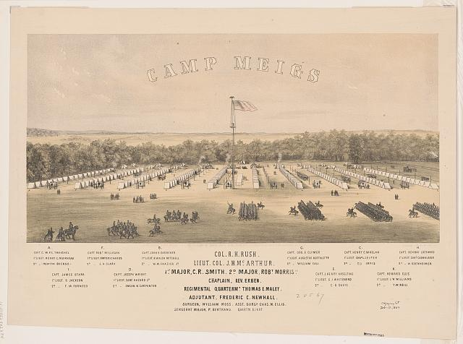
Training Camps

Slide 4
Training

