Slide 1
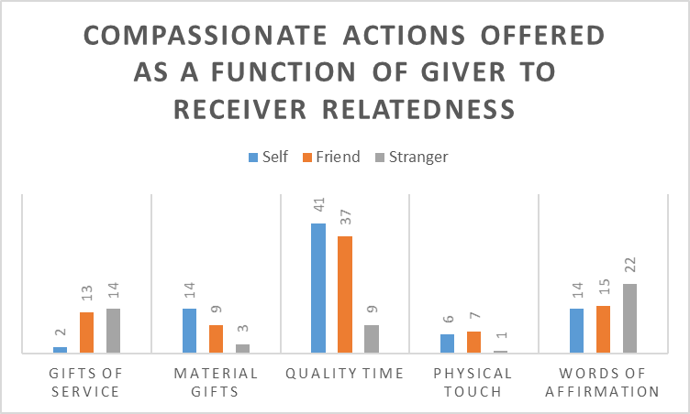
Compassionate Actions for Friends, Strangers, and Ourselves:
We Give Depending on Degree of Relatedness
Elizabeth Gazcon-Chesbro, Andrea Michel, Bree Rivera, Genesis Saltos, Allets Schicker, and Jeremy Walts
State University of New York - Potsdam
*Equal author contributions
Introduction
“Love and compassion are necessities, not luxuries. Without them humanity cannot survive (Dalai Lama, 1992).”
Compassion is generally defined as a feeling state that one experiences in response to the suffering of themselves or others. It is usually described as a feeling of warmth accompanied by a desire to alleviate suffering (Strauss et al., 2016); therefore a compassionate action is an expression of warmth-in-action with the intent to alleviate suffering (which according to Buddhism and other religious traditions is a general condition of being human).
We suggest that although individuals are willing to offer compassion to the self and others, the types of compassionate actions, or ways compassion is offered, may vary as a function of the receivers relatedness to the giver (are we giving to a friend, stranger, or ourselves).
Method
Participants
Eighty-six students from State University of New York – Potsdam.
Procedure
Participants were given a Qualtrics Survey asking them their likelihood to give compassionately to a friend, themselves, and a stranger. If they indicated any likelihood of giving we asked them to state the action and to categorize it according to Chapman’s five love languages (1992).
Chapman’s five love languages (1992):
Material Gifts, Gifts of Service, Quality Time, Physical Touch, and Words of Affirmation
Results
3 (Receiver: Self, Friend, Stranger) x 5 (Category: Love languages) Chi-Square Test of Independence
χ² (8) = 40.45, p < .0001)
Most offered compassionate Action
Self – Quality Time (N = 41)
e.g., taking a long drive, listening to music, artistic expression, self care and pampering
Friend – Quality Time (N = 37)
e.g., spending time together, offering support and advice
Words of Affirmation – (N = 22)
e.g., smile, compliments
Least offered compassionate actions
Self – Material Gifts (N = 3)
Friend – Physical Touch (N = 7)
Stranger – Physical touch (N = 1)
Discussion
Previous work shows individual’s are most likely to act compassionately towards friends than themselves and less so towards strangers. Current findings show participants also give differently depending on degree of relatedness.
Degree of Relatedness and Physical Touch
Participants were least likely to offer it to strangers.
Degree of Relatedness and Words of Affirmation
Words of Affirmation (compliments) and Gestures (smiles and holding doors, picking up fallen objects) were most often offered to strangers
These actions can be performed at a distance, whereas physical touch requires closeness
These physical distances correspond to the degree of relatedness
Quality Time and Degree of Relatedness
This action was most likely to be offered to friend and to the self. The sharing of one’s physical space is related to degree of closeness – it was only offered to friends and to the self
Friend Quality Time actions consisted of time spent in the form of “hanging out,” but also for support and advice whereas
Self Quality Time consisted of actions that may also be categorized as Eudemonic pleasure (e.g., self care and pampering, taking long drives, reading books, and artistic endeavors)
Hedonic Pleasure vs. Eudemonic Pleasure
The combination of hedonic pleasure (concerned with in the moment pleasures) and quality time, might be at the seat of eudemonic pleasure (concerned with an individual’s quality of life; their overall happiness derived from health, wellness, and fullness of experience).
References
Dalai Lama. Mind and life meeting. Presentation in Dharamsala, India, 1992.
Chapman, G., (1992). The five love languages: How to express heartfelt commitment to your mate. Chicago, IL: Northfield Publishing.
Gilbert, P., & Procter, S., (2006). Compassionate mind training for people with high shame and self-criticism: overview and pilot study of a
group therapy approach. Clinical Psychology & Psychotherapy, 13(6), 353-379
Harbaugh, W. T., Mayr, U., & Burghart, D. R., (2007). Neural responses to taxation and voluntary giving reveal motives for charitable
donations. Science, 316 (5831), 1922-1625.
Strauss, C., Lever Taylor, B., Gu, J., Kuyken, W., Baer, R., Jones, F., & Cavanagh, K. (2016). What is compassion and how can we measure it? A
review of definitions and measures. Clinical Psychology Review, 47, 15-27.

