Slide 1
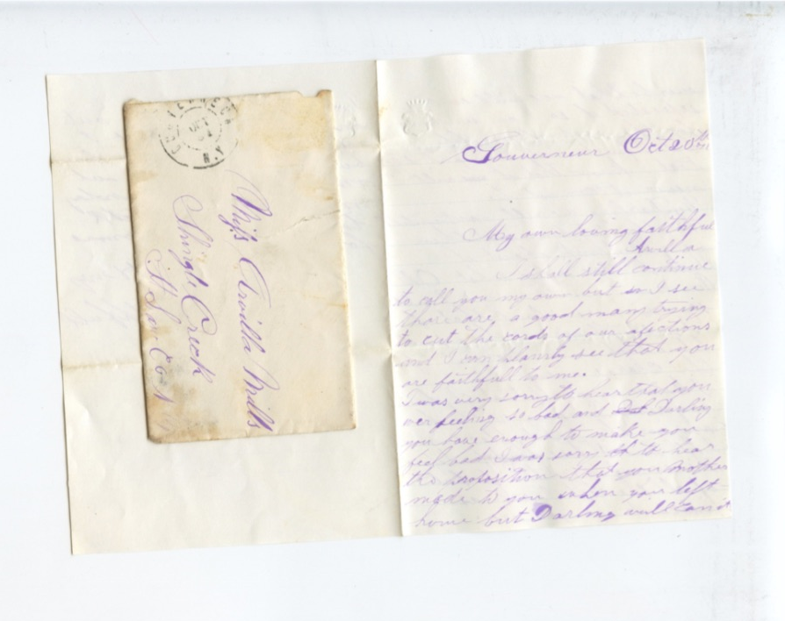
“My Own My Everloving Arvilla”: Correspondence Brings Life to History
Tabitha Brown
HIST 398
Spring 2020

Slide 2
The year is 1868.
Sixteen-year-old Lucelia Arvilla Mills is boarding in Gouverneur, twenty miles away from her home in Rensselaer Falls, in order to attend school.

Slide 3
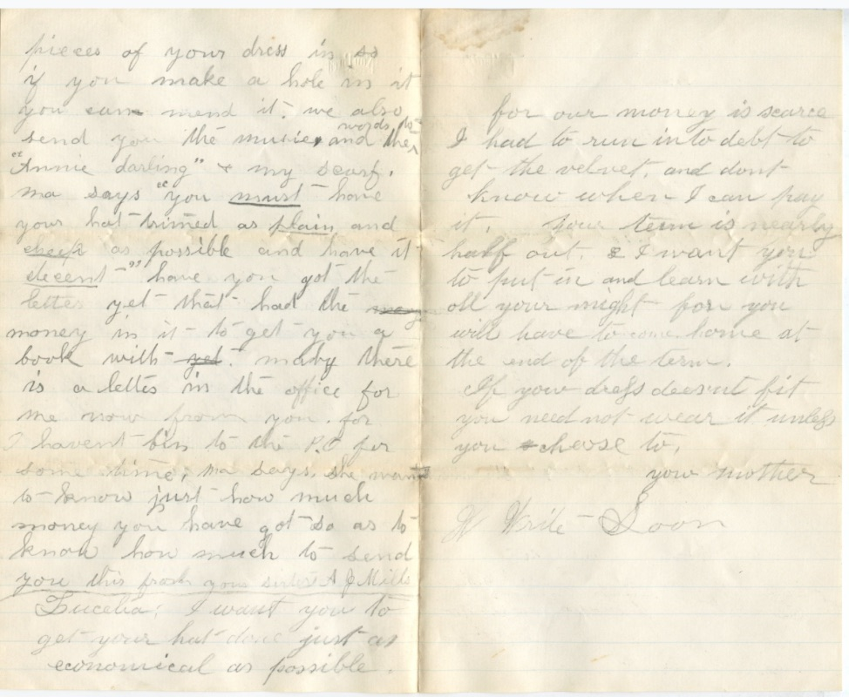
She receives a letter from her sister, Achsa “Jennie” Mills, and her mother, Jane Aldous Mills.

Slide 4
“Jennie” at age 10, Mother Mills, and Arvilla at age 11
Jennie and Mother plan to send Arvilla a newly made dress, material for a hat, and money for books.

Slide 5
“We also send you the music, and the words for ‘Annie darling’ and my scarf…” Jennie Mills 1868-10-22

Slide 6
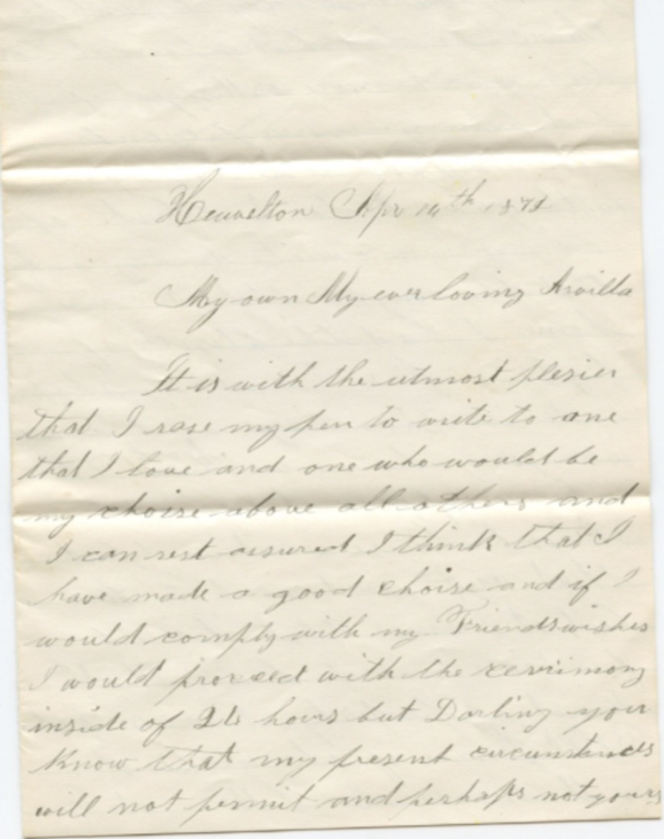
HIST 398 Tabitha Brown
Notes:
I am Tabitha Brown, a history major at SUNY Potsdam, and I am involved in an independent study through the History Department under the guidance of Dr. Thomas Baker, and this is part of my research. Because of this letter from Jennie and Mother Mills-- and others in the collection, I have a window on the world of what it was like to be a young adult in SLC around this time.

Slide 7
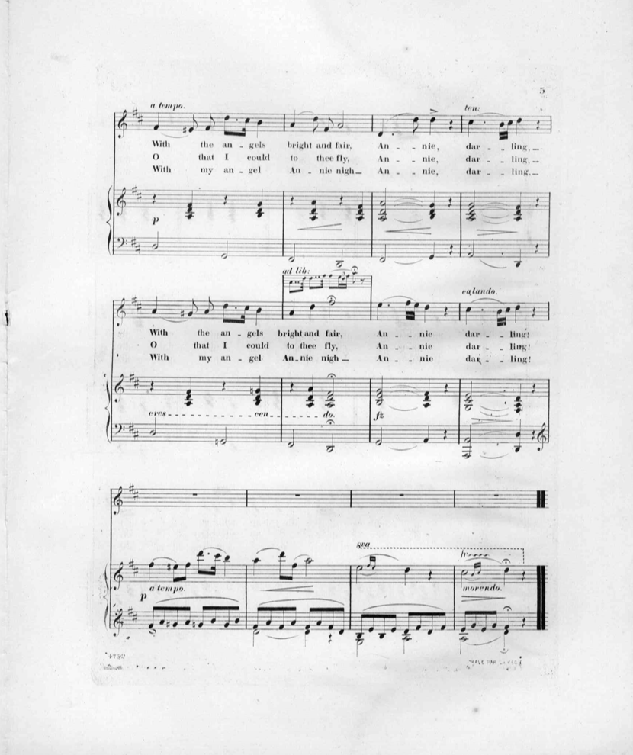
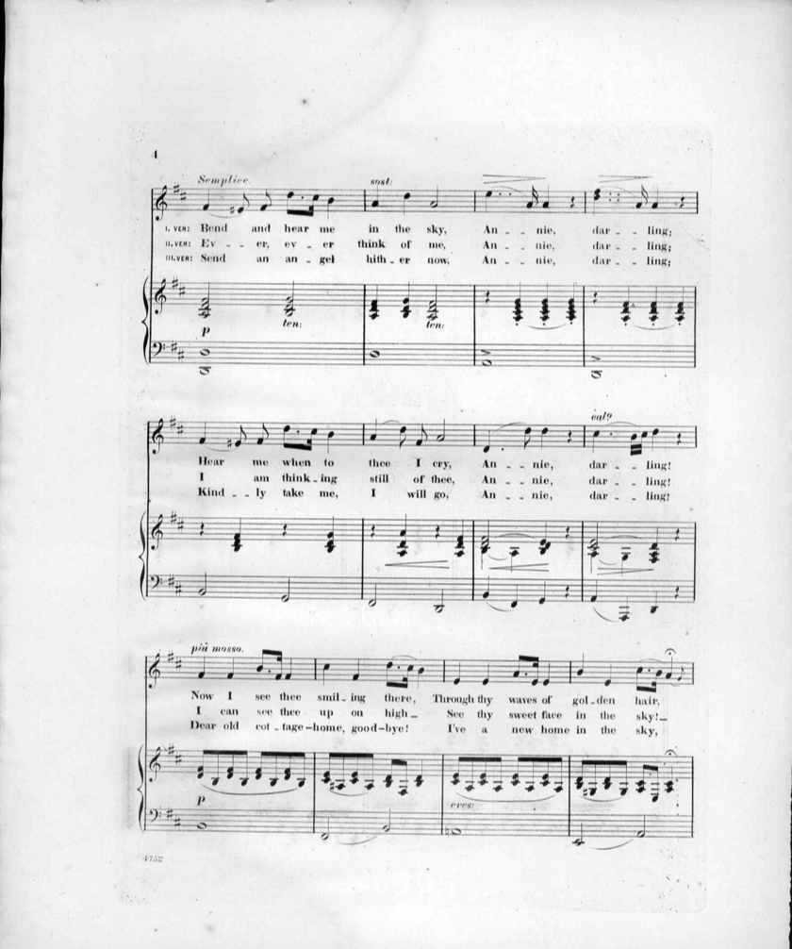
“Annie Darling” J. H. McNaughton 1859
Notes:
Taking the title of the song, I looked up the sheet music for Annie Darling in the LOC, then asked my daughter to play it. I can now imagine how Arvilla's music sounded as it flowed out of the parlor and throughout the house.

Slide 8
Notes:
The study I am involved with this semester picks up where the Spring 2019 project left off. The 2019 project focused on a collection of courtship letters spanning the years 1868-1873 and primarily written by Henry Clark of Richville, NY to Lucelia Arvilla Mills of Rensselaer Falls, NY.Both parties would have been around 18 years old when Arvilla responded positively to Henry's request for permission to write to her. Included in the collection were also letters from Arvilla's family and friends. The letters were shared with the 5 students in the class by Carol Opdyke, a descendant of Henry and Arvilla Clark.

Slide 9
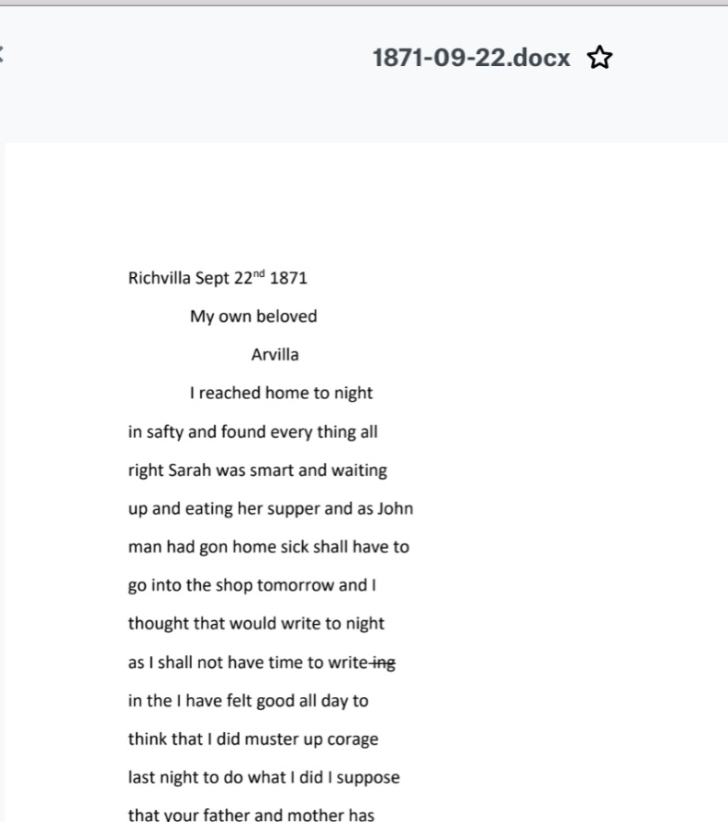
Reading, comparing, fixing…
Notes:
For the 2020 project, I am transcribing the 27 remaining letters, reviewing and editing each previously transcribed letter, standardizing the work of 5 people, researching and annotating. When I reviewed and edited the 2019 students' work, I compared each students' transcriptions to the scanned letters and addressed any issues that I found.

Slide 10
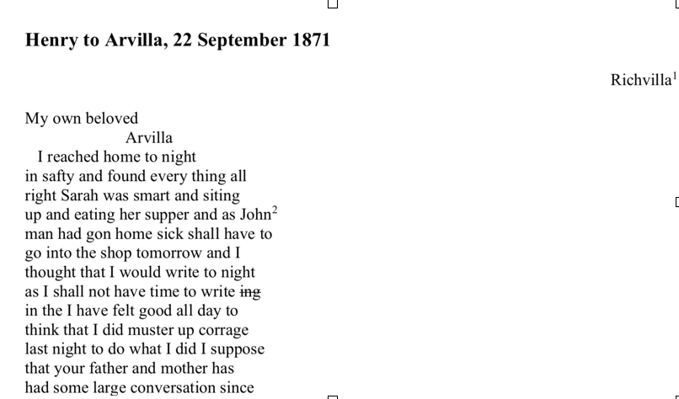
La Fantasie’s The Correspondence of Roger Williams served as model for my own editorial policy
Notes:
I then used the editorial method and apparatus employed by Glenn La Fantasie in his book, The Correspondence of Roger Williams, as a guide to create my own editorial policy regarding transcription and annotation decisions. I applied this policy to the letters in order to standardize their form.

Slide 11
Footnotes can be fun…
Notes:
I then decided what topics needed research, completed that research, and annotated the now standardized compilation of letters.
Transcribing is very exciting. You never know what the next letter may contain. Also, there exists an intimacy that cannot be felt with the printed word.

Slide 12
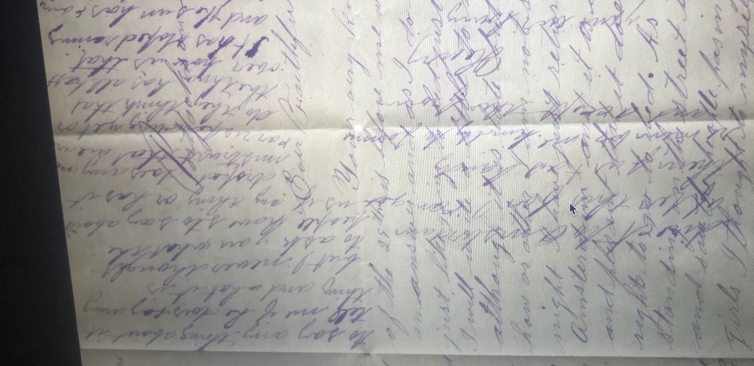
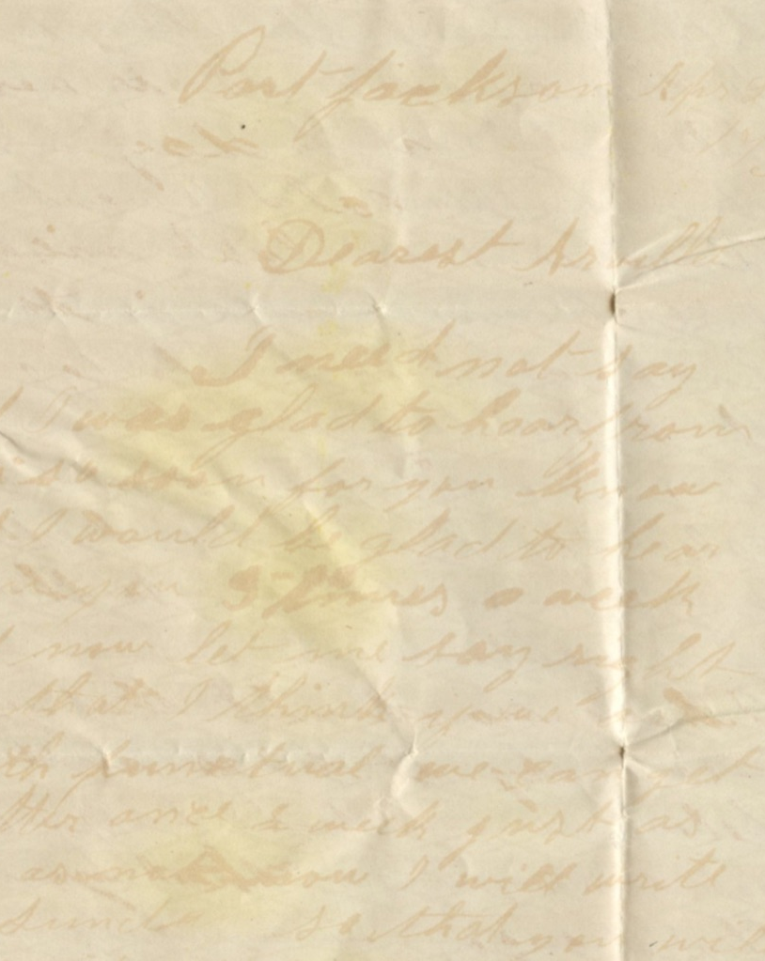
Oh, Henry…
Top photo: “crossing”
Right photo: light brown ink
Notes:
However, transcribing can be laborious, frustrating, and taxing. Henry seldom used the conventions of punctuation or capitalization, so it was hard to know where sentences began and ended. He also sometimes "crossed" his already written lines of text- or used brown ink which increased the difficulty of transcribing.

Slide 13
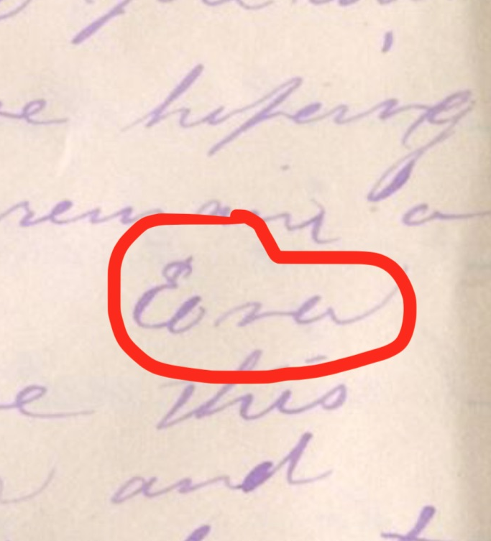
Challenges!
Notes:
Some words were nearly impossible to decipher. While often there was the benefit of context, the spelling could vary. I have come to believe the word on the left may be "protracted"--The word circled in red--is this Eliza? Edna? Elsa? Depending on whether you prefer transcribing or annotating, the next step will bring vexation or relief. For me, annotating was transcription's reward. The difficulty here was reining myself in. With only a semester to work on this study, I could not pursue every interesting detail.

Slide 14
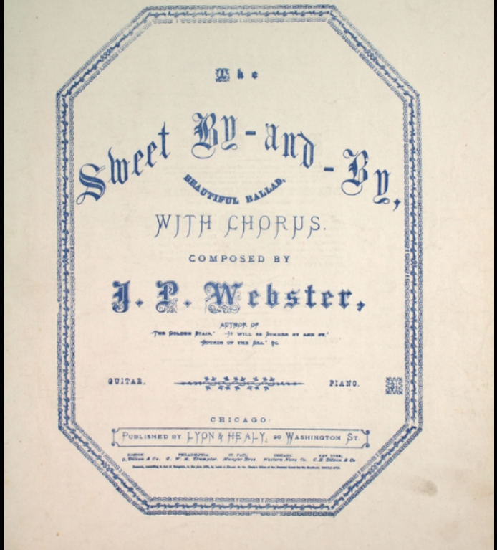
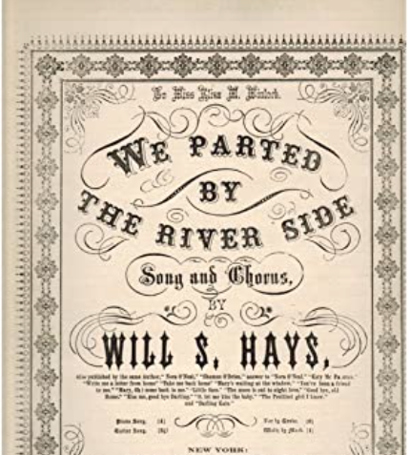
Popular music of the day according to Arvilla and Henry
Notes:
But the details were fascinating...whether it was learning about the popular music of the day that Arvilla and Henry discussed...

Slide 15
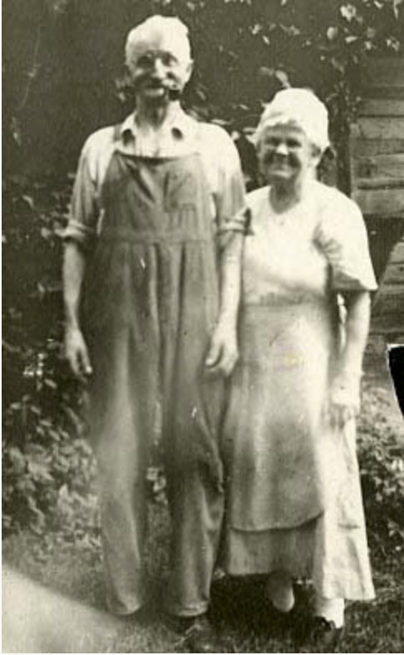
Relationships
Notes:
Relationships...

Slide 16
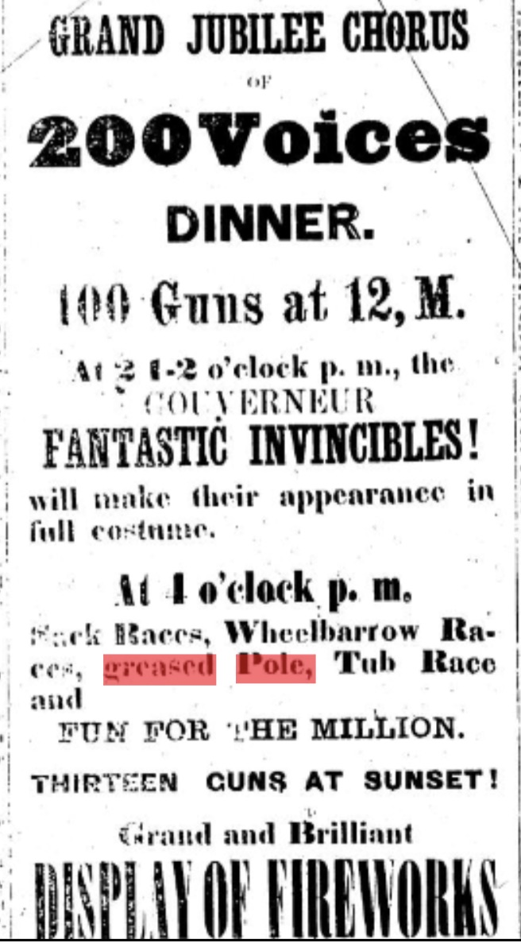
“I have seen large bills of their doings to Gouverneur and thought perhaps you would rather go thare they are going to have a large time thare the 4 th... " Suitor Henry Clark 1872-06-27
Notes:
How the inhabitants of SLC celebrated the 4th of July...

Slide 17
Railroads were key to connecting people
“I will meet you at the depot Friday Morning dont fail to stop...” Henry 1870- 12-10 “If you think you can come up on the afternoon train Wensday just drop a line back on the train tomorrow afternoon...” Henry 1871-11-27
Notes:
or How folk traveled around the county and the country...

Slide 18
Personal Correspondence Brings Life to History
Notes:
Research was a delight. Spending time with these letters helped me make connections and discoveries I never thought possible at the outset.
The bottom line for me is that personal correspondence brings life to history.

Slide 19
Photo Credits:
Carol Opdyke
Adirondack Museum Northern New York Historic Newspapers
Jefferson County Historical Society Child’s Gazetteer and Business Directory for Saint Lawrence County Library of Congress Digital Commons at Connecticut College
SUNY Potsdam

Slide 20
Acknowledgements:
Carol Opdyke for sharing the letter collection
Dr. Thomas Baker and Dr. Sheila McIntyre for guidance
Olivia Brown for performing “Annie Darling” on piano and violin

