Slide 1
Housing Structure and Inequality in the United States
Virtual Learning and Research Fair 2020
Alesha Roy, Adriana Hernandez, Angella St. Davis, Brian Allgeier, Meaghan Lee, and Sefania Owusu

Slide 2
Overview
The structure of the housing market and the inequalities within have been forming since the end of the 1930’s and are still seen today in the United States. This presentation will discuss how denying loans or insurance based on race(Redlining) and racial segregation, led into the Housing Crisis of 2008. Which lead into further rent inequality and how this has affected the rates of homeownership. Finally, how all the structurally based inequalities previously mentioned have led to the rising rates in homelessness seen today.

Slide 3
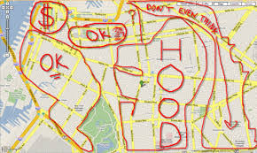
Redlining
Definition: Redlining is an unethical practice that puts services (financial and otherwise) out of reach for residents of certain areas based on race or ethnicity. It can be seen in the systematic denial of mortgages, insurance, loans, and other financial services based on location (rather than an individual’s qualifications).Notably, the policy of redlining is felt the most by residents of minority neighborhoods.

Slide 4
It’s more than denying me housing,loans,etc.
“Groundbreaking research on the intersection of climate change and segregation reveals how racist banking practices banned by Congress 52 years ago continue to shape how black and lower-income Americans experience the effects of global warming”.
“Among other things, researchers found that historical “redlining” of minority neighborhoods in more than 100 American cities has placed a heavier burden on residents from extreme heat than other communities, according to the findings published in the journal Climate”.
“For instance, air pollution and extreme heat are killing inner-city residents at a higher rate than almost all other causes, according to experts. And as average temperatures continue to rise—contributing to what scientists call the “urban heat island effect”—death and illness from the effects of climate change are expected to rise further”.
“Mustafa Santiago Ali, vice president for environmental justice, climate and community revitalization at the National Wildlife Federation and former leader of the congressional Hip Hop Caucus, said at a recent political forum that air pollution is “an epidemic” in minority communities where residents are “literally dying for a breath of fresh air.”
“In fact, historically redlined districts are on average 5 degrees Fahrenheit warmer than non-redlined districts, the study shows”.
“Those experiencing elevated temperatures face substantially higher risk of heatstroke and other heat-related illnesses, experts say, with the greatest risk to vulnerable populations whose homes lack air conditioning or adequate ventilation”.

Slide 5
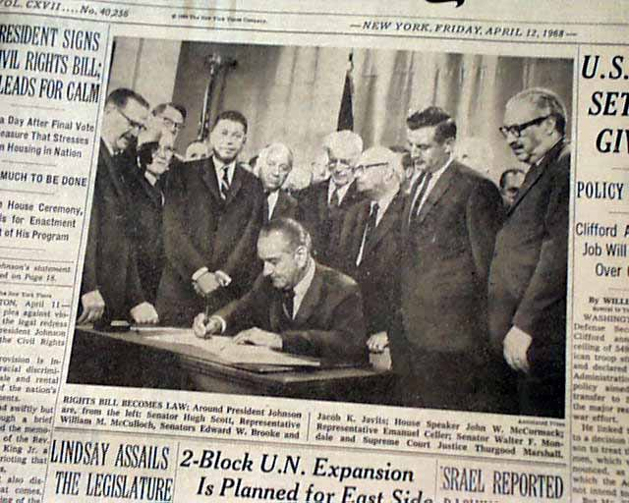
The Fair Housing Act of 1968
“April 11, 1968, President Lyndon Johnson signed the Civil Rights Act of 1968, which was meant as a follow-up to the Civil Rights Act of 1964. The 1968 Act expanded on previous acts and prohibited discrimination concerning the sale, rental, and financing of housing based on race, religion, national origin, sex, (and as amended) handicap and family status. Title VIII of the Act is also known as the Fair Housing Act (of 1968)”.

Slide 6
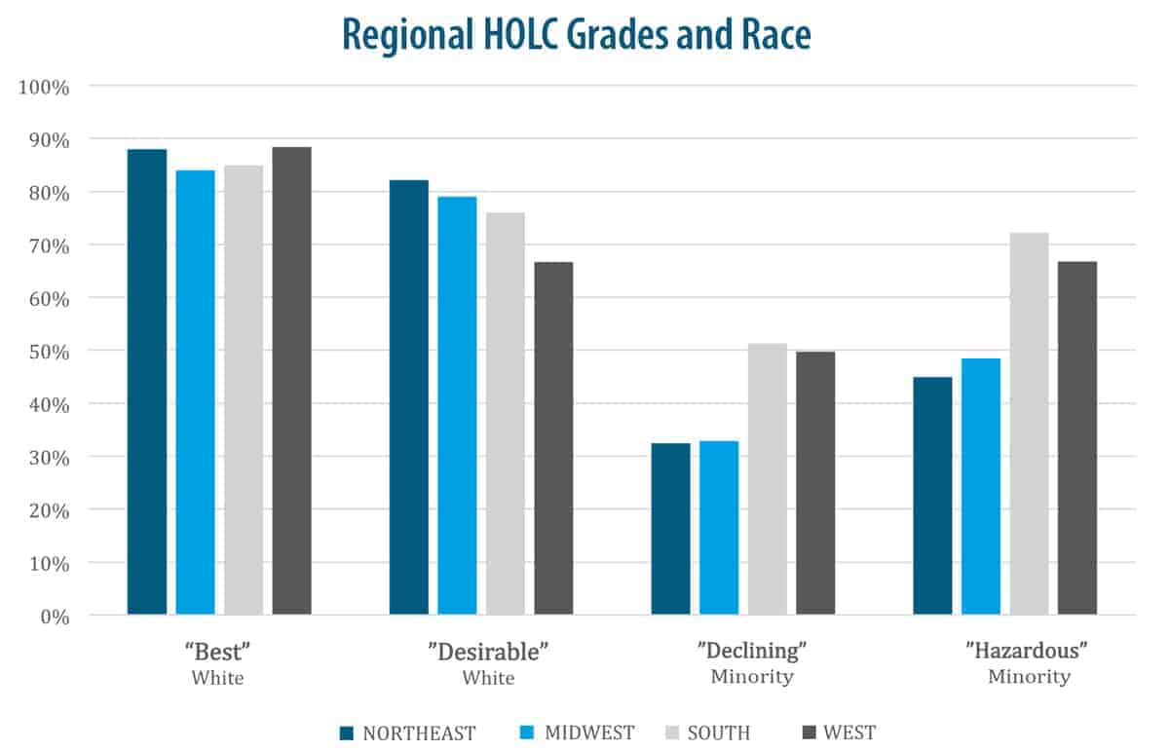
History of Housing Discrimination
Fifty years after the abolition of slavery, local governments continued to legally enforce housing segregation through exclusionary zoning laws, city ordinances which prohibited the sale of property to Black people. In 1917, when the Supreme Court ruled these zoning laws unconstitutional, homeowners swiftly replaced them with racially restrictive covenants, agreements between property owners which banned the sale of homes in a neighborhood to certain racial groups.
By the time the Supreme Court found racially restrictive covenants themselves unconstitutional in 1947, the practice was so widespread that these agreements were difficult to invalidate and almost impossible to reverse. According to a magazine article, 80% of neighborhoods in Chicago and Los Angeles carried racially restrictive covenants by 1940.

Slide 7
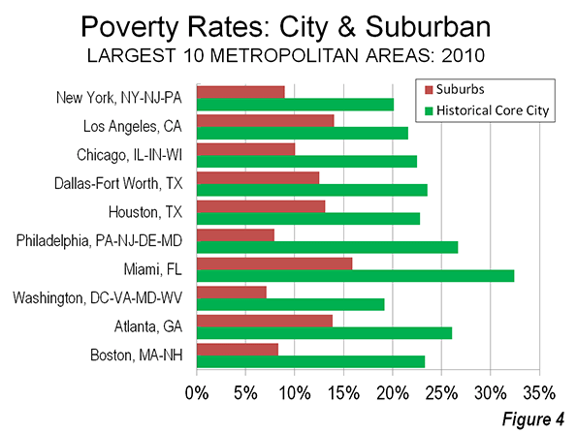
“Redlining was banned 50 years ago. It’s still hurting minorities today.”
Tracy Jan, of The Washington Post, wrote this article that looked at racial discrimination in mortgage lending in the 1930s shaped the demographic and wealth patterns of American communities today.” In it she talks about how redlining encouraged loans in these neighborhoods to be unavailable or very expensive, making it more difficult for low-income minorities to buy homes and setting the stage for the country’s persistent racial wealth gap. And homeownership being the number-one method of accumulating wealth, the effects of these policies create more hurdles for the poor is a permanent underclass that’s disproportionately minority,the racial disparity is reflected in the city’s poverty statistics.

Slide 8
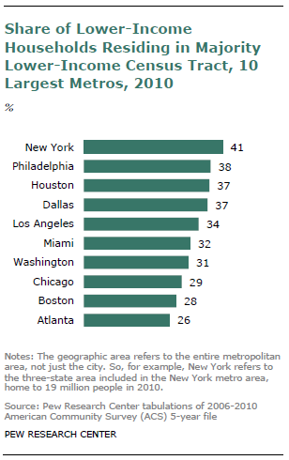
Racial Segregation by Income
We refer to the uneven geographic distribution of families of different income levels within a metropolitan area “family income segregation,” or more simply “income segregation.” Our use of the term “segregation” is descriptive; it denotes the extent to which families of different income live in different neighborhoods.
I

Slide 9
The Housing Crisis of 2008
“The foreclosure crisis and the conditions that bred it have become the hallmarks of the economic downturn and deepening inequality that the United States continues to suffer”(DasGupta, 2015, pg 51).

Slide 10
Where it Began: The Glass-Steagall Act
Passed in 1933, this act separated traditional banks from investment banks. This act was constructed to protect the American’s bank accounts from risky investments(DasGupta, 2015).
This act was passed by Congress to reduce commercial banks’ ability to use people’s money for risky investments.
In 1999, the act was repealed and the protections offered were erased.
Once the act was repealed, the investment banks had the freedom to return to predatory behaviors that put Americans at risk for financial ruin.

Slide 11
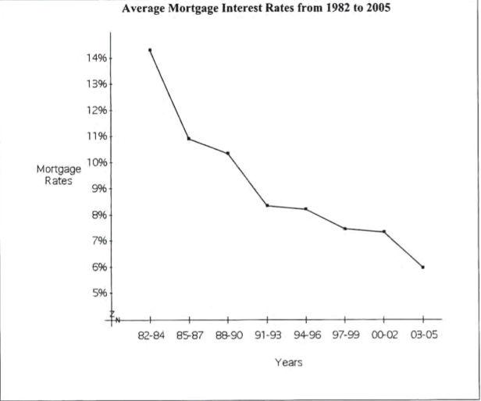
The Housing Bubble Burst: Mortgage Rates
As reported by the U.S Department of Housing and Urban Development(HUD) in 2005:
There was a 6-10% increase in house prices on the market.
House sales remained strong, at 69% despite the price increases and low income growth.
High cost and risky subprime loans were given to Americans that comprised a large percentage of the mortgage market.

Slide 12
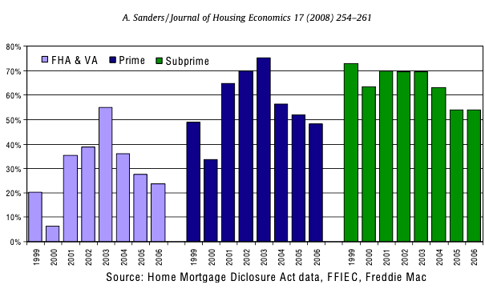
The Housing Bubble: Subprime & Alt-A Loans
Foreclosures increased among prime fixed-rate loans as the economy crumbled in 2008 leading into 2009.
Foreclosure and delinquency rates among Alt-A loans increased dramatically.
Banks and their agents made large profits during every stage of the approval process, leading to a rise in subprime lending.
Low mortgage interest rates
The abundance of capital from lenders and investors who were pursuing high profits flooded into even riskier loans, especially after 2003
Unemployment often accelerated homeowner’s vulnerability by stripping their income.
These was more commonly seen in the industrial states of the Midwest

Slide 13
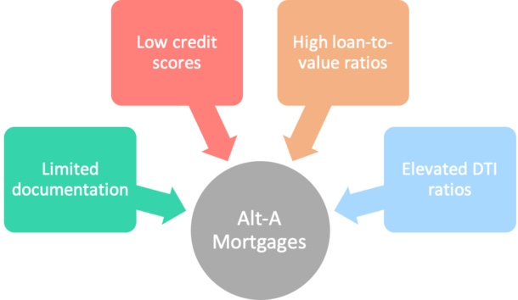
Subprime and Alt-A Loans
Alt-A Mortgage….Borrowers who have higher credit scores and have lower interest rates get prime mortgage.
Subprime mortgage are offered to borrowers with lower credit scores and have higher interest rates. Alt-A mortgages fall in between prime and subprime mortgage in terms of risk and interest rates.
“Many of the people who fell off the economic ladder were those who faced foreclosure of their homes, often precipitated by job loss and subsequent default on high-risk, high-cost subprime and Alt-A loans”(DasGupta, 2015, pg 51).

Slide 14
Rent Inequality
The impact of income inequality on rental affordability: An empirical study in large American metropolitan areas

Slide 15
Overview of the Study
A longitudinal and cross-sectional study by Hongwei Dong published by the Urban Studies Journal in 2018.
The study analyzed the rising inequality in rental affordability in relation with rising income inequality in 100 American Metropolitan areas.
The study found that during the 2000 to 2012 survey, when a city’s Gini coefficient increased by just 0.1, the rate of rent-burdened households increased by 2.9% at the county level.
Found that there is a significant association between income inequality and rental unaffordability.
Rent Burdens became worse over time for populations of poor, young adults, blacks, immigrants, and baby boomers.
Notes:
The impact of income inequality on rental affordability: An empirical study in large American metropolitan areas

Slide 16
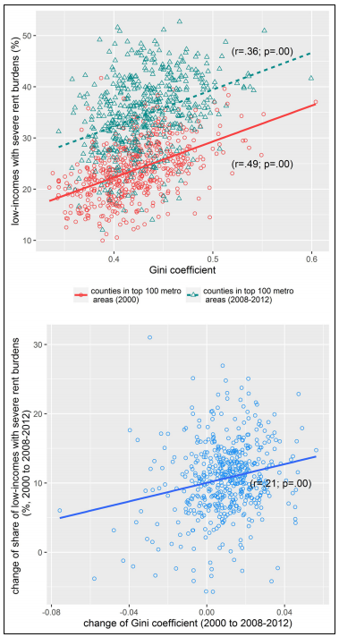
The Longitudinal Model
As the Gini coefficient increases, the amount of severely rent burdened households increases in each county.
The red data points indicate households before the 2008 housing crisis, and blue indicates after the crisis.
The results of the control variables are consistent with expectations on income inequality.
The study also shows that counties with rapid population growth have higher rates of rent burden.
The study also shows that median rent is increasing at a rate faster than average income can increase.

Slide 17
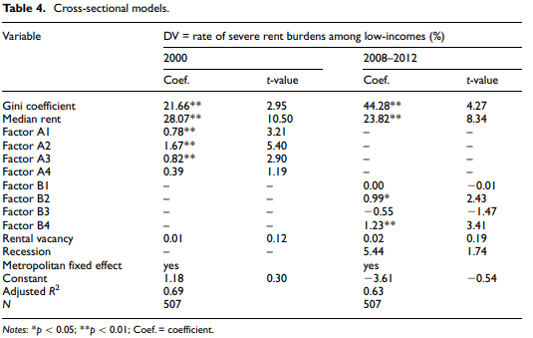
The Cross-Sectional Model
The two models show that income inequality has positive coefficients.
Counties with an increased Gini coefficient are more severely rent-burdened, and low income households.
A similar finding to the longitudinal study was that higher median rents are associated with higher rates of rent burden.

Slide 18
Homeownership vs. Renting Statistics:
There are more renters today than at any other time over the past 50 years.
There are currently over 136.57 million housing units in the U.S.
36.6% of households rent their homes.
64.4% current homeownership rate
Buying is more affordable than renting in about 64% of U.S. housing markets.
91% of 100 U.S. cities have seen a rent increase recently.
Households making at least $50K annually make up 36% of the rental market.
Renters are getting older. Almost 40% of renters are aged 45 or older.

Slide 19
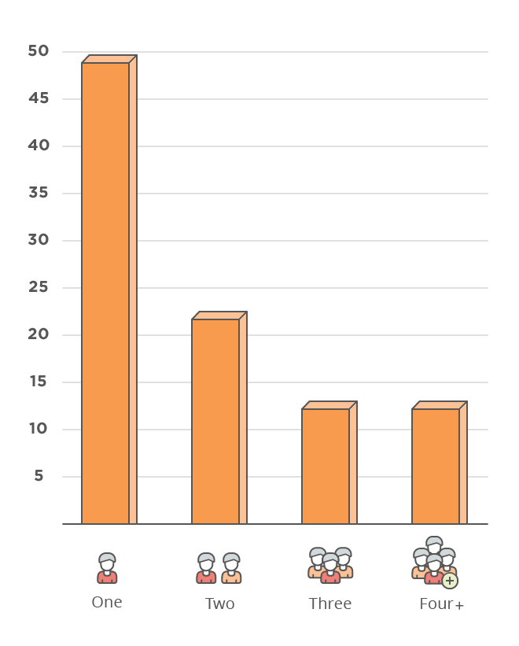
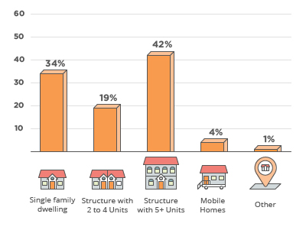
Renters:
Renters Per Household:
Types of Structures Renters Live in:

Slide 20
Differences between Renting and Homeownership:
Homeownership brings intangible benefits such as a sense of stability, belonging to a community, and pride of ownership, along with the tangible ones of tax deductions and equity.
Contrary to popular belief, renting doesn't mean you’re "throwing away money" every month, and owning doesn't always build wealth "in the long run."
Renting always means you are not “stuck” there forever, you can move without penalty whenever your lease is up.
Benefits of investing in a home include appreciation, home equity, tax deductions, and deductible expenses.
Risks and things to think about before investing in a home can include high upfront costs, depreciation, and illiquidity.

Slide 21
Homelessness in the United States
*Homelessness is a result of the different housing inequalities that prevent people from getting any sort of housing, leaving those with no family or friends homeless*
Notes:
With everything that we have discussed homelessness in the United States is ultimately the result of some of these different forms of inequality, For example the redlining, racial segregation, and rent inequality. The statistics and graphs on the slides give us some real indication on, how many people in the United States are experiencing some sort of homelessness and how many are sheltered vs those who aren’t. Research have also shown certain people are targeted with homelessness like minorities with mental disorders or people of a specific race , similar to what we have seen in the circumstances before.

Slide 22
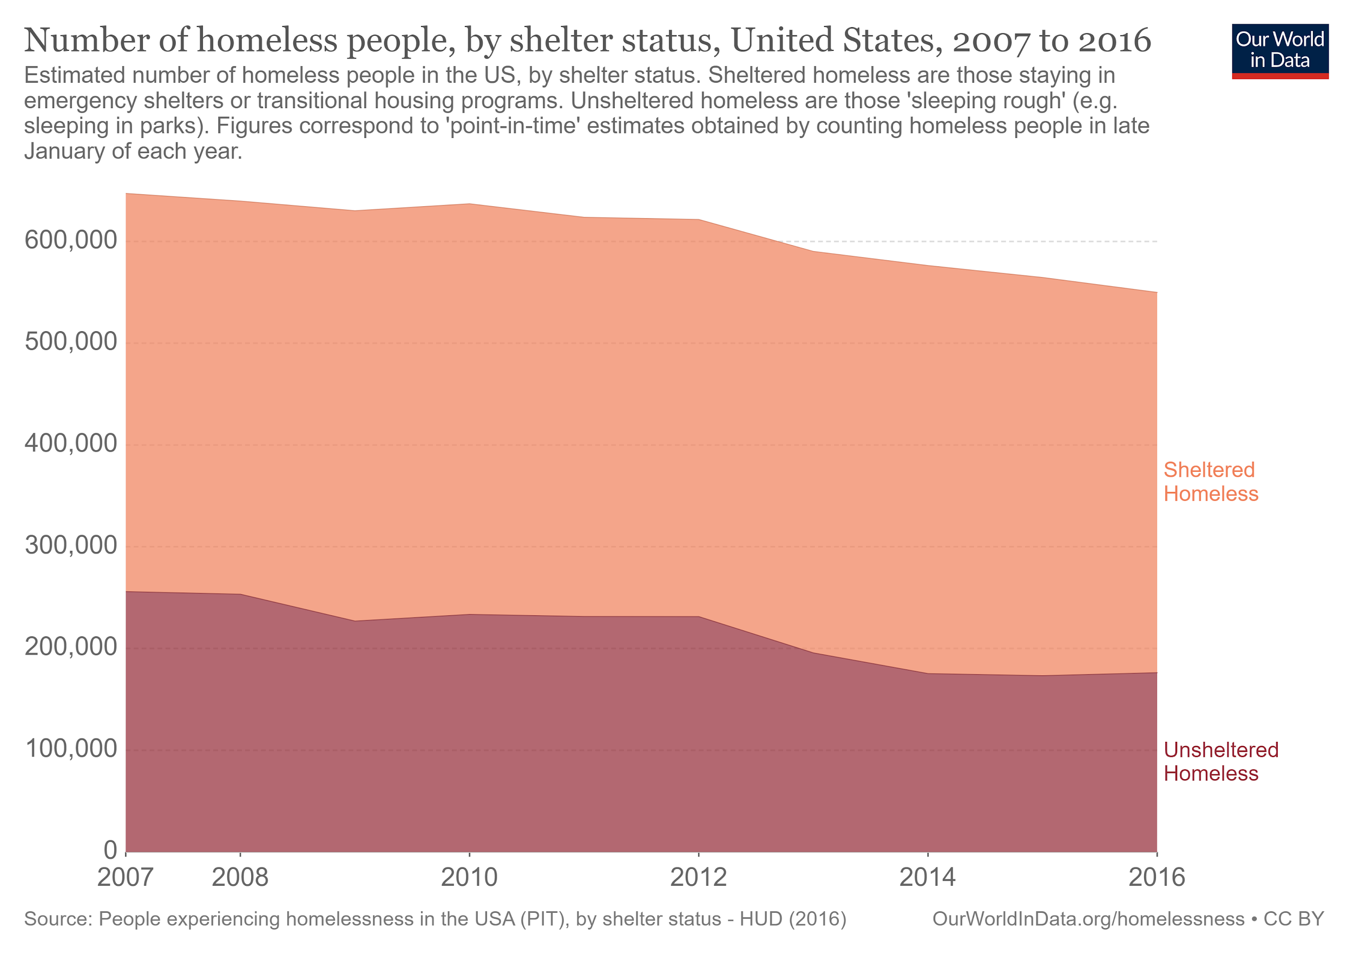
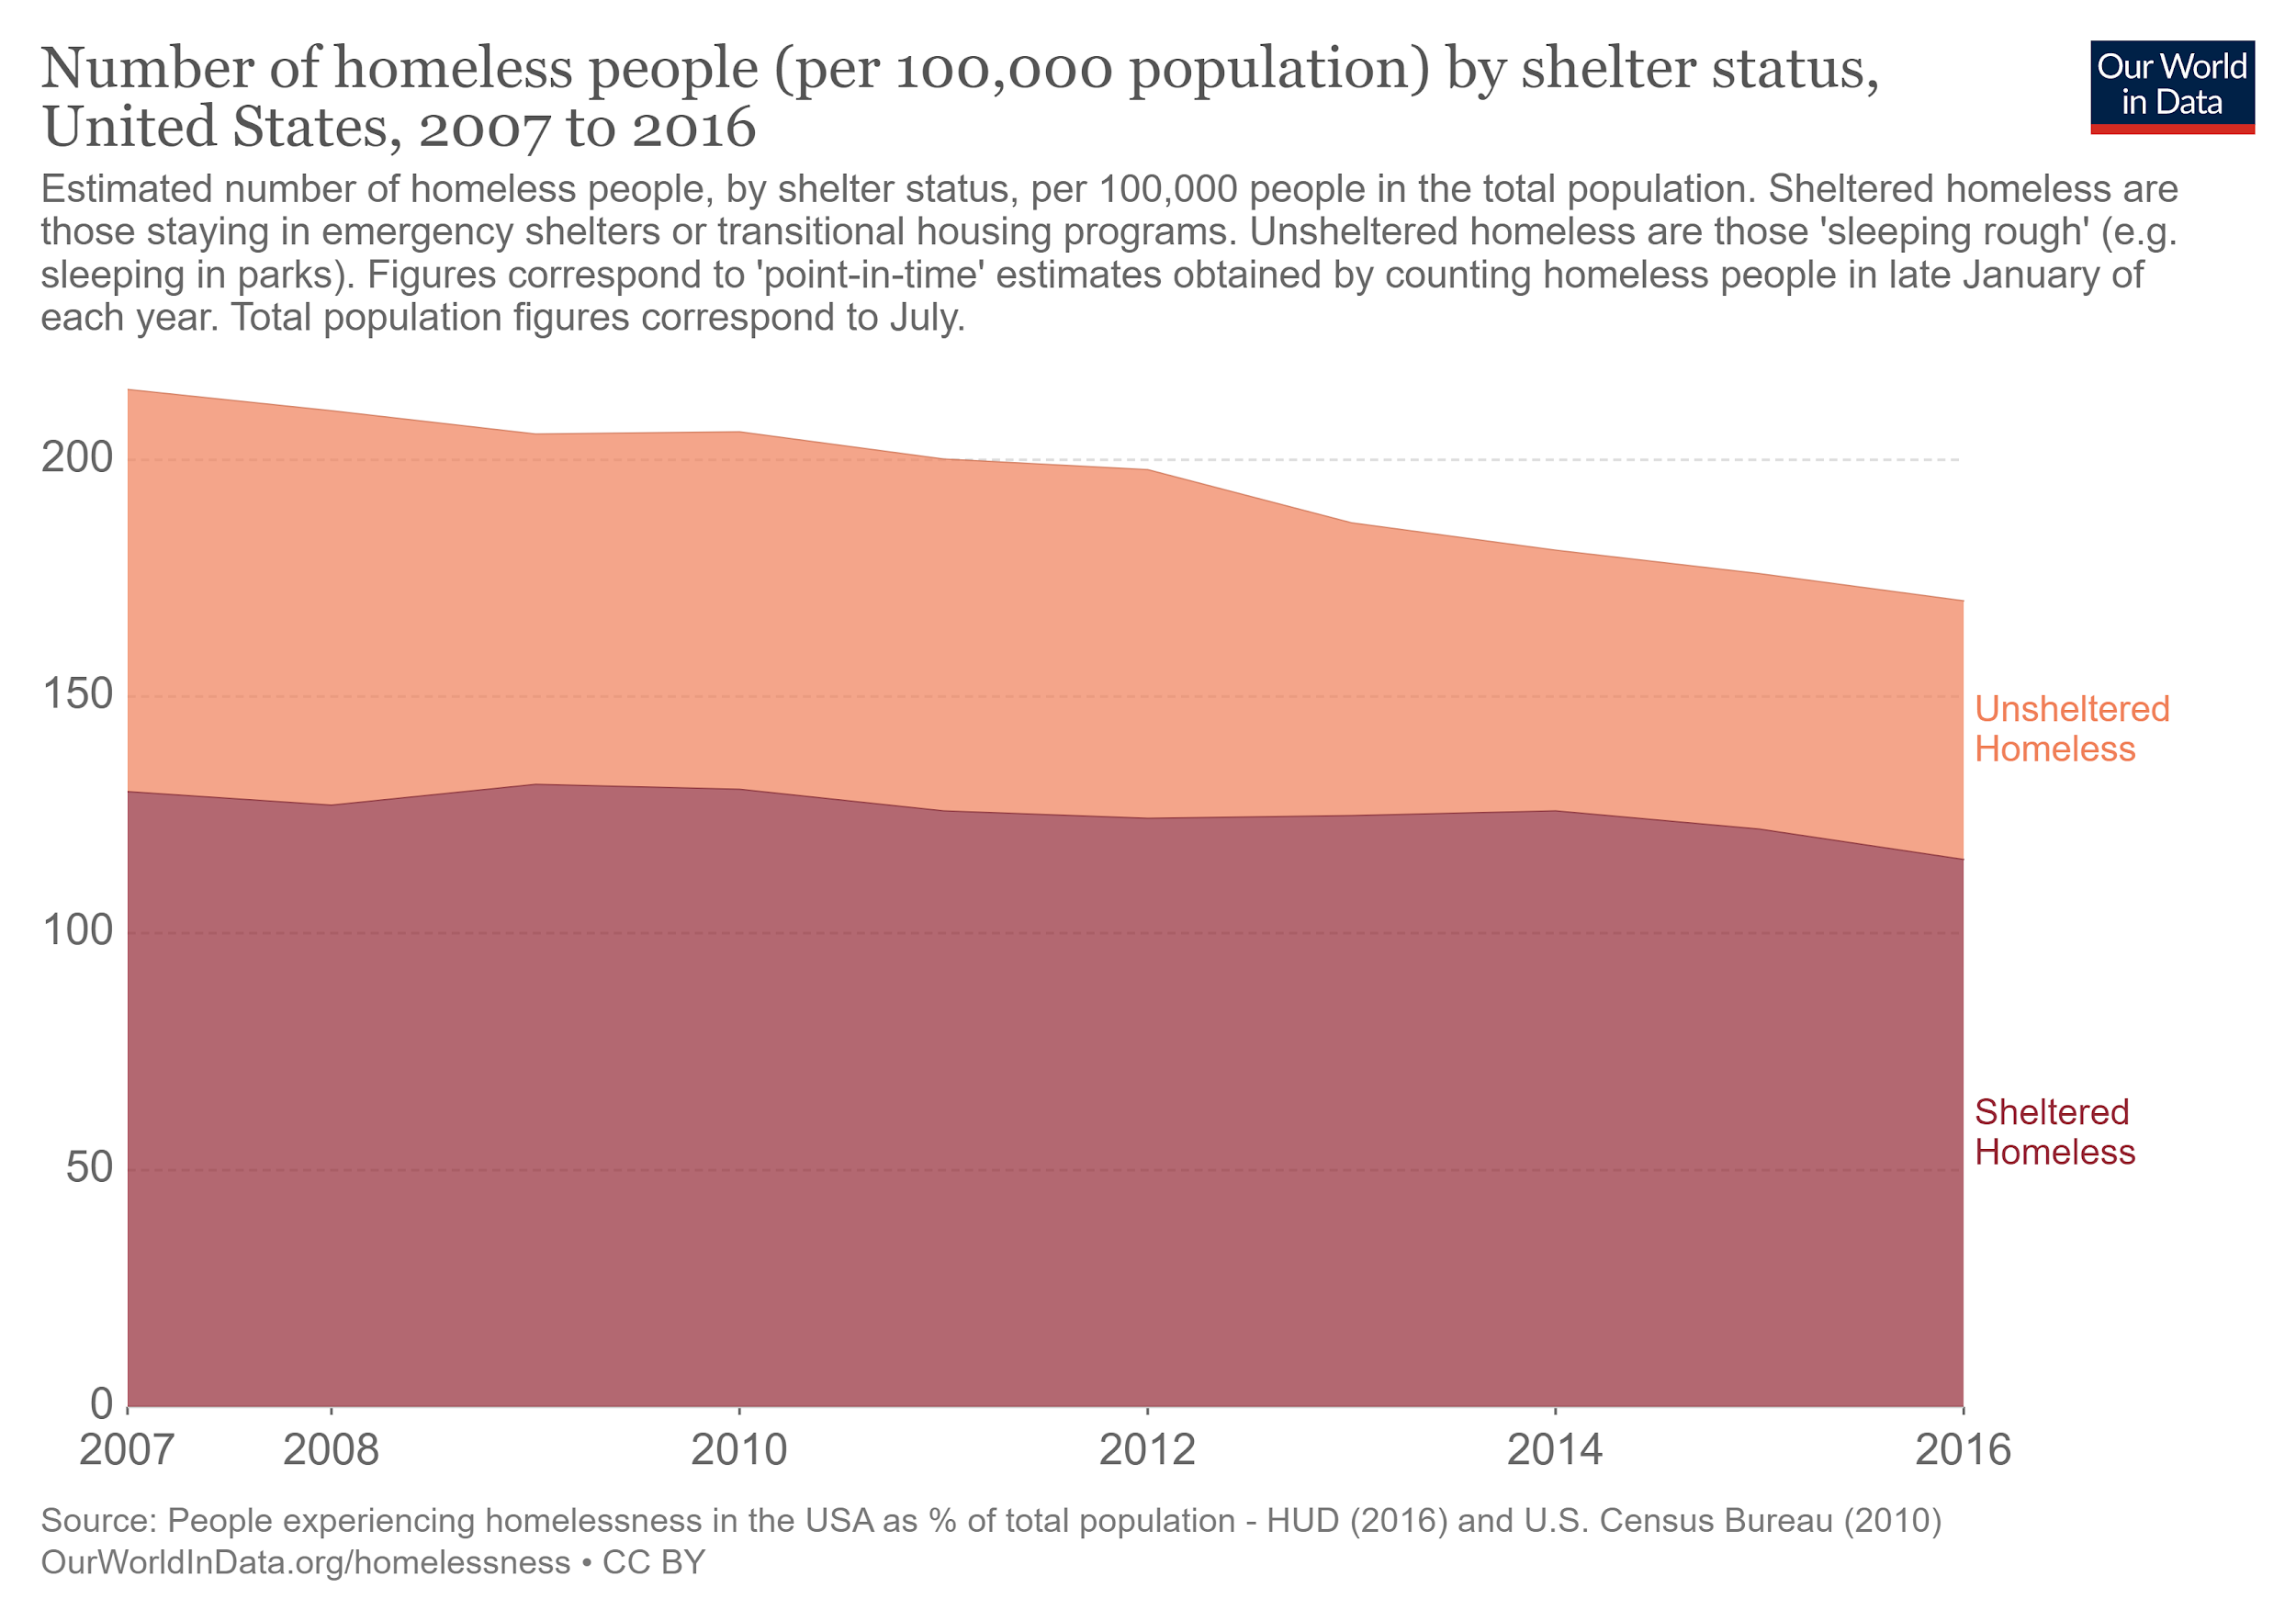

Slide 23
Homelessness Statistics
On an average night in the year 2011 in the U.S, over 636,000 people experience homelessness according to the National Alliance to End Homelessness.
Between Oct 1, 2009 to Sep 30, 2010 1.6 million people were homeless.
From 2009-2011 we see a 2% increase in people facing homelessness.
In 2011, four of every ten people were homeless and unsheltered.
January 2012 National Alliance to End Homelessness published a report on the state of homelessness in the United States...
These statistics are pulled from Chapter 5 of the book Introducing Social Stratification: the Causes and Consequences of Inequality by Kasturi DasGupta

Slide 24
What Accounts for Homelessness
Economic Factors like:
Unaffordable rent and mortgage costs
Unemployment
Foreclosure
Social Factors
Social factors can be anything that influences someone to think or act a certain way.
Wealth, education, buying habits, and family size
Linking Poverty to homelessness
Studies have found that those who are more likely to be homeless are people who are the “lowest” of the social hierarchy.
These people may have… “ A diagnosed mental disorder or problems with substance abuse, and showed lower levels of self-rated psychological distress.”(Ortiz-Ospina, 2017)

Slide 25
In Conclusion,
The topics mentioned throughout this presentation all show a timeline of how one inequality has led into another in the housing structure of the United States. Furthermore, it highlights how each topic affects Americans in different ways. Overall, it may be said that each topic shows the different ways in which the United States allowed and supported inequality within housing, and how it is still affecting Americans to this day.

Slide 26
References
Anon. 2020. “Homeowners vs Renters Statistics & Demographics by State [2020].” Property Management.com.
Anon. n.d. “Alt-A Mortgages: What Are They and How Do They Work?” Alt-A Mortgages | Alt-A Lending | The Truth About Mortgage.
Bischoff, Kendra and Sean F. Reardon. 2014. “Residential Segregation by Income, 1970-2009” In Diversity and Disparities: America Enters a New Century, edited by John Logan. New York: The Russell Sage Foundation
DasGupta, Kasturi. 2015. Introducing Social Stratification. The Causes and Consequences of Inequality. Boulder, CO: Lynne Rienner Press.
Dong, Hongwei. 2018. “Urban Studies Journal.” The Impact of Income Inequality on Rental Affordability: An Empirical Study in Large American Metropolitan Areas 55(10).
Holt, Jeff. 2009. “A Summary of the Primary Causes of the Housing Bubble and the Resulting Credit Crisis: A Non-Technical Paper.” The Journal of Business Inquiry 8(1).
Jan, Tracy. 2018. “Analysis | Redlining Was Banned 50 Years Ago. It's Still Hurting Minorities Today.” The Washington Post.
Lockwood, Beatrix. 2020. “The US Government Used These Maps to Keep Neighborhoods Segregated.” ThoughtCo.
Ortiz-Ospina, Esteban and Max Roser. 2017. “Homelessness.” Our World in Data. Retrieved April 22, 2020 (https://ourworldindata.org/homelessness).
Probasco, Jim. 2020. “All the Pros and Cons of Investing in a Home.” Investopedia.
Toro, P. A., Bellavia, C. W., Daeschler, C. V., Owens, B. J., Wall, D. D., Passero, J. M., & Thomas, D. M. (1995). Distinguishing homelessness from poverty: A comparative study. Journal of consulting and clinical psychology, 63(2), 280.
Weintraub, Elizabeth. 2019. “What Redlining Means-And Yes, It Still Happens Today.” The Balance.

