Slide 1
Inequalities of Employment Within the U.S.
By: Conor Brooks, Lucas Knight, Allison Smith, Kayla Medina, and Mitchell Spaulding

Slide 2
Inequalities of Employment Within the U.S
From its birth, The United States of America has had a history enriched in inequality, discrimination, and greed. Built upon the principles of freedom and capitalism , noticeable inequalities still exist especially in the aspect of US employment
How has US employment looked in recent history and currently in a world with COVID-19?
How have people of color been hindered in terms of employment opportunity?
How has government policy disadvantaged women in employment and economic opportunity?
What role does Capitalism play in employment inequality?
Where do the majority of US jobs exist? How has this changed over time?
For those unable to work, how does government policy accurately assist these people?

Slide 3
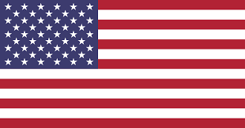
Brief History of U.S. Unemployment
Unemployment rate reflects our country’s economic status and represents a people’s political and psychological well being. Unemployment reflects people’s attitudes and views towards their country.
1942-1945, 1.2% - 1.9% The US joined World War 2 which put men to war, and brought women to the workplace forefront.
1982- 10.88% Throughout the USA’s history, economic recessions have coincided with higher unemployment rates. From 1945 - 2006, the economy and unemployment fluctuated concurrently but had a massive peak in 1982.
2009- 9.9% With the recession building in 2006 leading into the housing bubble of 2008, causing unemployment to drastically increase.
2019- 3.5% Since 2009, unemployment has slowly been decreasing. Our country is mostly working but does this represent inequality?

Slide 4
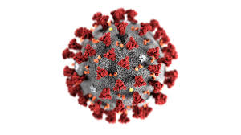
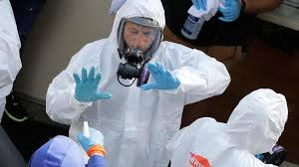
Current Effects of COVID- 19 Pandemic
Unemployment rate is currently unknown. Research suggests it may be around 14% and might continue to increase.
Before the pandemic, around 200,000 new unemployment cases would arise in a given week. Currently this number has increased by 20-30 times. This number doesn’t include the people backed up on trying to even apply for unemployment.
Health Care Workers: Health care workers are leading the fight in the pandemic, and are most at risk in the current pandemic.
5400 Health workers have estimated to have been infected already. This number is very underestimated due to high unavailability of COVID-19 testing.
Health Care Workers have experienced a lack of Personal Protective Equipment(PPE). Due to the closing down of businesses and rising unemployment, how can they get the PPE they need to damper this pandemic?

Slide 5
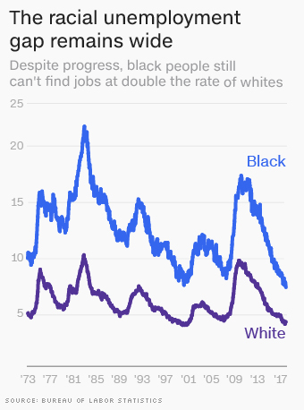
Racial/Ethnic Unemployment Inequality
Blacks and latinx individuals are more likely to be unemployed than white or asian individuals
2019: Black unemployment was at 6.1%, whereas white unemployment was at 3.3%, Latinx unemployment rate was at 4.3%
The highest black unemployment rate in the US is in the District of Columbia at 12.4%, with the highest state is in Illinois, at 9.3%, where the highest Latinx unemployment is in Nebraska at 5.9%. The state with the highest white unemployment is West Virginia at 5%.
Some factors that cause higher unemployment among black individuals include hiring discrimination and lower educational attainment.

Slide 6
Racial/Ethnic Wealth Gap
Median net worth by race in 2014
The median net worth of white families is ten times higher than the median net worth of black families
The gap as seemed to be getting larger, as between 1983-2003, white households saw their wealth increased by 14%, but black household wealth declined by 75% and Hispanic household wealth declined 50%.
Native American data seems to be ignored, since stats have not been taken since 2000
White (Non Hispanic) | $130,800
Black | $9,590
Hispanic (Any race) | $17,530
Asian | $156,500
Native American* | $5,700
*Native American data last recorded in 2000

Slide 7
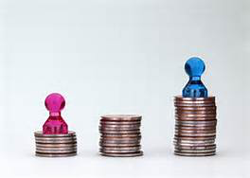
Gender Unemployment Inequality Historical Trends
In the late 1970s more women began working outside of the home and laws began banning sex discrimination
Even with these laws in place job segregation continued as women worked in “poorly paid, low status, stereotypical ‘female’ jobs.”
The one exception to this was the “massive integration of women into ‘men’s jobs’ in wartime industry.” Soon after women returned to the sex discrimination employment.
Milkman, R. (1987). Gender at work the dynamics of job segregation by sex during World War Ii. Urbana: Univ. of Ill. Pr.

Slide 8
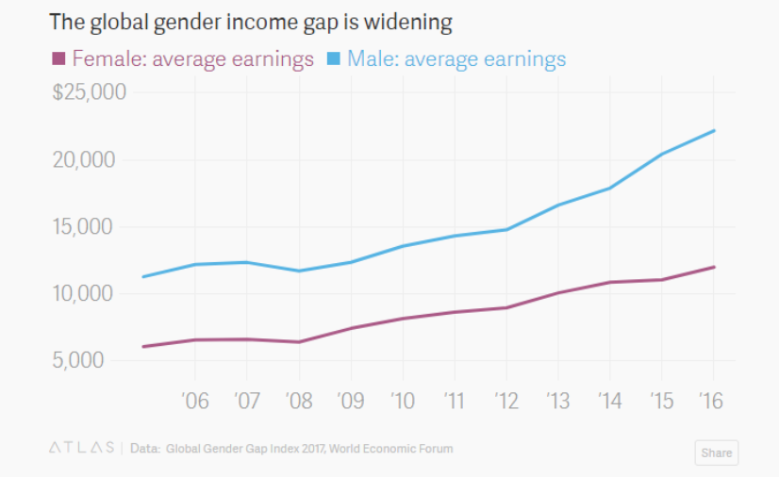
Equal Pay Act of 1963
During World War II, efforts were made to correct the wage gap due to the fact that women entered factory jobs in place of men, but laws failed to pass
The Equal Pay Act was then passed in 1963 which stated “employers cannot award unequal wages or benefits to men and women working jobs that require “equal skill, effort, and responsibility, and which are performed under similar working conditions.”
Even with these laws in tact, women are still only earning $0.79 for every $1.00 that men earn
History.com Editors. (2017, November 30). Equal Pay Act. Retrieved from https://www.history.com/topics/womens-rights/equal-pay-act

Slide 9
Occupational Sex Segregation
Occupational Segregation hurts economic growth
It also is highly racialized: “Women of color at all education levels are segregated into jobs with lower wages than their white female peers of similar skill levels.”
Women make up almost half of the workforce (49%)
13% | architects and engineers
32% | surgeons and physicians
60% | accountants and auditors
82% | elementary and middle school teachers
“Women accounted for the majority of all workers in the financial activities industry and in education and health services”
Women remain providing jobs involving nurturing and care which evidently are lower wage jobs
DasGupta, K. (2015). Introducing social stratification: the causes & consequences of inequality. Boulder, CO: Lynne Rienner Publishers, Inc.
Fact sheet: Occupational segregation in the United States. (2019, April 22). Retrieved fromhttps://equitablegrowth.org/fact-sheet-occupational-segregation-in-the-united-states/

Slide 10
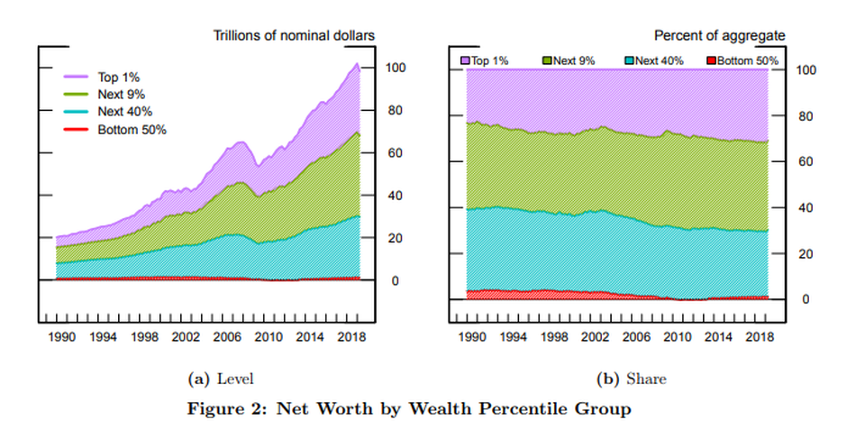
The Effects of Capitalism
The labor market has been adversely affected by the inequalities of Capitalism which disadvantages those with low to no economic status including the unemployed, those in poverty, and the working class. The rich and those who hold the most power in society benefit from these disadvantages.
As of 2018, the richest 10% held 70% of the total household wealth while the poorest 50% are being decimated by the rising inequality.

Slide 11
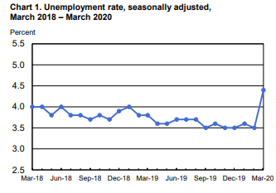
Is Capitalism the Root of all Evil?
Capitalism is dependent on the decisions of those with the most political and economic power with the sole goal of gaining profit, and if they are unable to acquire profit then unemployment occurs. Essentially, there is a small percentage of wealthy individuals that make decisions based on supply and demand that gamble with the jobs of those that provide labor.
The means of production (owned by the capitalists) requires workers to sell their labor for a living, thus creating the inequalities perpetuated by the preferential economic system of the U.S. and the ever-increasing wealth gap.
Source: https://www.bls.gov/news.release/pdf/empsit.pdf

Slide 12
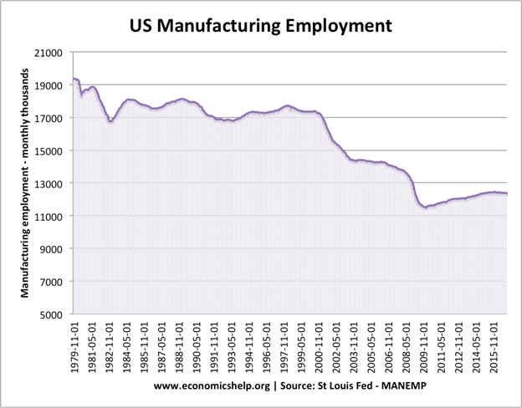
Loss of Manufacturing Jobs
Those that benefit from this economic system (the top 1% and wealthy capitalists) have created job loss and further inequalities from business practices such as outsourcing and deindustrialization.
This is evident by the rapid unemployment growth in cities such as Detroit and Flint that suffered from the loss of manufacturing jobs.
Since low paying industrial and manufacturing jobs are usually occupied by the working and lower-middle classes, the wealth gap increases as these jobs are cut while the top 1% gain more profit.

Slide 13
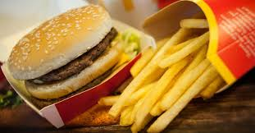
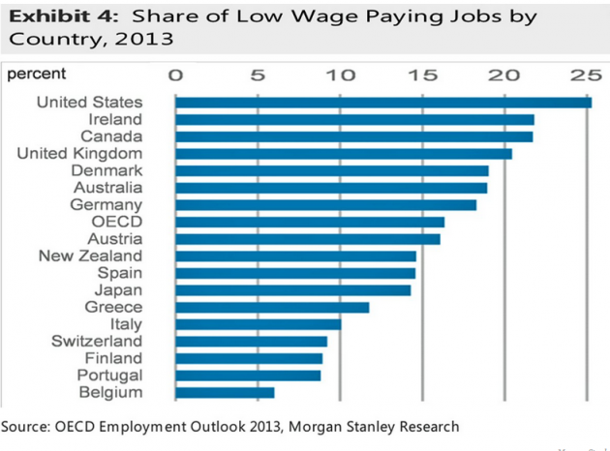
Service Jobs in America Is this Equality?
With the decline of manufacturing comes the ascension of the Service Jobs industry which dominates employment in the US. In February 2020, 15,000 manufacturing jobs were added while 51,000 foodservice and hospitality jobs were added. Most of these service jobs are part- time work , have inflexible hourly schedules, and most importantly have LOW Pay. The highest minimum wage in the US is in NY and it is $15.00.
Only 33% of food service workers in the United States think their salaries are sufficient for the cost of living in the area they live in.
COVID-19: During the COVID-19 pandemic, most service job workers have been deemed “essential”. Their companies have given temporary $1- $2 raises but working puts them at a higher rate of infection. If they become infected can they afford proper healthcare? If these workers are considered essential, they should always have sufficient to income to earn an adequate living.

Slide 14
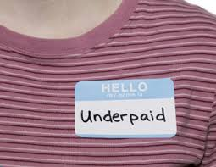
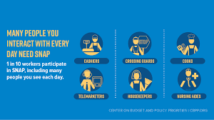
Most Common Low Paid Jobs in America
1. Food preparation and serving workers, including fast food
2. Dishwashers
3. Cashiers
4. Hosts and hostesses
5. Amusement park attendants
6. Movie theater ushers, ticket takers
7. Farm workers
8. Personal and home care aides
All of these jobs involve attending to other people, yet these are the people who are most likely to be treated treated the worst by customers. These are the workers that get the short end of the stick.

Slide 15
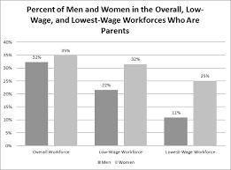
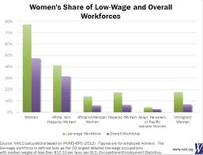
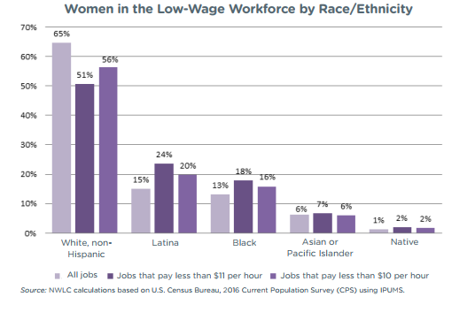
Who is Working the Low Paying Jobs?
“Despite making up less than half of all workers, women are nearly six in ten of the more than 26 million workers in low-wage occupations that typically pay less than $11 per hour.”
“Women are nearly seven in ten of the close to 7 million workers in the lowest-wage occupations that typically pay less than $10 per hour.”
“Across racial and ethnic groups, women account for larger shares of the low-wage and lowest-wage workforce than their male counterparts, even though their shares of the overall workforce are similar or smaller.”
https://nwlc.org/wp-content/uploads/2017/08/Low-Wage-Jobs-are-Womens-Jobs.pdf
Low paid jobs have all types of people in that specific category, but there is over represented by women and people of color. These are the same people who are working more than one job just to get by, the same people who are caring for children, elderly parents, family member with disabilities all while trying to care for themselves, and the same people who need or have government assistance.

Slide 16
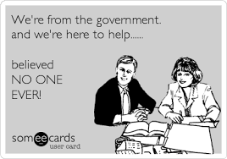
Who Needs Government Assistance?
Is the Government really Helping?
Its usual people that have disabilities, the elderly, and families that are living off a low income especially kids.
“Although welfare programs are commonly argued to support the lazy, data does not show this to be true. In the current state, welfare programs predominantly help Americans who receive low wages. The U.C. Berkeley Labor Center discovered that welfare program participation is higher for Americans receiving minimum wages.” https://www.lexingtonlaw.com/blog/finance/welfare-statistics.html
If Americans that work in low wage jobs are receiving government assistance doesn’t that mean minimum wage isn’t enough to expect people to live off of? Not only that, but there are people who need government assistance that are just above the requirements to receive them. There are people with disabilities that can’t work and need assistance from the government to survive. If the government can’t help those working then how can we expect them to help who can work? Is the government actually here to help? Does the government actually want to help?
More women (22 percent) participated in a food assistance program than men (12 percent) at some point in their lives.
39 percent of children under the age of 18 participated in some form of government assistance program in 2012.
On average 50 percent of female lead households participated in a form of government assistance programs.
On average 27 percent of Americans enrolled in a welfare program had completed less than high school, 33 percent had a high school diploma, 31 percent had some college or an associate’s degree and 9 percent had a bachelor’s degree or higher.

Slide 17
Conclusion- Employment Inequality
America has thrived on the notion that individuals should work hard in their life and through this, one can achieve any of their dreams.
As this project has outlined, all American citizens do not have the same potential in achieving the equality that America proposes is for all people . People of color, women, disabled, have become systematically disadvantaged in maintaining equitable opportunities in terms of employment.
How do these groups achieve their American Dream?

Slide 18
Works Cited
Amadeo, K. (2019, June 25). How to Close the Racial Wealth Gap in the United States. Retrieved April 12, 2020, from
https://www.thebalance.com/racial-wealth-gap-in-united-states-4169678
Amadeo, K., & Anderson, S. (2020, April 3). Unemployment Rate by Year Since 1929 Compared to Inflation and GDP.
Retrieved from https://www.thebalance.com/unemployment-rate-by-year-3305506
Costa, P. N. da. (2019, May 29). America's Humongous Wealth Gap Is Widening Further.
https://www.forbes.com/sites/pedrodacosta/2019/05/29/americas-humungous-wealth-gap-is-widening-further/
Current Employment Statistics Highlights. (2020, April 3). Retrieved from https://www.bls.gov/web/empsit/
ceshighlights.pdf
DasGupta, K. (2015). Introducing social stratification: the causes and consequences of inequality. Boulder, CO: Lynne
Rienner Publishers, Inc.
DePhills, L. (2018, January 25). Black unemployment is at a record low. But there's a lot more to the story. Retrieved
from https://money.cnn.com/2018/01/23/news/economy/black-unemployment/index.html
Fact sheet: Occupational segregation in the United States. (2019, April 22). Retrieved from
https:equitablegrowth.orgfactsheet-occupational-segregation-in-the-united-states/
Food Service Worker. (n.d.). Retrieved from https://www.indeed.com/career/food-service-worker/salaries
Harris,B. (n.d). What the pay gap between men and women really looks like. Retrieved from https://www.welform.org/
agenda/2017/11/pay-equality-men-women-gender-gap-report-2017
Hartman, M. (2020, April 9). Despite staggering unemployment numbers, it’s even worse than it looks. Retrieved from
https://www.marketplace.org/2020/04/09/unemployment-numbers-worse-than-it-looks/
Hirji, Z. (2020, April 10). Thousands Of US Health Care Workers Have Been Infected By The Coronavirus. This Is How
Each State Stacks Up. Retrieved from https://www.buzzfeednews.com/article/zahrahirji/us-health-care-workers-coronavirus

Slide 19
Works Cited
History.com Editors. (2017, November 30). Equal Pay Act. Retrieved from https://www.history.com/topics/womens-rights/
equal-pay-act
Jones, J. (2018, October 30). Black unemployment is at least twice as high as white unemployment at the national level
and in 12 states and D.C.: The highest African American unemployment rate is in the District of Columbia at 12.4 percent, while the highest white unemployment rate is in West Virginia at 5.0 percent. Retrieved April 12, 2020, from https://www.epi.org/publication/2018q3_unemployment_state_race_ethnicity/
Krulick, A. (n.d.). U.S. Employment. Retrieved from https://www.debt.org/jobs/unemployment/united-states/
Lee, F. (n.d.). Deindustrialization. https://www.economicshelp.org/blog/glossary/deindustrialisation/
Lexington Law. (2020, January 24). 44 Important Welfare Statistics for 2020. Retrieved from https://www.lexingtonlaw.com/blog/finance/welfare-statistics.html
Milkman, R. (1987). Gender at work the dynamics of job segregation by sex during World War Ii. Urbana: Univ. of Ill. Pr.
National Women's Law Center: Justice for Her. Justice for All. (2020, March 20). Retrieved from https://nwlc.org/
Tahmincioglu, E. (2010, July 12). The 8 lowest-paying jobs in America. Retrieved from http://www.nbcnews.com/id/
38168029/ns/business-careers/t/lowest-paying-jobs-america/
US Census Bureau. (n.d.). Census.gov. Retrieved from https://www.census.gov/
Workers of color are far more likely to be paid poverty-level wages than white workers. (n.d.). Retrieved from https://
www.epi.org/blog/workers-of-color-are-far-more-likely-to-be-paid-poverty-level-wages-than-white-workers/

