Slide 1
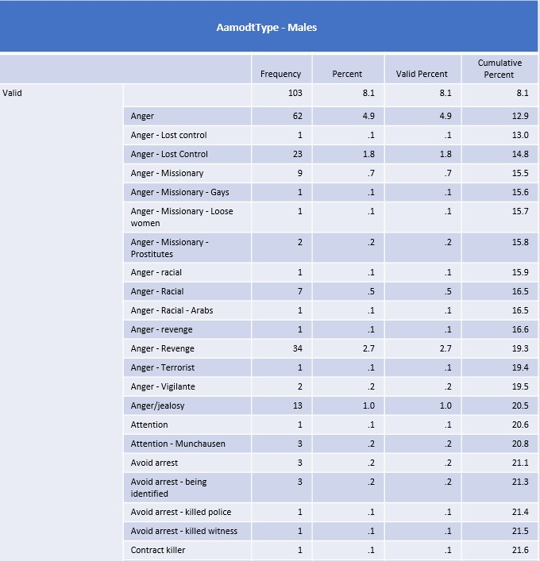
Gender Dynamics and Their Effects On Serial Killing
Zaine Roberts & Prof. Yanick, D.
Department of Sociology and Criminal Justice, SUNY Potsdam, NY
INTRODUCTION
METHODS
RESULTS
DISCUSSION
Existent research on serial killing suggests that male and female serial killers engage in divergent methods and experience different motives in their desire to kill (1).
Proper examination of female serial killers in the west has been overlooked in past research as women were believed to “not be capable” of serial killing due to traditional gender dynamics (2).
Traditional western gender dynamics within this study were examined using a masculinity and femininity binary construct to assess solo male and female serial killers as well as male/female and male/male serial killing teams.
The current study seeks to extend previous findings by investigating the impact of gender dynamics within the realm of the serial killer. For this project, variables such as motivation, method of execution, and team killing dynamics were examined to assess the impact gender dynamics have on serial killing.
Data collection
Serial killers listed within the Radford database.
N = 1673 total serial killers
1276 solo male killers
158 solo female killers
198 male/male team killers
40 female/male team killers
Serial killing can be defined as a series of three or more murders, committed as separate events per the FBI's definition.
Gender roles for this research can be defined as the behaviors a person learned to conduct based on their gender as designed by cultural forces (girls not being loud, boys not crying, etc.).
Research Questions
Do female serial killers act outside of gender norms in their motives for murder?​
What impact does age have on the dynamics of team killing? Does it differ between male/male and female/male teams?​
Design
A quantitative research design was conducted using a descriptive statistic and deductive reasoning to build a data set of serial killing statistics.
Procedure
Criterial selection for all serial killers included having killed three or more victims and being labeled a “serial killer” in the Radford data base. Solo serial killers had their partner selection indicated as “no” in order to eliminate partner data from their analysis.
Solo Female
The first conclusion is drawn from the data of Male/male and female/male serial killing teams as they were predominantly driven by sexual motives representative of solo male serial killers. ​
Another outcome came at the discovery that female serial killers tend to act alone, contrary to conventional claims that female serial killers typically work in conjunction with a man (Frei et al. 2006).​
A third unexpected finding was that 88 of the 158 reported female serial killers used a mixed or single method approach that involves overt physical methods of execution.
Traditional western gender roles of masculinity and femininity play a role in the motives and desires of serial killers as evident in the outcome of the data. ​
Males engaged in more brutal, overt killing styles as their preferred methods of kill emphasizing the dominance, strength, and power associated with masculinity.​
Female serial killers on the other hand are especially deviant in their roles as they predominately engaged in black widow killing (killing of the husband/significant other) opposing traditional feminine gender roles of “nurturing” and assuming the care of their significant others.
Hypothesis 1: Solo Killers
Congruent with previous research, female serial killers engaged in more covert, less confrontational means of execution (poisoning) while male serial killers are engaging in more overt physical acts of killing (stalking and strangulation).
Hypothesis 2: Team Killers
Female/male serial killing teams, as backed by previous research, engage in more overt acts of killing than the solo female killers.
HYPOTHESES
1. This project examined whether traditional Western gender roles will lead female serial killers to engage in less confrontational means of execution (such as poisoning), lower victim counts, and less sadistic motives for killing.
2. An analysis of team killing dynamics was also conducted to study whether female serial killers engage in traditional submissive roles in the team killing dynamic.
References
1. Fox, J. A., Levin, J., & Fridel, E. E. (2019). Extreme killing: understanding serial and mass murder. Los Angeles: SAGE.
2. Harrison, Marissa & Murphy, Erin & Ho, Lavina & Bowers, Thomas & Flaherty, Claire. (2015). Female serial killers in the United States: Means, Motives, and Makings. Journal of Forensic Psychiatry and Psychology. 26. 10.1080/14789949.2015.1007516.

